Slide 1
District Test Coordinator Training PED Assessment Bureau Fall 2020 Presenter: Karen Greer, Assessment Coordinator Assessment for Student Learning
Investing for tomorrow, delivering today.
Notes:
To change the image on this slide, select the picture and delete it. Then click the Pictures icon in the placeholder to insert your own image.

Slide 2
Part 1: a. PED Test Coordinator Portal b. Accessibility and Accommodations Part 2: Alternate Assessment: DLM and 1% Alternate Assessment Threshold Monitoring

Slide 3
Outcomes for Participants
Use updated features of PED Test Coordinator Portal
Locate information about testing accessibility and accommodations for Students with Disabilities and share with special education colleagues
a. Prepare for DLM testing -- Spring Year End and Instructionally Embedded (optional)
b. Anticipate 1% alternate assessment threshold monitoring activities
Notes:
Changes to assessment system first – stakeholder engagement, task force
Changes to graduation last so elementary DTCs can leave

Slide 4
Part 1a
Using the PED Test Coordinator Portal

Slide 5
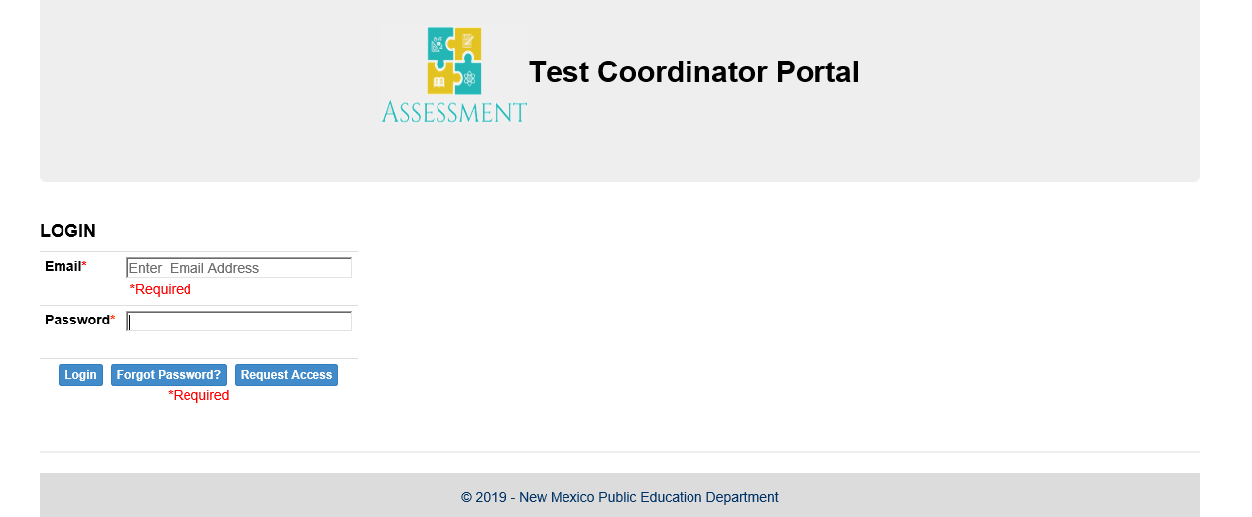
Request new accounts at https://tcp.ped.state.nm.us/
PED approves new DTC accounts
New STCs request accounts; DTCs approve
DTCs approve forms created by STCs; only DTCs submit to PED
Instructions at https://webnew.ped.state.nm.us/bureaus/assessment-3/district-test-coordinator/

Slide 6
New Forms in the Portal

Slide 7
PED Assessment Portal Forms
Before Testing
Superintendent/Director Designation
Request for Medical Exemption
Request for Non-standard Assessment Accommodation
During Testing
Testing Irregularity Reporting Form
After Testing
Superintendent’s Verification

Slide 8
What happens after I submit a form to the PED Portal?
Irregularity
Program manager reviews
Program manager completes PED section. PM approves or returns with decision.
DTC receives automatic notice of approval or return with PED decision and action.
If PM decides to invalidate score, student will not receive a score. Accountability will not include in proficiency rate calculation.
Superintendent Designation
PED staff review
PED staff approve or return
DTC receives automatic notice of
approval.
Or DTC receives notice of return.
If returned, DTC edits or completes
and resubmits.

Slide 9
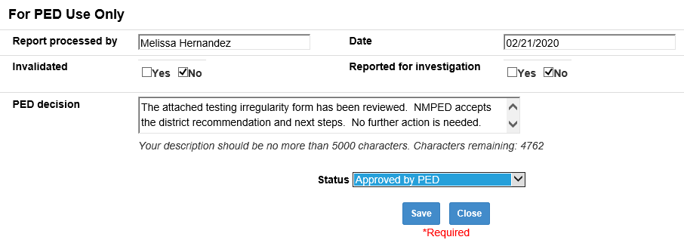
Irregularity Form PED Response

Slide 10
What do I do if the Test Coordinator Portal isn’t working?
Paper Forms are available on the Assessment Bureau web page: https://webnew.ped.state.nm.us/bureaus/assessment-3/district-test-coordinator/
Download
Complete
Sign
Email the completed form to ped.assessment@state.nm.us.

Slide 11
Questions for PED?

Slide 12
Part 1b. Testing Accessibility and Accommodations
Highlights from the PED Accessibility and Accommodations Manual https://webnew.ped.state.nm.us/wp-content/uploads/2020/09/assessment-accommodations-and-accessibility-manual.pdf

Slide 13
Accessibility Supports
Universal Tools
(all students)
Accessibility Features
(designated students)
Accommodations
(students with IEP,
504, or EL Plan)

Slide 14
Universal Tools Available to All Students
CBT (built in) or PBT
Examples:
blank paper
answer eliminator
highlighter
calculator (on test sections that allow)
zoom or magnifier

Slide 15
Accessibility Features Available to Designated Students
Designated by team such as SAT or by agreement among teacher, student, and parent
Only assign if used in classroom instruction
On CBT, must be enabled in platform
Examples:
color contrast
directions read aloud, clarified, or repeated
headphones as noise buffer
human reader or text-to-speech on a math or science (accommodation on ELA)

Slide 16
Accommodations Available Only to Students with IEP or 504 Plan
Changes in procedures or materials that ensure equitable access
Only assign if used in classroom instruction
Examples:
Human reader or text-to-speech on ELA assessment
Calculator on non-calculator section
Extended time (on timed test)
Braille

Slide 17
Accommodations vs Modifications
Modifications: Changes in student response or test administration that change the construct of the test
Change what the test is intended to measure
Give students an unfair advantage
Lead to invalid test result
Examples:
Allowing use of a dictionary
Paraphrasing a test question for a student

Slide 18
Non-standard & Emergency Accommodations
Non-standard accommodations
E.g., Cell phone for blood glucose monitoring, homebound student test at home
Submit form via PED Test Coordinator Portal at least 2 weeks before test
Emergency accommodations
E.g., student breaks arm and can’t write or use a mouse
504 Plan if time
Non-standard accommodation form if not

Slide 19
Accommodations Irregularities
Administering an assessment with an accommodation that is not in a student’s legal plan is an irregularity.
Administering an assessment without an accommodation that is in a student’s plan is an irregularity.
Avoid irregularities by checking and double checking which accommodations are assigned to students

Slide 20
Refer to Test Vendor Manuals for Specific Information
College Board (SAT)
College Reportable https://accommodations.collegeboard.org/pdf/accommodations-supports-handbook.pdf
Non College Reportable Scores https://webnew.ped.state.nm.us/wp-content/uploads/2019/12/College_Board_Accommodations_Non-Reportable_Scores.pdf
Cognia (NM-MSSA, ASR, iMSSA) https://newmexico.onlinehelp.cognia.org/wp-content/uploads/sites/10/2020/08/NM-Assessments-Univ-Tools-Accessibility-and-Accoms_August-2020.pdf
DLM https://dynamiclearningmaps.org/sites/default/files/documents/Manuals_Blueprints/Accessibility_Manual_2020-2021.pdf
ACCESS https://wida.wisc.edu/resources/accessibility-and-accommodations-supplement
iStation https://www.istation.com/Content/downloads/NM_IstationAssessmentAccommodations.pdf

Slide 21
IEP Team Decisions about Accommodations
Step 1: Expect Students to Achieve Grade-level Standards
Step 2: Learn About Accessibility Supports for Instruction and Assessment
Step 3: Identify Accessibility Supports for Instruction and Assessment
Step 4: Administer Accessibility Supports During Instruction and Assessment
Step 5: Evaluate Use of Accessibility Supports in Instruction and Assessment
Five-step Decision-making Process
Council of Chief State School Officers (CCSSO) Accessibility Manual

Slide 22
Medical Exemption Request
Student is not able to be assessed due to serious illness, injury, or medical emergency
Homebound students able to receive instruction should be assessed.
Complete form (Parts A, B, C) available on Assessment Bureau web page https://webnew.ped.state.nm.us/bureaus/assessment-3/district-test-coordinator/
Part A: Verified in writing by licensed medical provider
Part B: Parent Consent
Do not submit Parts A and B to PED
Keep on file 5 years
Document in IEP or 504 Plan if student has one
Submit Part C through Test Coordinator Portal
Student will not be counted toward 95% ESSA participation rate.

Slide 23
Questions for PED?

Slide 24
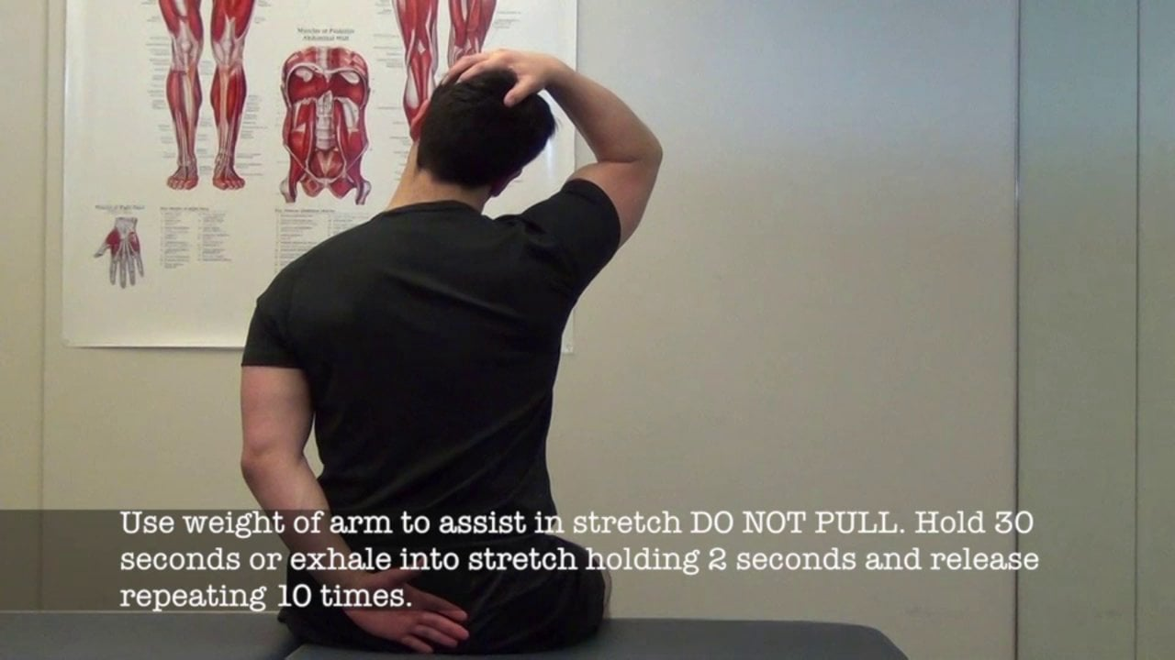
5 Minute Stretch Break

Slide 25
Part 2
Alternate Assessment
DLM – Looking back and looking forward
1% Alternate Assessment Threshold Monitoring

Slide 26
Alternate Assessment
IEP team determines whether student takes
General assessment
General assessment with accommodations
Alternate assessment (1%)
Alternate assessment
Measures alternate content standards: Essential Elements
DLM

Slide 27
Who takes DLM?: Guiding Questions for IEP Teams
Does the student’s past and present performance in multiple settings (home, school, community) indicate that a significant cognitive disability is present?
Does the student need intensive, pervasive, or extensive levels of support in school, home, and community settings?
Do the student’s current cognitive and adaptive skills and performance levels require direct instruction to accomplish the acquisition, maintenance, and generalization of skills in multiple settings (home, school, and community)?
Notes:
Not just an academic disability, adaptive skills such as feeding, dressing, getting around
1:1, repeated instruction
Multiple settings e.g., learning to button a shirt at school may not generalize to home

Slide 28
Information from questions 1-3 drives placement decisions:
Instruction
Assessment
Instruction in the general education academic standards is not appropriate, even with intensive accommodations and supports
Instruction in alternate academic standards is appropriate
Participation in the general assessment is not appropriate, even with intensive accommodations and supports
The alternate assessment is appropriate for the child
Notes:
Veteran DTCs: What challenges do you face working with IEP team decisions impacting alternate assessment administration? Data? Access to IEP placement decisions? Test orders?
A: Elbow partner: What part can a DTC play in working with IEP teams to avoid these issues? in decision making about assessment?
Accessibility features, accommodations, access to IEP placement decisions, ordering windows

Slide 29
Looking Back
Schools closed one week after DLM Spring 20 test window opened
About 1/3 of the students rostered completed testing and received score reports
Webinar for special ed teachers: Understanding DLM reports and Using Results in IEPs September 22 and 29,

Slide 30
What to do Now
Reset Educator Portal passwords
Subscribe to updates
Update user accounts in Educator Portal: add new, delete old

Slide 31
Highlights of DLM District Fall Training
Basic information about DLM
DLM assessment design
Essential Elements
Blueprints
Linkage levels
Testlet structure and test delivery
Kite Educator Portal and Student Portal

Slide 32
Roles and Responsibilities of DTCs
Communicate and collaborate with special education leaders, STCs, test administrators, data managers, and technology personnel.
Ensure all staff are trained in their responsibilities and know where to find manuals including the checklists for data managers, technology coordinators, and test administrators.
Manage district and school staff responsibilities. Identify the staff who will fill the roles of technology personnel, data managers, and STCs. Ensure each person is aware of their roles and responsibilities and the timeline of events, and ensuring each person understands PED and DLM assessment policies and procedures.
Create Educator Portal user accounts for STCs and TAs, monitor account activation.
Establish an assessment security plan and monitor adherence to PED and DLM policies.
Use Kite Educator Portal extracts to monitor completion of Required Test Administrator Training, the test security agreement, student enrollment and roster, the First Contact survey for students, and the PNP settings selected for students.

Slide 33
To view the entire recorded video:
Valuable information for DTCs new to DLM, data managers, technology personnel, and special education leaders
Recorded video is at https://kusurvey.ca1.qualtrics.com/jfe/form/SV_4YM5F91fCOrDGcJ
You must watch the video to enroll in an optional online Q & A chat session and complete the registration form.
Online Q&A chat with DLM staff is 10/1/20 1:00-1:30 PM MT

Slide 34
Looking forward to Year End Testing
Review Checklists for Assessment Coordinators, p. 8 in the Assessment Coordinator Manual https://dynamiclearningmaps.org/sites/default/files/documents/Manuals_Blueprints/Assessment_Coordinator_Manual_YE.pdf
Test window: March 22 to April 30, 2021
Review PED Detailed Testing Calendar https://webnew.ped.state.nm.us/bureaus/assessment-3/district-test-coordinator/

Slide 35
DLM Instructionally Embedded Assessments
Formative or baseline measure
Integrate instruction with assessment seamlessly
Administered throughout the school year
Opens 9/14/20
Test Administrators must complete required TA training
Module in Canvas: Overview of Instructionally Embedded Assessments for DTCs, special ed teachers and leaders

Slide 36
Instructionally Embedded Assessment
Optional
Provided at no cost by PED
Benefits:
Provides teachers with information and tools to plan instruction
Based on the student’s academic goals
Equal protection

Slide 37
Who Gives DLM?
DLM Test Administrators must:
be certified or licensed employee of the district;
be familiar with student and vice versa
be familiar with the current Test Administrator Manual;
complete and sign the DLM Confidentiality Agreement; and
have completed the Required Test Administrator Training.

Slide 38
DLM Required Online TA Training
All Test Administrators must complete New TA Training in 2020-21
The training modules can be completed in multiple sessions.
Can be taken self-directed or in a facilitated group training

Slide 39
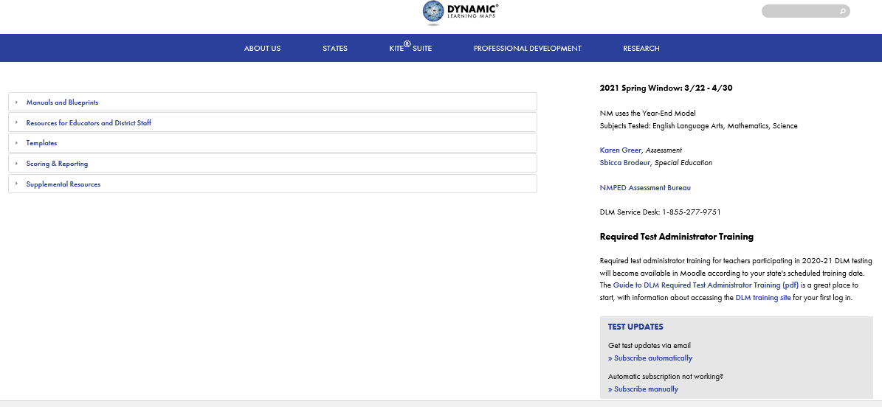

Slide 41
1% Threshold Monitoring Update
ESSA requires that the percentage of students with significant cognitive disabilities who participate in the alternate assessment not exceed 1% of the total number of students who are tested
Notice from the US Department of Education July, 2020
New Mexico is out of compliance by exceeding 1% participation rate in alternate assessment based on July, 2018 data
ESSA prohibits PED from preventing LEAs placing students in the alternate assessment

Slide 42
1% Threshold Monitoring Activities
Assessment Bureau staff will collaborate with Special Ed and REC9 contractors
All LEAs will receive notice of their alternate assessment participation rate
IEP teams in all LEAs will receive training on appropriate placement in the alternate assessment
LEAs exceeding the 1% participation will need to submit justifications
Justifications will be publicly posted
LEAs without reasonable justification will received in-depth monitoring and support

Slide 43
Questions for PED?

