Slide 1
Welcome to District Test Coordinator Training PED Assessment Bureau Fall 2020
Investing for tomorrow, delivering today.
Notes:
To change the image on this slide, select the picture and delete it. Then click the Pictures icon in the placeholder to insert your own image.

Slide 2
Housekeeping Rules
Please remain on mute when not speaking
Camera use encouraged
Chat questions encouraged
The meeting is being recorded
Closed Captioning is available
Click on this icon
Then, select “Show Subtitles”

Slide 3
2020-21 Assessment Programs by Grade Level & Subject Area
Math
ELA
SLA
Science
English Language Proficiency
Early Childhood
Istation
K-2
K-2
K-2
Cognia
3-8
3-8
3-8,11
5,8,11
X
3-8
3-8
College Board
10-11
10-11
X
Dynamic Learning Maps
3-8
10-11
3-8 10-11
X
3-8,11
5,8,11
K-12
ACCESS for ELLs
X
X
X
X
K-12
Early Childhood Observation Tool
PreK-K
*National Assessment of Educational Progress (NAEP): 2020-21 is a main NAEP year grade 4 & 8 math and reading sample
X

Slide 4
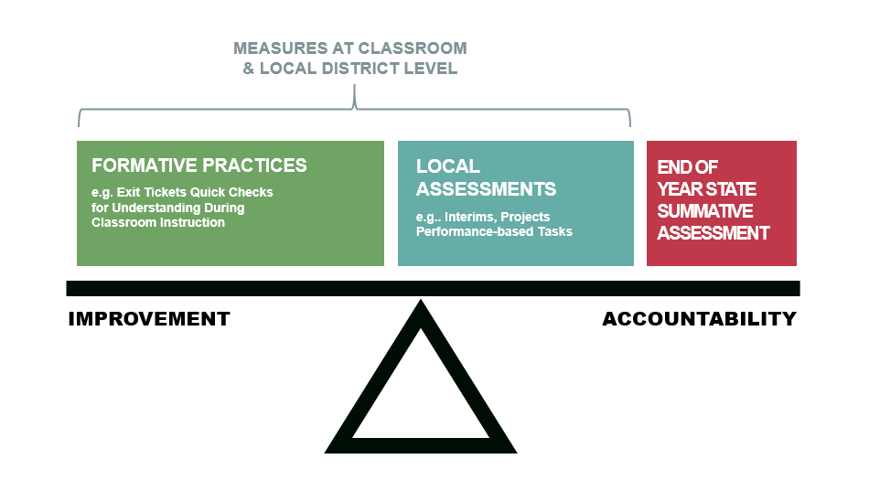
Balanced Assessment System Context
An assessment system is balanced when:
the assessments in the system are coherently linked through a clear specification of learning targets,
they comprehensively provide multiple sources of evidence to support educational decision-making, and
they continuously document student progress over time.
(National Research Council, 2001).
Notes:
Vertically and horizontally coherence:
Vertically coherence: that the expectations in the way a student progresses within a domain are aligned between various measures across the system: classroom grading, formative feedback, local assessments and state assessments)
Horizontal coherence, that alignment between, curriculum, instruction and assessment regarding the common vision of learning and how proficiency is developed in a content domain.
Comprehensive: Is there a range of evidence gathered and does that evidence vary by use and purpose—often times the measure or results of student performance most relevant o a policy maker are least relevant to the classroom teacher.
Continuity: The degree to which the assessments in the system allows for monitoring and evaluating progress.
Efficiency: How can we eliminate reduce and eliminating unused and untimely assessments—so much of which the control in the system lies with the teacher.

Slide 5
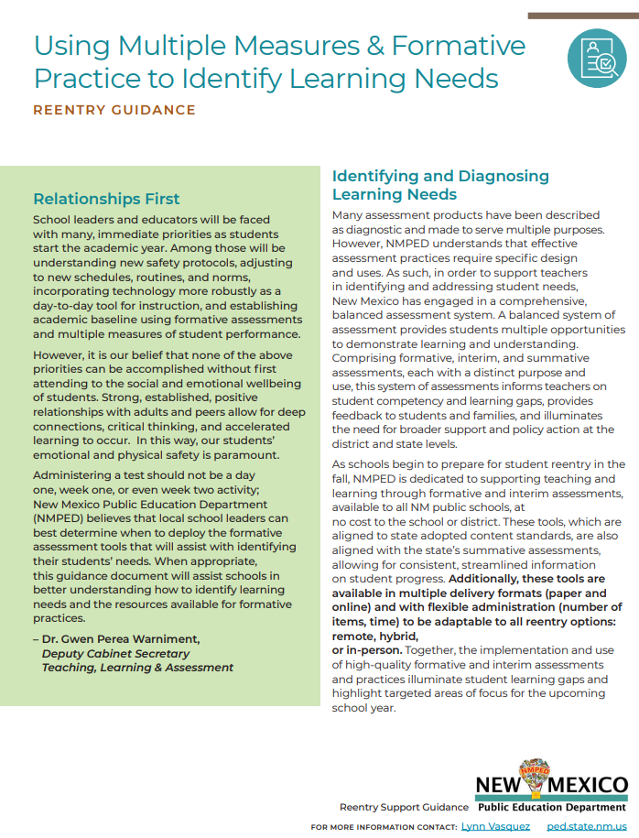
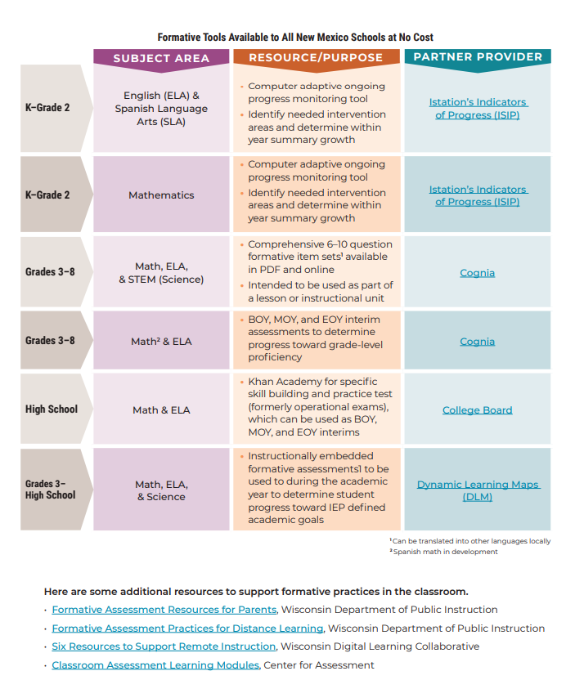
Formative Assessment Resources & Reentry
Guidance on Instructional Acceleration
Reentry Guidance on Formative Practice
4-Part Webinar Series for Supporting educators on reentry and PED provided curriculum & assessment resources
NMPED Reentry Support Page

Slide 6
Formative Resources Available to All LEAs
Istation
K-2
Math, ELA, SLA formative progress monitoring tools
Cognia
3-8
Math, ELA, Science Formative Item Sets & Interims in Math and ELA
College Board
High School
Math & ELA: Khan Academy, SSQB item bank, released operational forms
Dynamic Learning Maps
3-High School Significantly cognitive disabled students
Math, ELA, Science Instructionally Embedded Formatives

Slide 7
Your Fall 2020 DTC Training Schedule
Session | Dates / Times
General Welcome (PED) Test Platform Setup/Pre-ID (eMetric) | Monday, September 14, 2020 | 7:30 - 9:30 AM MT
 | Tuesday, September 15, 2020 | 12 - 2 PM MT (Repeat)
 | Wednesday, September 16, 2020 | 7:30 - 9:30 AM MT (Repeat)
Federal Testing Requirements Policies, Procedures, and Test Security (NMPED) | Monday, September 14, 2020 | 10 AM - 12 PM MT
 | Tuesday, September 15, 2020 | 2:30 - 4:30 PM MT (Repeat)
Universal Features and Accommodations, PED Test Coordinator Portal, DLM (NMPED) | Wednesday, September 16, 2020 | 10 AM - 12 PM MT
 | Thursday, September 17, 2020 | 2:30 - 4:30 PM MT (Repeat)
Q&A Drop-in Office Hours (eMetric & NMPED) | Friday, September 18, 2020 | 7:30 - 9 AM MT (Highly encouraged for new DTCs)

Slide 8
Assessment Staff Contact Information
Name | Phone | Email | Title
Assessment Help Desk | 505-827-5861 | PED.Assessment@state.nm.us | General Assessment Bureau Email
Lynn Vásquez | 505-469-8967 | Lynn.Vasquez@state.nm.us | Division Director Assessment & Learning Management Systems
Melissa Hernandez | 505-819-9621 | Melissa.Hernandez2@state.nm.us | Assessment Coordinator Istation, SAT, PSAT 10, SLA, ACCESS, Graduation Requirements
Karen Greer | 505-570-7392 | Karen.Greer@state.nm.us | Assessment Coordinator DLM, iMSSA, Cognia Formative Item Sets, SWD accommodations, Test Coordinator Portal
Xavier De Leon | 505-470-2539 | Xavier.Deleon@state.nm.us | Assessment Coordinator NAEP, NM-ASR, NM-MSSA
Maureen Nash | 505-412-5345 | Maureen.Nash2@state.nm.us | Business Operations Superintendent Verification Forms DTC Newsletter Distribution

