Slide 1
Welcome to District Test Coordinator Training 101 PED Assessment Bureau Fall 2020
Lynn Vásquez
Division Director
Assessment &
Learning Management Systems
Investing for tomorrow, delivering today.
Notes:
To change the image on this slide, select the picture and delete it. Then click the Pictures icon in the placeholder to insert your own image.

Slide 2
Housekeeping
Please remain on mute when not speaking
Camera use encouraged
Chat questions encouraged
The meeting is being recorded
Closed Captioning is available
Click on this icon
Then, select “Show Subtitles”

Slide 3
Getting to Know You!
Use one word that describes your personality!
https://www.menti.com/n9k572f2xp

Slide 4
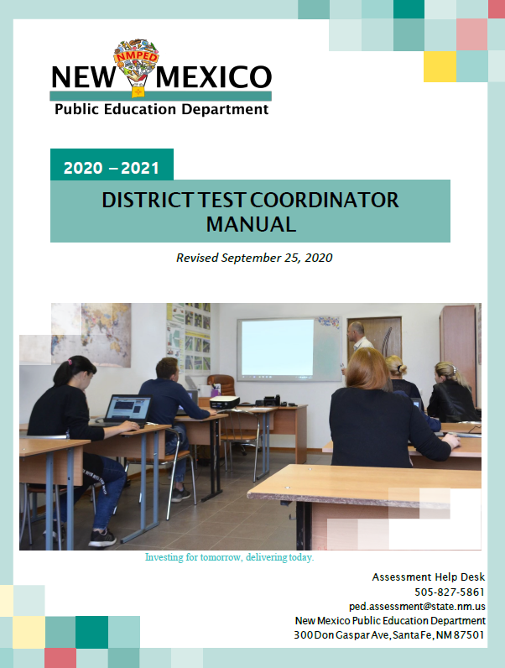
References for Training
DTCs are responsible for reading and understanding all appropriate rules, manuals, and other test administration materials.
6.10.7 NMAC, Standardized Testing Procedures & Requirements (Filed December 7, 2018)
The following manuals also apply:
District Test Coordinator Manual
Accommodations Manuals
Test Coordinator Manuals (TCMs)
Test Administration Manuals/ Directions for Administration (TAMs/DFAs)

Slide 5
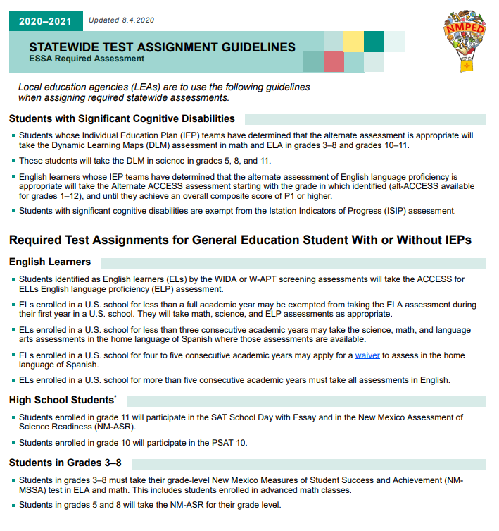
Participation in State Assessments
The Elementary and Secondary Education Act (ESEA) of 1965, re-authorized as the Every Student Succeeds Act (ESSA) of 2015, requires (ESSA 1111(b)(2)(B)(v)) that states administer high quality academic assessments in:
•Mathematics in grades 3-8 and once in high school,
•Reading or language arts in grades 3-8 and once in high school, and
•Science at least once in each grade band: 3-5, 6-9, and 10-12.
The law requires that all students participate in these assessments, including students with disabilities (SWD) and English learners (ELs), who must be provided with appropriate accommodations (ESSA 1111(b)(2)(B)(vii).

Slide 6
2020-21 Assessment Programs by Grade Level & Subject Area
Math
ELA
SLA
Science
English Language Proficiency
Early Childhood
Istation
K-2
K-2
K-2
Cognia
3-8
3-8
3-8,11
5,8,11
X
3-8
3-8
College Board
10-11
10-11
X
Dynamic Learning Maps
3-8
10-11
3-8 10-11
X
3-8,11
5,8,11
K-12
ACCESS for ELLs
X
X
X
X
K-12
Early Childhood Observation Tool
PreK-K
*National Assessment of Educational Progress (NAEP): 2020-21 is a main NAEP year grade 4 & 8 math and reading sample
X

Slide 7
Bureau Website
Resources by Testing Programs
FAQs
Blueprints
Test Specifications
Resources for General Audiences
Fact Sheets
Assessment Literacy
Resources to Support Role of the DTC
Assessment Newsletter
Memorandums
DTC interactive calendar
Test Assignment Guidance
Secure Portal Links and Help Desk Lines
DTC Training Manual and more

Slide 8
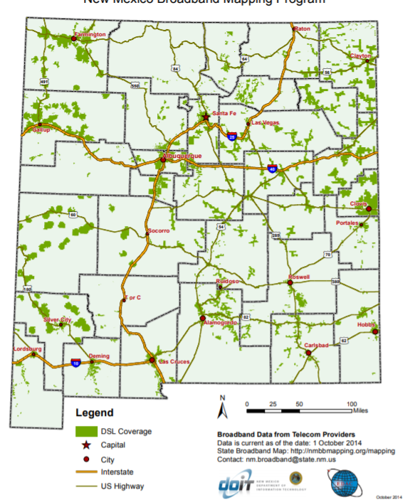
Participation/Testing Modes
Fall SAT School Day is available as paper only
Generally, schools will test using computer-based mode.
Paper is always available option per IEP, 504 Plan
99% of our schools have internet access
25% of our students do not have internet access from home

Slide 9
Student Privacy
The Family Educational Rights and Privacy Act (FERPA) of 1974 protects that privacy of all student data.
Use only the 9 digit SSID number for transmitting communication.
Personally identifiable information must be sent be secure file transfer
The Health Insurance Portability and Accountability Act (HIPPA) of 1996 protects the privacy of all student medical records.
When Requests for Medical Exemptions are submitted to PED, the required medical documentation should be kept at the school district and not sent to PED in order to comply with HIPAA.

Slide 10
Section 504
Section 504 of the Rehabilitation Act of 1973 states that no otherwise qualified individual shall, solely by reason of her or his disability, be excluded from participation or subjected to discrimination under any program or activity receiving federal financial assistance.
The Section 504 plan identifies the necessary accommodations and services for a student to access instruction and the plan may include accommodations in the classroom for local and state assessments.
Provides services and changes to the learning environment to enable students to learn alongside their peers.

Slide 11
Students With Disabilities
The Individuals with Disabilities Act (IDEA) of 2004 mandates that all SWD be included in all state assessment programs, including federal assessments required under ESSA (IDEA 612(a)(16)(A)).
Every SWD must be assigned the appropriate accommodations to participate in general and/or alternate assessments as indicated in the student’s Individualized Education Program (IEP) (IDEA 612(a)(16)(A)).
IDEA also requires the state to develop guidelines for the use of appropriate testing accommodations and to use universal design principles in developing and administering assessments when feasible.

Slide 12
Assessment Roles and Training Model
PED Assessment Bureau
District Test Coordinator(s)
School A
STC, Principal
School B
STC, Principal
District Charter
School Test Coordinator
Test Administrators, Proctors
Test Administrators, Proctors
Test Administrators, Proctors
Test Administrators, Proctors
State Charter &
State-Supported Institution
Test Coordinator
SUPERINTENDENT
STATE CHARTER LEADER

Slide 13
Superintendents/Charter Leader
Designates District Test Coordinator
Verifies that procedures are followed correctly and assessments were administered

Slide 14
Site/School Principals
Attend local trainings led by DTC
Verify that procedures are followed correctly
Sign Principal Verification form and maintain at school/district for five years

Slide 15
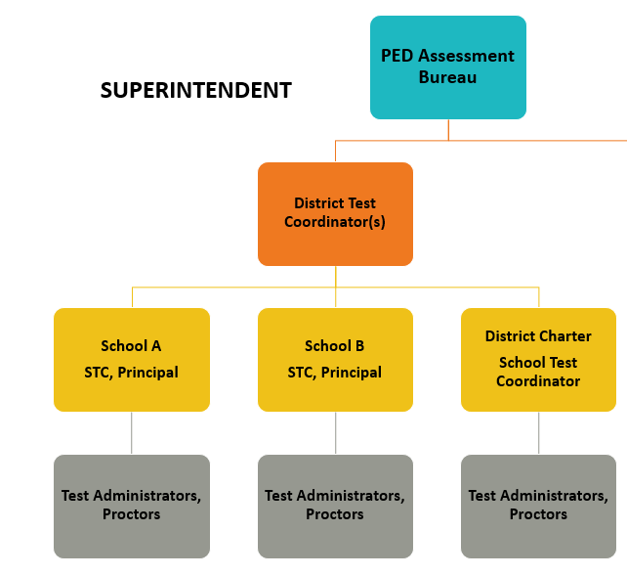
Role & Responsibilities of the DTC

Slide 16
DTC Licensing Requirements
District or State Charter Test Coordinators must:
Hold a valid PED license
School Instructor
Administrator
Counselors & Student Success Advisors
Be designated by the Superintendent/State Charter Leader
Be officially registered with PED
6.10.7.7.A. NMAC

Slide 17
DTC Leadership Responsibilities
Attends PED training twice a year; prior to fall and spring windows
Must be completely knowledgeable of 6.10.7 NMAC
Communicates assessment information to district, schools, parents, and community
Develops local district test security policy or checklist

Slide 18
DTC Leadership Responsibilities
Responsible for test material orders, inventory, and security
Ensures standardized test administration
Serves as primary liaison with PED and testing vendors

Slide 19
DTC Training Responsibilities
Provides training to local STCs and principals prior to fall and spring administrations
Disseminates 6.10.7 NMAC to all staff
Provides clear instructions on procedures and prohibited practices (refer to 6.10.7.12.C)
Provides manuals in advance of training and reviews manuals during training

Slide 20
DTC Training Responsibilities
Assists STCs with training school staff
Provides and reviews testing schedules
Coordinates availability of locally-provided test materials (e.g., calculators, scratch paper) to school staff
Develops local secure tracking procedures

Slide 21
DTC Test Administration Responsibilities
Inspects schools’ accommodations documents
Ensures TAs and Proctors are certified, trained, and have signed Confidentiality Agreements
Inspects schools to ensure secure storage of assessment materials and tracking procedures are followed
Reports irregularities to PED and conducts investigations

Slide 22
DTC Post-Test Responsibilities
Works with STCs to ensure that:
all students were tested
all student data are complete and accurate
all secure materials returned to vendors according to directions

Slide 23
PED Site Monitoring Requirement

Slide 24
Role & Responsibilities of the School Test Coordinator

Slide 25
School Test Coordinator (STC) Licensing Requirement
STCs must hold one of the following, valid PED licenses:
School Instructor
Administrator
School Counselors
(Including Student Success Advisors)
Educational Diagnostician
Interpreter for the Deaf
Rehabilitation Counselor
School Psychologist
School Social Worker
Speech Language Pathologist
6.10.7.7.E. NMAC

Slide 26
STC Pre-Testing Responsibilities
Provides training to TAs and Proctors twice a year
Reviews 6.10.7 NMAC with TAs and Proctors
Disseminates materials and trains TAs and Proctors
Provides manuals to TAs in advance of training
Trains TAs on local secure tracking procedures
Provides student and room testing assignments
Ensures proper administration of accommodations (Section 504 Plans, IEPs, ELL Plans)
Provides TAs clear instructions on proper procedures and prohibited practices

Slide 27
STC Responsibilities During Testing
Ensures Posting of “Testing, do not disturb” signage
Actively monitors for proper and standardized administration and appropriate use of accommodations (visiting classrooms during test sessions)
Distributes allowable support materials/tools to TAs (calculators, scratch paper, No. 2 pencils, etc.)

Slide 28
STC Responsibilities During Testing
Securely stores assessment materials (including student testing tickets) following DTC’s tracking procedures
Reports irregularities to DTC and supports DTC’s investigation of irregularities, as appropriate

Slide 29
STC Post-Testing Responsibilities
Ensures all students were tested
Verifies student data in the online administrator portal (CBT) or on students’ PBT materials
Returns all secure materials to DTC
Securely destroys all scratch paper and recycles manuals

Slide 30
Role & Responsibilities of the Test Administrator/Proctor*
*Term used in SAT and PSAT 10 administration

Slide 31
Test Administrator Licensing Requirements
school instructor
administrator
school counselor
student success advisor
instructional support providers (e.g., educational diagnostician, psychologist, social worker)
Long-term substitutes holding a current PED license may serve as TAs.
Short-term substitutes, educational assistants (EAs), school nurses, and coaches may not serve as TAs, unless they also have another valid license listed on the previous slide.

Slide 32
Test Administrator Responsibilities
Administers assessments to assigned students according to TAM/DFA
Reads scripts to students as written
Provides accommodations as directed
Strictly monitors students during testing
Maintains security of assessment materials
Reports irregularities immediately to STC and principal
Sign Confidentiality Agreement

Slide 33
Proctors/Educational Assistants
Proctors are generally EAs/IAs but can be any trained staff or community member
Assist TAs; active monitoring of room
Trained by STC in proper test administration and test security
Must sign the Confidentiality Agreement
Hall monitor/restroom escort
No parents in child’s or relative’s room

