Slide 1


SAT Suite of Assessments
Winter DTC Training
February 2021

Slide 2

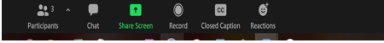
Housekeeping
Please remain on mute when not speaking
Camera use is encouraged
Submit questions via Google document link
The meeting is being recorded and available through Canvas by Friday.
Closed Captioning is available
Click on this icon
Then, select “Show Subtitles”

Slide 3
Session Goals
Our goal today is to provide information to assist District Test Coordinators for preparing schools for the spring test administration. Topics to be covered:
Activities that should have started
Activities to start
Available resource materials for Educators, Students, and their Families

Slide 4
Key Dates

Slide 5
Key Dates
Key Dates for Digital and Paper Based Testing are available on PED website.
Activity | Role | Primary Testing Window March 3-5 | Makeup Testing Window #1 March 24-26 | Makeup Testing Window #2 April 13-15 | Makeup Testing Window #3 April 27-29
Submit Requests for College Board Accommodations Requests, EL Supports, and State Allowed Accommodations | SSD Coordinator | 1/27/21 | 2/2/21 | 2/22/21
Submit Late Requests in SSD Online | SSD Coordinator | 1/27/21 | 2/12/21 | 3/5/21
Submit Offsite Testing Requests | School Test Coordinator | 2/26/21
Receive Access to TIDE | School Test Coordinator District Test Coordinator | 2/3/21 | 2/3/21 | 2/3/21 | 2/3/21
Install College Board Secure Browser | Technology Coordinator | At least four weeks prior to test day.
Complete TIDE Training | Test Coordinator | At least four weeks prior to test day.
Complete Technical Readiness Activities; Configure Student Test Settings; Setup Proctor Accounts | School Test Coordinator | At least two weeks prior to test day.
SAT Coordinator Training Opens | School Test Coordinator | 2/1/21
Materials Arrive In Schools | School Test Coordinator | Week of 2/8/21

Slide 6
Key Dates
Key Dates for Digital and Paper Based Testing are available on PED website.
Activity | Role | Primary Testing Window March 3-5 | Makeup Testing Window #1 March 24-26 | Makeup Testing Window #2 April 13-15 | Makeup Testing Window #3 April 27-29
Update Rosters; submit Updates to Pre-ID file | District Test Coordinator | 1/28 – 3/2/21 | 3/8/21 – 3/23/21 | 3/29/21 - 4/12/21 | 4/16/21 - 4/26/21
Print Test Tickets & Confirm Student Device Readiness for initial Testing Window | School Test Coordinator | 2/22/21-2/26/21 | 3/15/21 – 3/19/21 | 4/5/21 – 4/9/21 | 4/19/21 – 4/23/21
Testing Window | School Test Coordinator | 3/3/21-3/5/21 | 3/24/21-3/26/21 | 4/13/21-4/15/21 | 4/27/21-4/29/21
Accommodated Testing Window | SSD Coordinator | 3/3/21-3/16/21 | 3/24/21-4/6/21 | 4/13/21-4/26/21 | 4/27/21-4/29/21
Deadline to Return Test Day Forms | School Test Coordinator | 3/5/21 | 3/26/21 | 4/15/21 | 4/29/21
Scores Available to Students | Students | Beginning 3/19/21 | Beginning 4/9/21 | Beginning 4/30/21 | Beginning 5/14/21
Scores Available to Educators | School Test Coordinator | TBD | TBD | TBD | TBD

Slide 7
Fall Testing vs. NM School Day Administrations
While there are many similarities to the SAT testing that took place in the fall of 2020, it is important to understand the differences with the spring SAT School Day Administration.
 | Fall 2020 SAT | Spring 2021SAT
School/Staff Setup | Spring 2020 established school list was used for Fall 2020 setup. School contacts provided in College Board’s Test Ordering System (TOS) Contact information is updated in TOS | PED defines eligible schools for testing DTCs provide school contacts via school setup survey. All schools have been setup and should have received a Welcome Email on January 25, 2021. Staff changes should be submitted to NMSAT@collegeboard.org
Ordering/Registration | Schools/Districts ordered materials in TOS | There is NO ordering in TOS. PED has uploaded the initial student Pre-ID registration file. DTCs will upload additional students to College Board to update rosters and to roster students for administrations that occur after the March 3, 2021 primary admin date. Paper-based materials will be sent based on the number of students Pre-ID’d and the accommodations submitted in SSD Online.

Slide 8
Fall testing vs. NM School Day Administrations
 | Fall SAT | Spring SAT
Accommodations | All accommodations are submitted in College Board’s SSD Online System | All accommodations are submitted in College Board’s SSD Online System EL Supports are available – translated test directions, word to word glossaries, time and one-half (+50%) State-allowed accommodations have been defined by PED.
Test Administration | Paper-based | Computer-based Paper-based
Scores & Reporting | Scores will be available in the reporting portal. | Scores will be available in the reporting portal State proficiency levels and benchmarks will be set and reported by PED. Proficiency levels will not appear on the College Board score report
Communications | Standard College Board Communications | Custom communications including DTC emails, state specific trainings, policies, etc. Some policies may be different for state accountability testing
Support | General College Board Support | NM-specific phone number and email address NM-specific field staff
Other | Fee Waivers indicated in TOS | Fee Waiver codes will be posted to the K12 reporting portal for distribution by the school

Slide 9
Schools Established for Paper Pencil Testing(PPT)
School AI Code | School State Code | School Name | District Name
320435 | 11105 | MAXWELL HIGH | MAXWELL MUNICIPAL SCHOOLS
320470 | 28101 | MOSQUERO HIGH | MOSQUERO MUNICIPAL SCHOOLS
320184 | 43089 | TSEYIGAI HIGH | GALLUP-MCKINLEY CTY SCHOOLS
320185 | 62038 | CUBA HIGH | CUBA INDEPENDENT SCHOOLS
320495 | 70124 | PECOS HIGH | PECOS INDEPENDENT SCHOOLS
320740 |  | EARLY COLLEGE HIGH SCHOOL - GCCS | GRANTS-CIBOLA COUNTY SCHOOLS
320482 | 88057 | LAGUNA-ACOMA HIGH | GRANTS-CIBOLA COUNTY SCHOOLS
320305 | 88055 | GRANTS HIGH | GRANTS-CIBOLA COUNTY SCHOOLS
320002 | 94015 | NM SCHOOL FOR THE BLIND AND VISUALLY IMPAIRED | NM SCHOOL FOR THE BLIND AND VISUALLY IMPAIRED
320416 | 505001 | SCHOOL OF DREAMS ACADEMY | SCHOOL OF DREAMS ACADEMY
320142 | 542001 | MISSION ACHIEVEMENT AND SUCCESS | MISSION ACHIEVEMENT AND SUCCESS
Notes:
DTCs will not complete Bulk Reg activities for these 11 schools. Instead, these schools must complete the makeup survey to order makeup materials for any administrations beyond the March 3, 2021 primary. The makeup survey will be sent to School Test Coordinators via email and must be completed no later than the day after each test administration date to order materials for the next administration date.

Slide 10
Activities that should have started

Slide 11
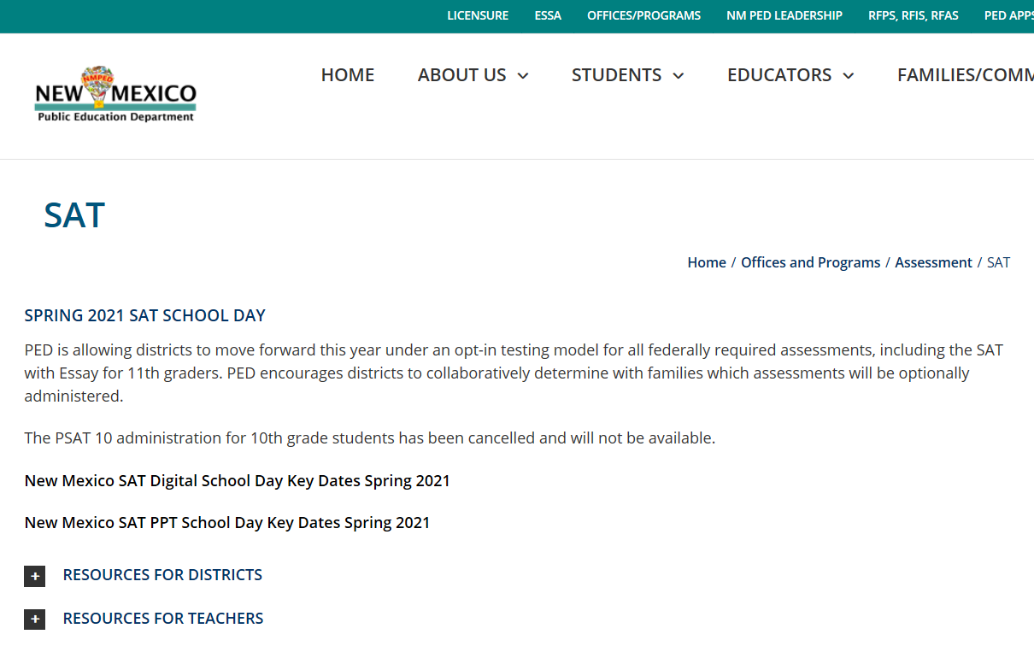
Bookmark the PED Website and Review Resources
For DTCs and
Test Coordinators
Training Materials
Guideline/Policy Documents
Resources
  Educators
  Students/Parents
Find more at: https://webnew.ped.state.nm.us/bureaus/assessment-3/sat-psat/
Notes:
Show live site and scroll to materials on right side and call out resources
Make sure you and your testing staff have bookmarked this valuable resource.

Slide 12
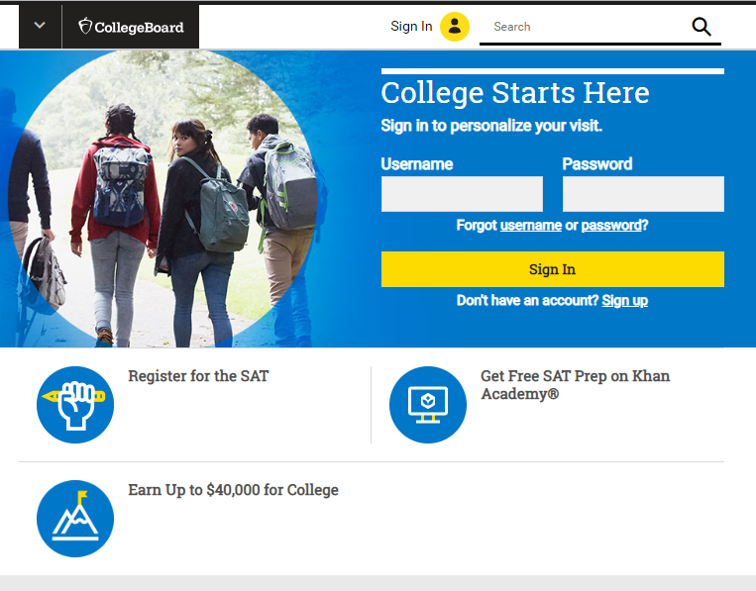
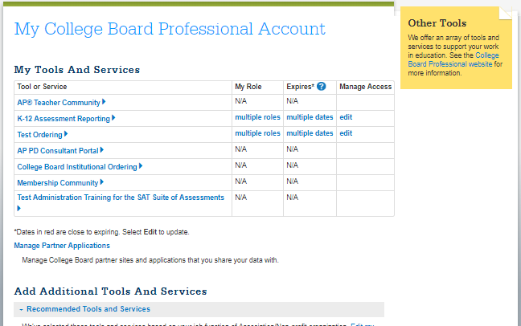
Create a College Board Professional Account
For DTCs, Test Coordinators, and SSD Coordinators
A College Board Professional Account is required for all system access.
Each user creates his or her own account to allow for a single sign-on to the following features:
  SSD Online System
  College Board Online Test Day Training
  College Board Reporting Portal
Create an account at collegeboard.org
Notes:
We also have professional development resources available for you and your teachers. At sat.org/PD, you’ll find e-modules that walk through the most important information about the SAT, Official SAT Practice, and the K-12 Score Reporting Portal. click I’d like to highlight the Success Steps series, in which educators like you share their processes and programs that support all students.
In addition, there are 10 PowerPoint decks meant to be used as self-guided courses that principals and teachers can use while collaborating to understand the skills tested on the SAT Suite of assessments.

Slide 13
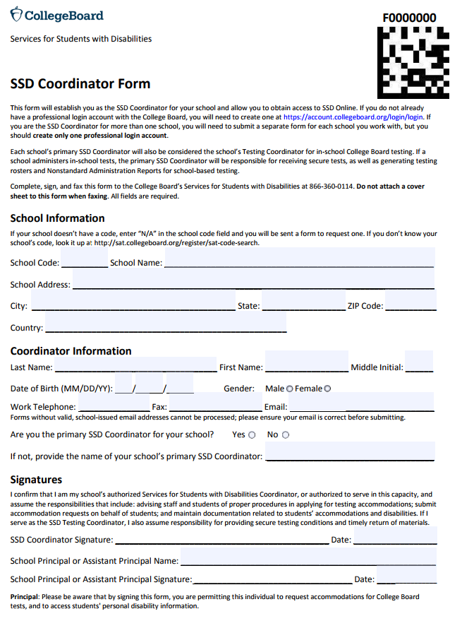
Get Access to SSD Online
New SSD Coordinators should go to www.collegeboard.org to create a College Board Professional Account if you don’t already have one.
Complete the SSD Coordinator Form, found at www.collegeboard.org/ssd
  Provide information about you and your school.
  Obtain your principal’s signature.
  Fax the form to College Board (instruction on form). An access code will be emailed approximately 2-3 days after receipt of your form.
If you are the SSD Coordinator for more than one school, you will need to submit a separate form for each school you work with, but you should create only one professional login account.
For SSD Coordinators

Slide 14
Activities to be completed

Slide 15
District Test Coordinators
Provide school information and staff contacts for setup
Assist schools with understanding processes
Responsible for helping schools understand key deadlines
Participate and assist with training
Provide support as needed
Update school rosters - add students, if needed, using the College Board Bulk Registration Tool
Before Test Day

Slide 16
District Test Coordinators
Confirm schools tested all eligible students
(Digital) Update school rosters for student requiring a makeup – upload students, if needed, for the makeup administration
(Paper) Remind schools to complete the makeup survey which will be emailed to school Test Coordinators after each test administration date to order appropriate makeup materials for the next administration.
Assist schools with returning forms and materials on time
Provide support for testing irregularities
After Test Day

Slide 17
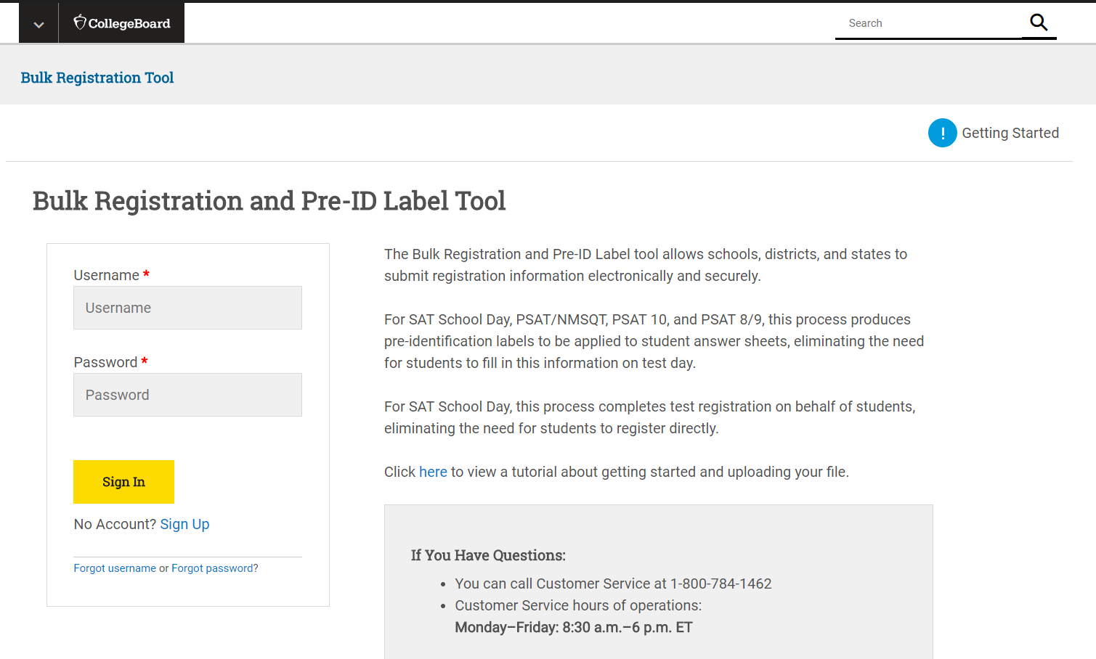
Bulk Registration – Roster Updates
Access the pre-recorded webinar and slide deck that provides an overview and instructions for New Mexico educators about the SAT School Day bulk registration process for spring 2021.
Click Here-New Mexico School Day Bulk Registration Webinar
Passcode: NMPED_Spring2021
Click Here-New Mexico School Day Bulk Registration Slide Deck
PED provided an initial Bulk Registration file of students using the 40th day data. DTCs will be able add/update students beginning on February 1st for the primary testing window. DTCs and bulk registration coordinators should have received an access code to the Bulk Registration tool on January 28th.
DTCs will be able to register students to update rosters.
DTCs will use a specific template and format to upload student information.
  Go to https://bulkreg.collegeboard.org
  Click Getting Started
No access is needed to obtain templates or the file
specifications.

Slide 18
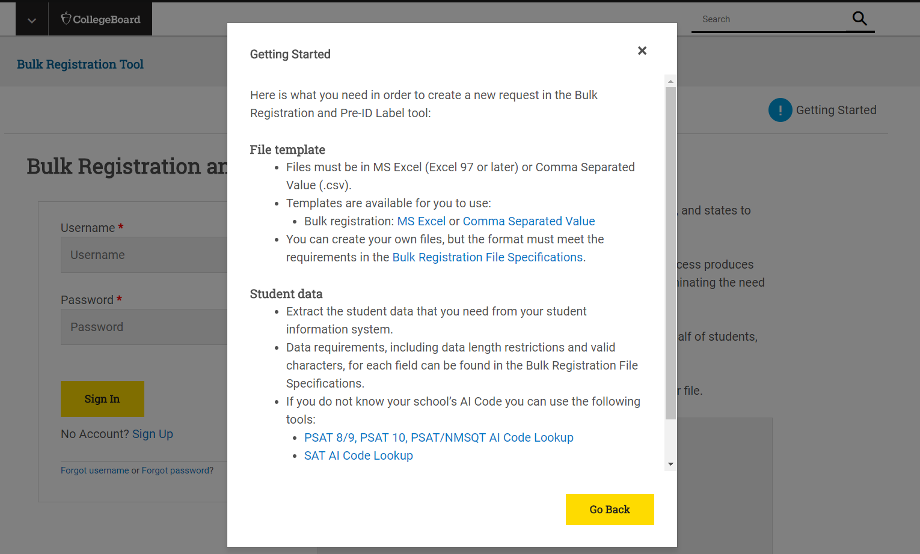
Bulk Registration – Roster Updates
File templates in Excel or Comma Separated Value are available.
Use the Bulk Registration File Specifications to know about
each field in the template.

Slide 19
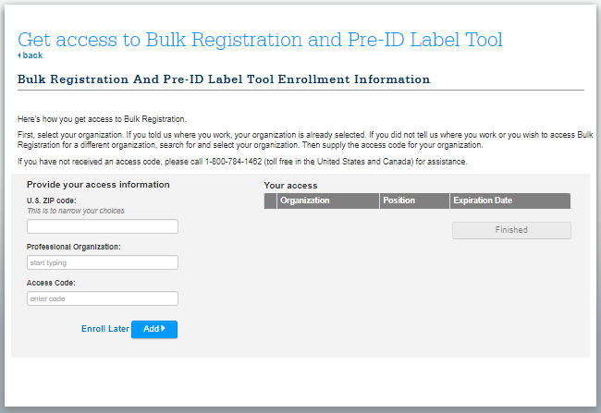
Plan for Bulk Registration
Look for the access email from NMSAT@collegeboard.org.
Identify students who are eligible to test.
Plan timing for your uploads. Discuss approach with schools to determine how they will notify you of students and test dates.
Scheduling Tips For computer-based testing
  Put a plan in place for schools to notify you if students are missing.
  You may want to download the initial file posted by PED to begin review of included students.
  Districts can upload as many files as needed. However, we recommend working with your schools to determine the timing that aligns with their room planning and schedule specific dates to complete the upload.
  For example, consider setting a date in February or March when schools are working in TIDE to prepare room rosters and another one just before test day, if additional students have been enrolled.
Scheduling Tips For paper-based testing
  Plan to upload one file closer to the test date to capture all students at the school.
District test coordinators will upload at least one file for each test date.
For DTCs

Slide 20
Bulk Registration Dates
 | March 3rd SAT Administration | March 24th SAT Administration | April 13th SAT Administration | April 27th SAT Administration
Initial Pre-ID by PED | Complete | Complete | Complete | Complete
District Test Coordinators Receive Access Email | February 3, 2021
Update rosters; Complete Bulk Registration File for new students | January 28 – March 2, 2021 For accommodated window, rosters can be updated through March 15, 2021 | March 8 – 23, 2021 For accommodated window, rosters can be updated through April 5, 2021 | March 29 – April 12, 2021 For accommodated window, rosters can be updated through April 25, 2021 | April 16 – 26, 2021 For accommodated window, rosters can be updated through April 28, 2021
Action | Upload only if students are missing in TIDE and the school will be testing on March 3rd. Upload all eligible students or only missing students. | Upload if schools will be testing students on March 24th. Upload all students or only students planning to test. | Upload if schools will be testing students on April 13th. Upload all students or only students planning to test. | Upload if schools will be testing students on April 27th. Upload all students or only students planning to test.
Note: Dates on College Board’s website about bulk registration, may not be applicable to the PED-provided administrations.

Slide 21
Student Data Privacy
Schools will be requested to collect parental consent for
  Accommodations Requests
  Student participation in Student Search and the optional questionnaire
Accommodations requests in SSD Online
  A template is provided in SSD Online as a part of the request process.
  Schools may use the provided template or follow existing district processes for consent.
  Consent is required to ensure parents are aware their child’s information is being shared with College Board in support of delivering their accommodations.
  Students already approved for accommodations do not need to have an additional consent form completed.
  SSD Coordinator will be asked to confirm they have consent prior to submitting the request.
  Consent should be kept on file at the school. College Board will not collect consent form.

Slide 22


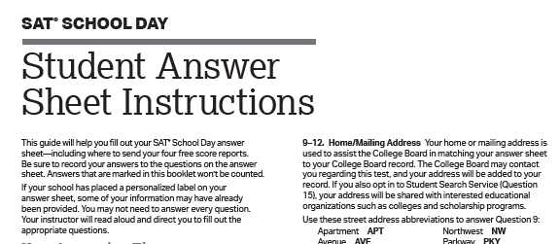
Student Search Service® and Consent
  The College Board's Student Search Service is a free, voluntary program that connects students with information about educational and financial aid opportunities from nearly 1,900 eligible colleges and universities, and scholarship and other educational programs.
  By opting in, students give the College Board permission to share their names and limited information provided by the optional questionnaire with colleges and scholarship programs looking for students like them. Search users can also search for students based on score ranges.
  In advance, schools should distribute the Student Guide. The Student Guide and Questionnaire Instructions will be posted on the PED website.
Notes:
The College Board's Student Search Service is a free, voluntary program that connects students with information about educational and financial aid opportunities from nearly 1,900 eligible colleges and universities, and scholarship and other educational programs.
By opting in, students give the College Board permission to share their names and limited information provided by the optional questionnaire with colleges and scholarship programs looking for students like them.
In advance, schools should distribute the Student Guide provided in the preadministration shipment to students to discuss with their families.
Follow your district or school policy for collecting consent. Schools and districts may opt to use the consent form provided by the College Board or may choose to use their own. Consent should be collected prior to the preadministration session.
Schools should collect consent from parents for students who wish to opt-into Student Search Service and complete the optional questionnaire.
Consent is only required to opt into Student Search Service and the questionnaire. Students can still take the SAT and PSAT 10 without completing the questionnaire.
If a parent does not return a consent form, the school should proceed assuming that the parent did not consent.
Consent forms should remain at the school until the student graduates and do not need to be returned to College Board.

Slide 23
Student Search Service® and Consent
  Follow your district or school policy for collecting parental consent. Schools and districts may opt to use the consent form provided by the College Board or may choose to use their own. Parental consent should be collected prior to the preadministration session.
    Schools should collect consent from parents for students who wish to opt-into Student Search Service and complete the optional questionnaire.
    Consent is required only to opt into Student Search Service and the questionnaire. Students can still take the SAT without completing this information.
  If a parent does not return a consent form, the school should proceed assuming that the parent did not consent.
  Consent forms should remain at the school until the student graduates and do not need to be returned to College Board.
Notes:
The College Board's Student Search Service is a free, voluntary program that connects students with information about educational and financial aid opportunities from nearly 1,900 eligible colleges and universities, and scholarship and other educational programs.
By opting in, students give the College Board permission to share their names and limited information provided by the optional questionnaire with colleges and scholarship programs looking for students like them.
In advance, schools should distribute the Student Guide provided in the preadministration shipment to students to discuss with their families.
Follow your district or school policy for collecting consent. Schools and districts may opt to use the consent form provided by the College Board or may choose to use their own. Consent should be collected prior to the preadministration session.
Schools should collect consent from parents for students who wish to opt-into Student Search Service and complete the optional questionnaire.
Consent is only required to opt into Student Search Service and the questionnaire. Students can still take the SAT and PSAT 10 without completing the questionnaire.
If a parent does not return a consent form, the school should proceed assuming that the parent did not consent.
Consent forms should remain at the school until the student graduates and do not need to be returned to College Board.

Slide 24
Planning for Preadministration
  Follow your district or school policy for collecting parental consent. Schools and districts may opt to use the consent form provided by the College Board or may choose to use their own. Parental consent should be collected prior to the preadministration session.
    Schools should collect consent from parents for students who wish to opt-into Student Search Service and complete the optional questionnaire.
    Consent is required only to opt into Student Search Service and the questionnaire. Students can still take the SAT without completing this information.
  If a parent does not return a consent form, the school should proceed assuming that the parent did not consent.
  Consent forms should remain at the school until the student graduates and do not need to be returned to College Board.
If unable to do a preadministration session before test day:
  Plan to share student guides and consent forms in advance.
  For paper-based testing, add Pre-ID labels to answer sheets before or on test day.
  Allow students to complete their free score sends after testing is complete. The test day scripts will provide guidance.
  Allow students to complete the optional questionnaire if they have permission after testing or https://studentsearch.collegeboard.org/
Notes:
The College Board's Student Search Service is a free, voluntary program that connects students with information about educational and financial aid opportunities from nearly 1,900 eligible colleges and universities, and scholarship and other educational programs.
By opting in, students give the College Board permission to share their names and limited information provided by the optional questionnaire with colleges and scholarship programs looking for students like them.
In advance, schools should distribute the Student Guide provided in the preadministration shipment to students to discuss with their families.
Follow your district or school policy for collecting consent. Schools and districts may opt to use the consent form provided by the College Board or may choose to use their own. Consent should be collected prior to the preadministration session.
Schools should collect consent from parents for students who wish to opt-into Student Search Service and complete the optional questionnaire.
Consent is only required to opt into Student Search Service and the questionnaire. Students can still take the SAT and PSAT 10 without completing the questionnaire.
If a parent does not return a consent form, the school should proceed assuming that the parent did not consent.
Consent forms should remain at the school until the student graduates and do not need to be returned to College Board.

Slide 25
Test Coordinators
Bookmark the digital testing site: digitaltesting.collegeboard.org
Share the Digital Testing Quick Guide with your technology coordinator
Work with your school's technology coordinator to ensure that all student and proctor devices have supported operating systems and web browsers.
Review and complete critical digital setup activities listed in the Step-by-Step Guide.
  Includes whitelisting appropriate sites. Included in the guide, or as a separate list on the PED website.
Install the secure browser on all student test-taking devices.
Preview the student digital test experience
Work with your Services for Students with Disabilities (SSD) coordinator to ensure accommodation requests are being submitted in SSD Online
Immediate Activities
Notes:
Demo the digital testing site.

Slide 26
Test Coordinators
Plan testing room and staffing
Receive access to College Board's required online training activities. Complete training prior to test day.
Receive access to Cambium’s test delivery system and supporting tools, including the Test Information Distribution Engine (TIDE).
Receive your school's shipment of coordinator manuals, guides, and forms related to the test administration.
  Share information with students
  Prepare and conduct a preadministration session
Configure accommodations in TIDE.
~4 Weeks Prior to Test Day

Slide 27
Technology
Coordinators
Bookmark the digital testing site: https://digitaltesting.collegeboard.org
Review the Digital Testing Quick Guide .
Work with the school’s test coordinator to ensure that all student and proctor devices have supported operating systems and web browsers.
Review and complete critical digital setup activities listed in the Step-by-Step Guide.
Install the secure browser on all student test-taking devices.
Preview the student digital test experience
Immediate Activities

Slide 28
SSD Coordinators
Using the SSD Online Dashboard, identify students who will be testing this year and confirm accommodations
For new students or students who need accommodations that have not yet been requested, submit a request in SSD Online.
For students with previously approved accommodations, verify
  The accommodations approved match the student’s current identified IEP/504 accommodation needs.
  The student information name, birth date, and graduation date are correct.
  The student is receiving the testing accommodation on school and district assessments
Immediate Activities

Slide 29
Preparing for the SAT
Begin using the practice resources
Khan Academy provides personalized, free practice for all students. The practice items are developed in conjunction with the College Board based on the SAT Suite of Assessments test specifications. Students who took PSAT/NMSQT can link their scores with Khan Academy or take a diagnostic quiz to get their personalized practice plan to help them identify areas .
Share the Khan Academy Flyer with students and their families.
Review the Khan Academy educator resources and coaching tools. Begin using the tools.
  For students that participated in PSAT in the fall, they can link their scores to get personalized practice.
  For students who haven’t taken the PSAT, have them begin the diagnostic quizzes to build their personalized practice.
As an alternative to online practice, download paper practice tests SAT.
Helping prepare students

Slide 30

Administering the School Day SAT in a Pandemic
Kristie Eamello
District Test Coordinator
Alamogordo Public Schools

Slide 31
Logistics, Procedures & Communication
Parents and guardians were called to inform them that APS was offering the SAT School Day.
An electronic form was created giving students an opportunity to sign up online. (Give yourself time to set up sessions and ensure students are in College Board with any needed accommodations)
Communication with students & parents.
Emails were delivered to both students and parents multiple times about testing.
Additional emails with testing information was sent to parents and students who had signed up.

Slide 32
Clear and Concise Information
Where
When
Times
Items to bring
Covid-Safe Rules
Entry Procedures
Exit Procedures

Slide 33
Test Ticket
Please print this ticket or take a picture with your phone and bring with you on test day.
Name:
Date: | October 27th
Arrival time: | 8:15am to 8:45am
Where should you go? | Room 102/AHS
Come Prepared on Test Day!
Did you bring?
• Picture ID? (Student ID or Driver’s License)
• An acceptable calculator? Calculators will be provided, however you may bring your own calculator if it is on the SAT-approved list (see this link:
https://collegereadiness.collegeboard.org/sat/taking-the-test/calculator-policy )
• Your School email address?
• A snack and a drink?
*Check email titled “Important SAT Information” for further instructions.

Slide 34
*Your Testing Room Is *
PSAT/NMSQT Information
Contact: Jane Wood/Test Coordinator 575-491-7380
WHERE:
Alamogordo High School
WHEN:Tuesday, January 26th, 2021 TIMES:
Entry: 8:00am to 8:25am
Test Start Time: 8:30am
Test End Time: 12:30am
ITEMS TO BRING:
Face coverings
Know the room number where you will be testing. Calculators will be provided, however you may bring your own calculator if it is on the PSAT-approved list see this link: https://collegereadiness.collegeboard.org/psat-nmsqt-psat-10/taking-the-tests/test-day-checklist/approved-calculators
You may bring water and a snack which you can have at the breaks.
If you bring a cell phone, smart watch or any electronic device you will have to place it in a box in the testing room with the Test Administrator until the entire test is completed.
COVID-SAFE RULES:
Wear a face covering from the time you exit your vehicle until you return to your vehicle at the end of the test.
Maintain social distance at all times while on campus.
ENTRY PROCEDURES:
Enter the campus through the front doors of the school.
If you arrive before doors open please stand on a Tiger Paw and this will help maintain social distance.
Park in the front parking lot.
Drop offs may use bus lanes If being dropped off, please ask your driver to wait until you confirm (by call, text or security personnel) that you have been admitted for testing.
Upon exiting your vehicle, you must wear a face covering and maintain social distance until you return to your vehicle when the test is complete.
Enter the building maintaining at least 6-feet distance from all others.
Security and the nurse will meet you, ask Covid-19 regulation questions, and instruct you to use the hand sanitizing station and temperature scanning kiosk.
If the scanner indicates a fever (100.4 degrees F or higher), you will be allowed to rest for a few minutes and rescan.
If the second scan indicates a fever, you will be sent home with instructions to be evaluated for illness.
If your temperature is normal, you will be directed to your testing room, and if dropped off, inform your driver that you have been admitted for testing.
EXIT PROCEDURES:
Students will exit the building through the front doors.
*Your Testing Room Is *

Slide 35
Testing
Students and Proctors were assigned a classroom ahead of time.
Students and parents were emailed a test ticket with times and room numbers to streamline entry procedures.
Nursing staff, security, secretarial staff, teachers administering exam and administration were included in the planning and given all testing information as well as student rosters and room numbers.
School testing info, such as AI code etc, was written on each classroom white board prior to testing
Custodial staff was informed of which rooms were being used for testing to ensure sanitizing before and after testing.

Slide 36
Technology Considerations for SAT School Day
Criss Grubbs
Las Cruces Public Schools

Slide 37
Digital Testing
All the information on Digital Testing can be found on the College Board website
Things that need to be done before testing by the technology department – Step-by-Step Guide
  Check supported browser’s
  Auto Update
  Filters and Firewalls
  White list appropriate URL’s
  Install Secure Browser
    District wide push out or individual computer install

Slide 38
Devices for testing
First Priority Devices – Laptops and desktops that are already in the building. (Without disassembling labs)
Second Priority Devices – Student checked-out laptops
  Students will bring device with them – charger cords
  Time in schedule to allow device to update and install secure browser
Third Priority – Rearranging desktop labs in building. Moving desktops to other locations

Slide 39
Other things to consider
Power strips
Extension cords
Extra charger cords
Hard wire or Wi-Fi - Bandwidth
Headphone
  Students bring their own or school provided
Directions for teachers on how to install secure browser if the district can’t push out

Slide 40
Support Materials for Students and Families

Slide 41
Resources for Families
Use the following links to download information that can be shared with students and their families:
SAT Student Guide
Khan Academy Flyer

Slide 42


SAT Fee Waiver Benefits
Free Tests and Free Feedback
College Application Benefits
Other Benefits
Unlimited score reports to send to colleges
Waived application fee at participating colleges
Free CSS Profile™ applications
Fee reductions for score verification reports
No non-U.S. regional fees for free tests
No late registration fees for free tests
2 free SAT tests
2 free Question-and-Answer Service (QAS) or Student Answer Service (SAS) reports
Notes:
Students who test as part of the NM SAT School Day and meet the eligibility requirements can receive a fee waiver for future use. The fee waiver benefits are intended to improve access to college for students with financial need. In order to remove the financial barrier of testing, sending score reports, applying to and providing financial information to colleges, College Board offers fee waiver benefits to address these costs. When students are eligible for fee waivers, whether they take the SAT on a weekend or a school day, they are eligible for Free Tests & Free Feedback, College Application Benefits, and some additional benefits. Specifically, they’ll receive:
(Free Tests & Free Feedback)
2 Free SAT tests, with or without the essay. Two out of three students improve their scores when they take the SAT again, so students may want to take advantage of both registrations.
6 Free SAT Subject Tests
2 Question-and-Answer Service (QAS) or Student Answer Service (SAS) in the online score report
They can have Unlimited score reports sent to all colleges
Waived application fees at participating colleges
CSS Profile application fee waivers to apply for financial aid if they are a first time, domestic college applicants
In addition they can get
A fee reduction for multiple-choice score verification or essay score verification
Late registration at no charge for testing in the United States or U.S. territories.
And, Coverage of the non-U.S. regional fee for fee-waiver-eligible U.S. students who are testing abroad
Once a student is determined to be fee waiver-eligible, all of these benefits are accessible in their College Board account. You can see how beneficial these fee waivers are for students. College Board wants to do what we can to remove barriers for students.

Slide 43
Who is Eligible for Fee Waiver Benefits?
Students are eligible for fee waivers benefits if they:
1
Are enrolled in or eligible to participate in the National School Lunch Program (NSLP);
4
Are in a family that receives public assistance;
2
Have an annual family income that falls within the Income Eligibility Guidelines set by the USDA Food and Nutrition Service;
5
Live in federally subsidized public housing or a foster home or are homeless, OR
3
Are enrolled in a federal, state, or local program that aids students from low-income families (e.g., Federal TRIO programs such as Upward Bound);
6
Are a ward of the state or an orphan.
Notes:
In order to access fee-waiver benefits, students must meet specific eligibility requirements. Students are eligible for fee waivers/reductions if they are in 11th or 12th grade and:
Are enrolled in or eligible to participate in the National School Lunch Program (NSLP).
Have an annual family income that falls within the Income Eligibility Guidelines set by the USDA Food and Nutrition Service.
Are enrolled in a federal, state, or local program that aids students from low-income families (e.g., Federal TRIO programs such as Upward Bound).
Are in a family that receives public assistance.
Live in federally subsidized public housing or a foster home, or are homeless.
Are a ward of the state or an orphan.
If there are questions about a student’s eligibility for fee waivers, contact the educator help line at 888-SAT-HELP.

Slide 44
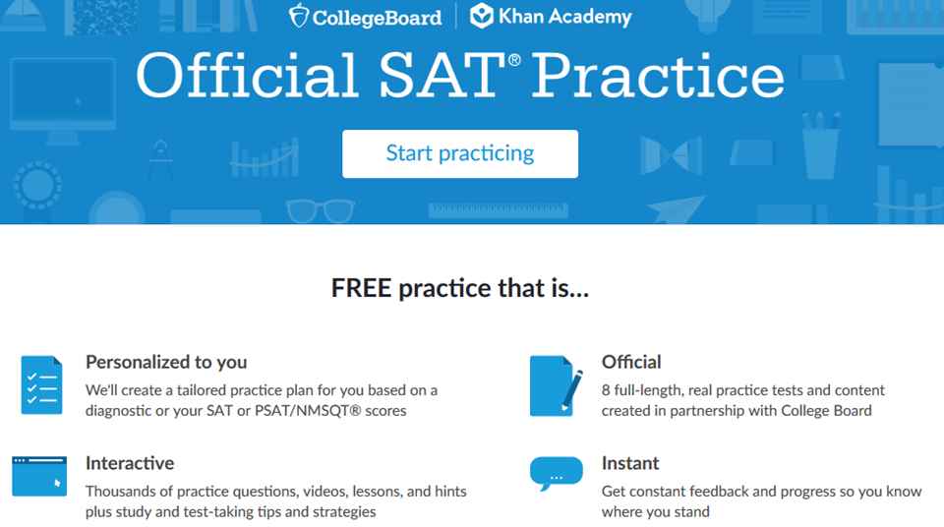
Introduction to Official SAT® Practice on Khan Academy®
Notes:
Khan Academy® is a nonprofit organization that provides free online materials and resources to support personalized education for learners of all ages.
Founded by Salman Khan in 2008 after he saw the popularity of videos he was creating to help his cousin with math, Khan Academy® now has a team of over 100 full-time employees.
Together, the College Board and Khan Academy® have developed comprehensive SAT® practice materials that are personalized, interactive, engaging, and are completely FREE.
Official SAT® Practice is powered by thousands of practice problems, developed by Khan Academy® and approved by the College Board. For the first time ever, all students have access to the best SAT® practice available, regardless of educational background or ability to pay for preparation.
Practice programs are individually targeted to address each student’s greatest areas of need (based on diagnostic assessment on SATpractice.org or based on the student’s past PSAT/NMSQT, PSAT 8/9, PSAT 10, or SAT® results.)
If a student has not previously participated in a College Board PSAT-related assessment, a student can still create a Khan Academy® account and take diagnostic assessments that allow Khan Academy® to evaluate their results and create a practice program that is individually targeted to address that student’s greatest areas of need.
If a student has participated in the PSAT/NMSQT, PSAT 8/9, PSAT 10, or SAT®, they can choose to link their College Board and Khan Academy® accounts, and Khan Academy® will use their results from the SAT® Suite of Assessments to tailor their SAT® practice to their individual needs.

Slide 45

Why Link Khan Academy® and College Board Accounts?
Personalized practice and recommendations: Once students link their accounts, Khan Academy individualizes student practice based on their results from the SAT®, PSAT/NMSQT™, PSAT™ 10, and PSAT™ 8/9.
Jump right into practice:
No additional diagnostic quizzes are needed.
Notes:
It is easy to find Official SAT® Practice on Khan Academy®. Students can visit SATpractice.org. Beyond the over 4,000 questions, eight full-length tests, and hundreds of hours of videos, one of the most powerful aspects of Official SAT® Practice on Khan Academy® is that it allows students to link their actual performance on the SAT®, PSAT/NMSQT, PSAT 10, or PSAT 8/9 directly to Khan Academy® for personalized learning. This means that every hour spent on Official SAT® Practice is spent working on a topic that is directly connected to improvement.
While counselors or educators cannot link their College Board and Khan Academy® accounts (pause), students can. This can help them get to personalized practice quickly.
When the accounts are linked, students receive personalized practice plans based on students’ SAT® and PSAT–related results, even if they link assessment data from 2019. Khan Academy® will continue to refine individualized practice based on results from the SAT® Suite of Assessments.
Students with linked accounts and prior SAT® Suite Assessment scores do not need to take additional diagnostic quizzes to receive personalized practice.
Even if your students have scores from a previous College Board assessment taken in spring or fall of 2019, students can still link the data from their accounts to receive their individualized practice.

Slide 46



Best Practices
Best practices are behaviors that any student can do to make the MOST of their practice time on Official SAT Practice.
The three best practices include:
•Leveling up skills: As students progress through OSP material, they can achieve new levels in the skills practiced. Overall, leveling up provides a signal that students are consistently advancing in content tested on the SAT, and is a marker for learning progress on OSP. This best practice also helps students learn how to monitor their progress.
•Taking a full-length practice test: Taking a full-length practice exam simulates the real test experience and helps students see what they do and don’t know. There are 8 full-length online practice exams available on OSP which can be taken in one sitting or over time.
•Following personalized practice recommendations: OSP provides personalized practice recommendations based on a student’s previous scores and performance on any PSAT or SAT assessment or through mini-diagnostic quizzes. Following practice recommendations helps students learn how to stay focused when they study and work on areas where they most need to grow.
•

Slide 47
Engaging Students in Official SAT® Practice
Independent Practice: Students practice individually at home or in virtual study groups. | Share information about Official SAT® Practice with handouts available at https://www.isbe.net/Pages/sat-psat.aspx. Encourage parents to work with students to set and stick to a study schedule. Link to resources on website, through social media, make announcements, and post flyers around school.
Extracurricular Practice: Students practice in a college prep course or with a community-based organization virtually. | Incorporate Official SAT® Practice tools during non-content classes, such as a college prep class or seminar courses. Partner with community-based/college-access organizations to support students with practice.
Teacher-Guided Practice: Students practice in class (in-person or virtually) using Official SAT® Practice as a learning tool. | Incorporate independent practice into the class period and answer student questions. Use an SAT® question from Official SAT® Practice as bell work or an exit ticket. Assign 60 minutes of Official SAT® Practice per week as homework.
Notes:
There are three main approaches to supporting students using Official SAT® Practice: Independent Practice, Extracurricular Practice, and Teacher-Guided Practice. The district or school can decide how best to implement Official SAT® Practice to support their students, focusing on one of these approaches or a combination of two or more even in a hybrid, blended, in-person, or virtual setting.
When students practice independently, they can do so individually or in virtual study groups.
Practice may also be encouraged through community-based organizations and college access networks by incorporating Official SAT® Practice tools during non-content classes, such as a college prep class or seminar courses, even if these are held virtually.
Practice can also be teacher-guided during class, in-person or virtually, and using the platform as a learning tool.

Slide 48

Practice Builds Confidence

Slide 49
Independent
Practice Plans
Parent Involvement
Share information about Official SAT® Practice with parents.
Encourage parents to work with student to set a study schedule.
Study Groups
Students form groups of three-five for virtual practice.
Students meet virtually on their own schedule for 60 minutes per week.
Encourage students to set up virtual study groups and pick a leader.
Direct students to SAT.org/studygroup for a sample schedule and tips for setting up a study group.
Notes:
Here are specific suggestions for promoting independent practice among students and parents.
Share information about Official SAT® with parents.
Encourage parents to work with students to set and stick to — a study schedule
Encourage students to meet virtually on their own schedule for 60 minutes per week in a study group. Selecting a leader and sticking to a schedule adds value to the dynamic of a study group.

Slide 50
Extracurricular Practice
Incorporate Official SAT® Practice tools during non-content classes
  Use time during college prep or seminar courses.
  Encourage students to use 30 minutes of class time twice per week for independent student practice.
Partner with community-based/college-access organizations
  Virtually train CBO/CAO staff on Official SAT® Practice.
  Designate a point of contact to coordinate communication.
  Develop study plans for students.
  Encourage students to create a practice schedule.
Notes:
Coaches can incorporate Official SAT® Practice tools during non-content classes such as study hall, advisory periods, and seminar courses.
Coaches can partner with community-based/college-access organizations and provide virtual training to those staff members on the coaching tools.

Slide 51

Teacher-Led Practice: Getting Started
Incorporate independent practice into the class period and answer student questions
  Use one class period a week.
  Add your students to your class in the Coach Tools and track progress.
  Utilize the Official SAT® Practice Lesson Plans.
  Use during a shortened class period.
  Begin the class with Official SAT® Practice as bell work.
Homework assignments
  Assign 60 minutes of Official SAT® Practice per week.
Notes:
Teachers can implement independent practice into the class period as bell work. Consider using the exercises, videos, and other activities imbedded within the Official SAT® Practice lesson plans. These suggested models can be done in person or in a virtual setting.

Slide 52

Benefits of Khan Academy

Slide 53
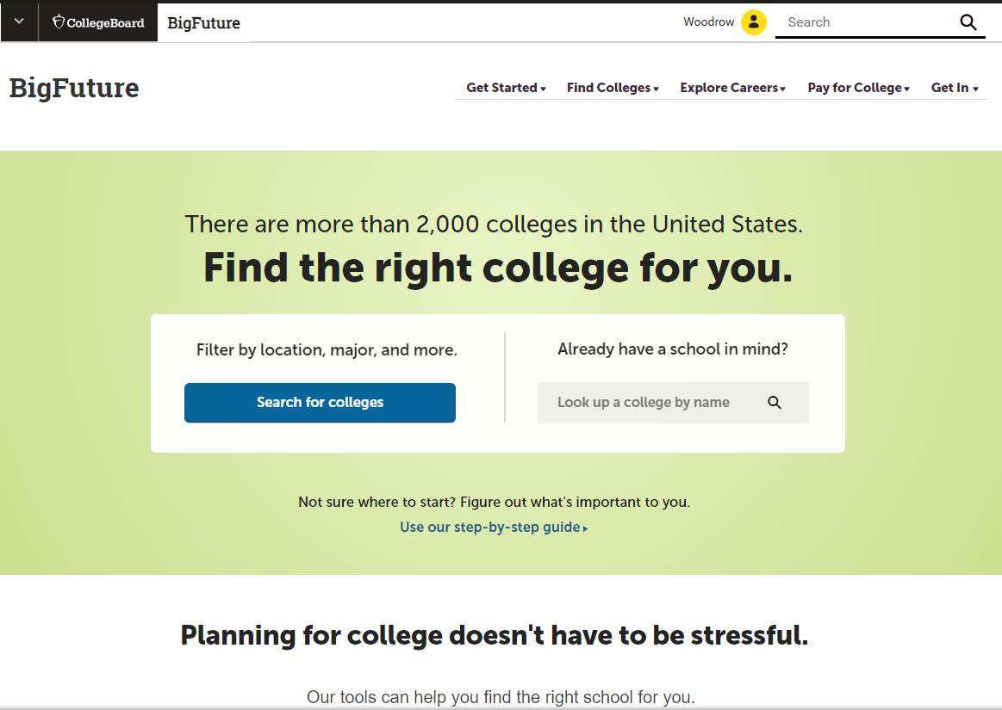
BigFuture™— Search Colleges, Scholarships, and Careers
Search for colleges.
Watch videos from real students.
Hear from education professionals.
Learn about different colleges.
Get help paying for college.
Build a personalized plan for
getting into college.
Notes:
Will demo features of the site
Students who take the PSAT/NMSQT have access to valuable tools that help them research colleges and careers. On BigFuture the website that helps students plan for college. It is a free, comprehensive website that guides students as they prepare for, find, and enroll in college. At bigfuture.org, students can:
Start with a focus on themselves: their interests, what and where they want to study, how much financial assistance they think they’ll need, and other important considerations.
Search for colleges and easily compare them based on factors ranging from majors to size and location.
Watch videos from real students who explain what they did to get into college and what their college experiences have been like.
Hear from education professionals who provide the inside story on preparing for and getting into college.
Learn about the different kinds of colleges and how to find one that is the right fit for them.
Find valuable help in paying for college by discovering what goes into college costs and how to find financing.
Build a personalized plan for realizing their goals and getting into a college that meets their needs.

Slide 54
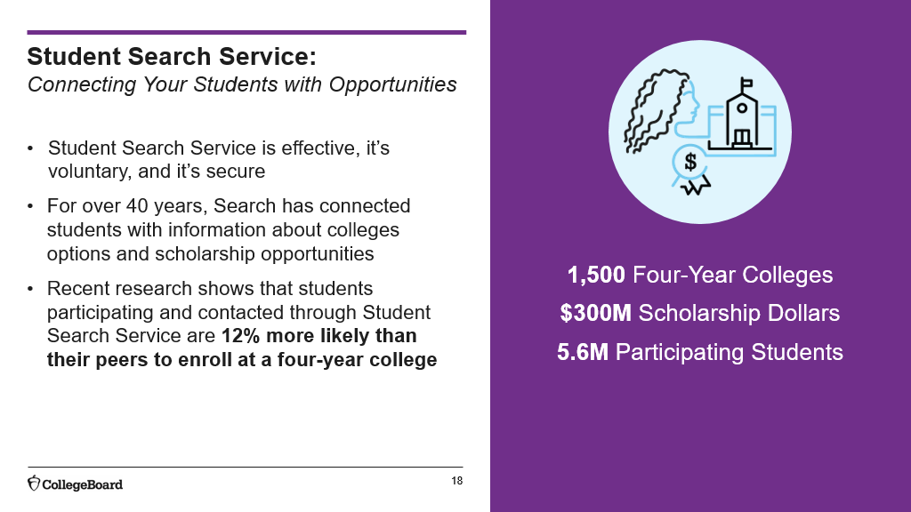

Slide 55
College Board Opportunity Scholarships
Launched in December 2018, the program now recognizes more winners and addresses affordability concerns by connecting students with other scholarships and aid.
Students earn chances at scholarships by completing six key actions along the path to college. Scholarships are awarded monthly through drawings among all eligible students.
Half of the scholarships (more than $2 million a year) are designated for students whose families earn less than $60,000 per year. Students who qualify have more chances to earn money for college.
More than 7,000 students each year will earn a total of nearly $5 million in scholarships.
Notes:
The College Board Opportunity Scholarships launched in December 2018.
Now more than ever, students and families are concerned about how to pay for college. The College Board Opportunity Scholarships program has evolved to address these concerns and support students as they navigate the college planning and financial aid process—no matter their circumstances.
The program guides students through the college planning process and offers students a chance to earn money for college for each action they complete.​ Think of it as a college planning tool-meets-scholarship program.
Students earn chances at scholarships by completing six key actions along the path to college. Scholarships are awarded monthly through drawings among all eligible students.
More than 7,000 students each year will earn nearly $5 million in scholarships.
Half of the scholarships – more than $2 million each year – will be designated for students whose families earn less than $60,000 per year.

Slide 56

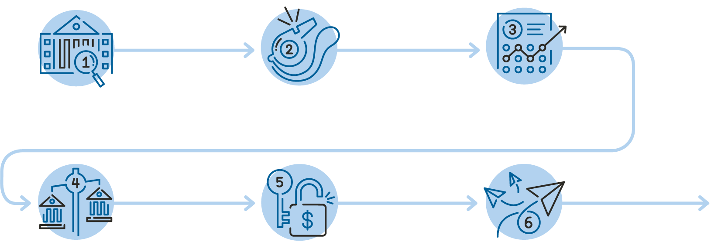
The 6 Key Actions to Prepare for College
Build Your College List $500
(1,800 Scholarships)
Get started by exploring colleges that interest you on BigFuture™.​
Practice for the SAT $500
(2,200 Scholarships)
Get ready for test day with Official SAT Practice on Khan Academy®.​
Explore Scholarships $500 (800 Scholarships)
Find scholarships and other aid to help you pay for college.
Strengthen Your College List $500 (400 Scholarships)
Make sure your college list has a mix of safety, match and reach schools.
Complete the FAFSA $500
(1,700 Scholarships)
Fill out the free government form to apply for financial aid.
Apply to Colleges $500
(300 Scholarships)
Apply to the colleges you want to attend.
Notes:
Here is how the program works: The College Board Opportunity Scholarships program lays out six steps that all students should take when applying for college – three steps junior year and three steps senior year.
Research shows how important these steps are in being able to apply to and go to college.
By completing each step, students will earn a chance for a scholarship, and by completing all six steps, students will earn a chance to win a $40,000 scholarship for their college education.
Scholarship recipients will be selected randomly through a drawing each month, and as previously mentioned, students whose families earn less than $60,000 per year have extra chances at earning the scholarships.
The 6 steps in this program begin in the students’ junior year and continue into their senior year:​
​
First: Build Your College List ​
Many students start their college research too late and many students don’t explore colleges broadly enough, missing out on schools that could be a great fit for them. This scholarship prompts students to get started by exploring colleges they’re interested in on our free BigFuture college planning website. Just by creating a college list with 6 or more schools on it, students will be eligible for one of 1,800 scholarships each worth $500.​
​
Second: Practice for the SAT ​
We partner with Khan Academy to offer students Official SAT Practice on Khan Academy. It offers free, personalized practice and the research shows how it helps students prepare for the SAT. When students complete at least one Timed Mini Section or one Diagnostic Quiz on Official SAT Practice on Khan Academy, they will be eligible for one of 2,200 scholarships each worth $500.
​
Third: Explore Scholarships
It’s never too early to start thinking about how to make college affordable. When students explore scholarships and other aid in College Board Scholarship Search, they become eligible for one of these 800 scholarships, each worth $500.
Fourth: Strengthen Your College List ​
This fourth scholarship opens up to students as they head into their senior year. It is all about making sure their college list has a good mix of academic safety, match, and reach schools. By creating a well-balanced college list on BigFuture, students will be eligible for one of 400 scholarships each worth $500.​
​
Fifth: Complete the FAFSA​
This fifth scholarship is all about making sure students know to fill out the Free Application for Federal Student Aid, also known as the FAFSA. Data shows that students who fill out the FAFSA for financial aid are more likely to apply to, go to, and complete college. The form opens up on October 1st of senior year, so by completing the form with their families students will be eligible for one of 1,700 scholarships each worth $500. We often get questions about how this step will work for undocumented students: undocumented students – and any other students who don’t have a Social Security Number and/or who are ineligible to complete the FAFSA (ex: international students who attend high school in the US) are still eligible for this scholarship.
​
Sixth and last step: Apply to Colleges​
The sixth and final scholarship activity is all about applying to college. By applying to at least two colleges, students will be eligible for one of 300 scholarships each worth $500

Slide 57
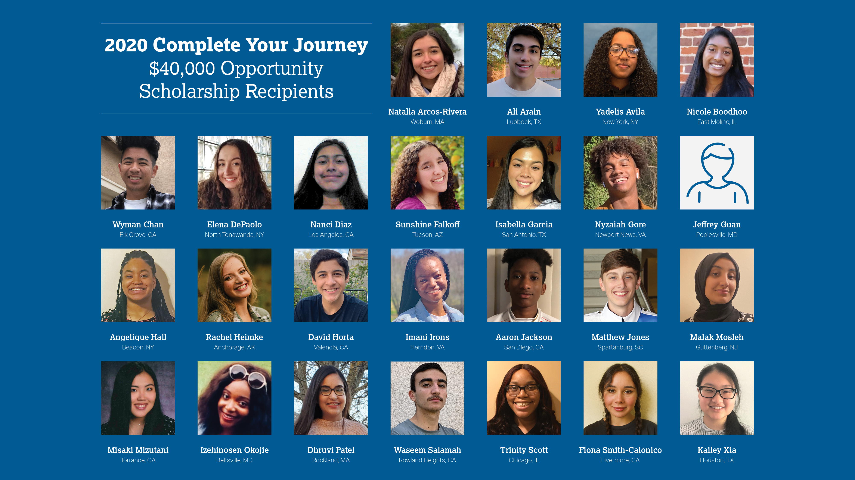
When students complete all six steps, they are eligible for a $40,000 scholarship
Notes:
Students who earn an entry for all six steps will earn a chance at a $40,000. 25 of these scholarships will go to students all over the country.

Slide 58
Additional Resources

Slide 59
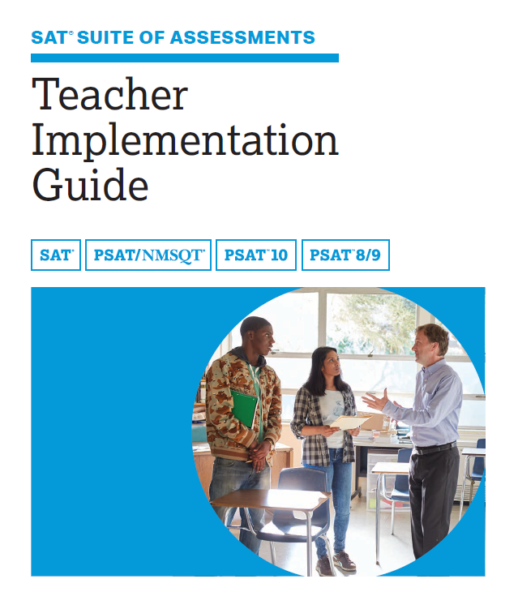
Read the Teacher Implementation Guide
SAT.org/k12
For DTCs, Test Coordinators, and all Curriculum staff
Information and strategies for teachers in all subject areas
Overview of content and structure for the SAT Suite of Assessments
Test highlights
General Instructional Strategies
Sample test questions and annotations
Skill-Building Strategies for the classroom
Keys to the SAT (information pertaining to the SAT Suite structure and format)
Rubrics and sample essays
Scores and reporting
Advice to share with students
Notes:
The teacher implementation guide is a manual that explains the changes in the redesigned SAT and suggests instructional strategies to prepare and support students. Use it as a book club selection in PLCs. Download it for free at sat.org/k12

Slide 60
NM SAT School Day Training
Professional Development | Audience | Timing
Learn about Accommodations and Supports and using SSD Online | Test Coordinators, District Test Coordinators, SSD Coordinators | Available now – click here
Bulk Registration Webinar | District Test Coordinators are invited to learn the process for uploading and registering additional students via the Bulk Registration Tool. | Available now – click here Password to access: NMPED_Spring2021
Digital Readiness Implementation Overview | Technology Coordinators, District Test Coordinators, School Test Coordinators, and school administrators are invited to participate in this training to begin preparing for digital specific activities. | February 16th Registration email will be sent soon.
College Board Accommodations and Supports Q&A Sessions | Test Coordinators, District Test Coordinators, SSD Coordinators. | February, March, April

Slide 61
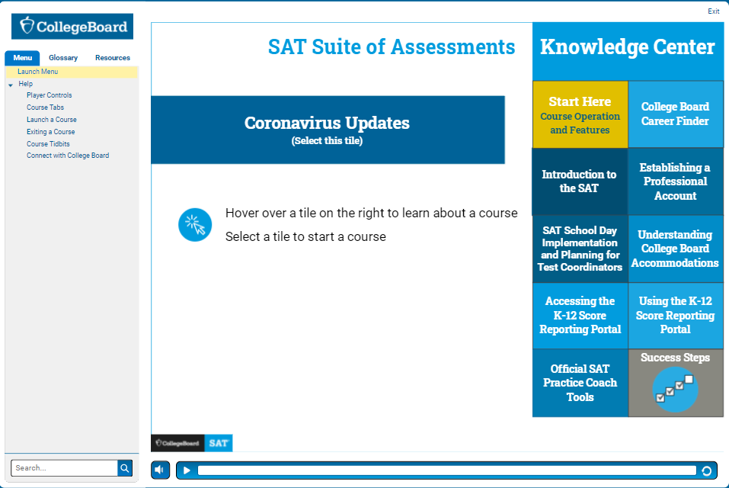
Other College Board Professional Development
For DTCs, Test Coordinators, and SSD Coordinators
New Mexico Customized Training
E-learning Modules
Self-Directed Courses
Find more at:
https:\\collegereadiness.collegeboard.org/educators/k-12/professional-development
Notes:
We also have professional development resources available for you and your teachers. At sat.org/PD, you’ll find e-modules that walk through the most important information about the SAT, Official SAT Practice, and the K-12 Score Reporting Portal. click I’d like to highlight the Success Steps series, in which educators like you share their processes and programs that support all students.
In addition, there are 10 PowerPoint decks meant to be used as self-guided courses that principals and teachers can use while collaborating to understand the skills tested on the SAT Suite of assessments.

Slide 62
Thank You
SAT School Day contact:
adam.rios2@state.nm.us
Phone: (505) 250-3175
College Board New Mexico Email: NMSAT@collegeboard.org

