Slide 1
ASR Fall Administration Paper Materials
October 12, 2022
Investing for tomorrow, delivering today.
Notes:
To change the image on this slide, select the picture and delete it. Then click the Pictures icon in the placeholder to insert your own image.

Slide 2
Housekeeping
Please remain on mute
Camera use is encouraged
Submit questions via Google document link
The meeting is being recorded and available through Canvas.
Closed Captioning is available
Click on this icon
Then, select “Show Subtitles”

Slide 3
Presentation Team
PED Team
Nick Salazar: Assessment Coordinator
Nicholas.Salazar@state.nm.us
Axel Hernandez: Senior Program Coordinator
Axel.Hernandez@Cognia.org
Cognia Team
Larry Ehret: Lead Program Manager
Larry.Ehret@Cognia.org
Mara Allaire: Program Manager
Mara.Allaire@Cognia.org
Sarah Owens: Senior Program Manager
Sarah.Owens@Cognia.org

Slide 4
The Fall Administration is an opportunity for Seniors, who have NOT TAKEN the Grade 11 ASR – Science Summative Assessment.
NM-ASR Fall Administration

Slide 5
Key Dates
Test Administration Window
Begins October 3, 2022
Ends October 21, 2022
Additional Materials ordering window closes October 20, 2022.
UPS pick-up window for return of paper test materials is October 3 – October 24, 2022
UPS pickup scheduling (in iServices) must occur no later than October 21, 2022 at 1 p.m. (MT).

Slide 6
Paper Testing Booklets
Test booklet with inserted answer document within the test booklet
The test booklets contain “Spring 2022” on the front cover
NM-ASR Special Forms: Large Print, Braille
Large Print kits contain:
Large Print Test Booklet
Regular size test booklet and answer document
Reference sheets as applicable by content and grade
Large Print Instructions
Braille kits contain:
Braille Test Booklet
Regular size test booklet and answer document
Reference sheets as applicable by content and grade
Braille Instructions
All used and unused paper materials needs to be returned.

Slide 7
Paper Testing – Biogrid
Pre-ID labels were not provided for the ASR Fall Administration
Carefully fill in the student identification information using the biogrid on the last two pages of the answer document or integrated test booklet and answer document
Ensure all student information in the biogrid is accurate.
Errors in the biogrid will require clean-up of student data prior to reporting.

Slide 8
Test Report Codes/Test Completion Status
For students who did not complete testing, it should indicate the reason.
Withdrew Before Completion
Non-Allowed Modification
Language Exempt for Reading Only
Medical Emergency
Parent Refusal
Other Non-Completion
Test Irregularity
Absent
COVID Exemption
Paper Testing – Test Completion Status (Box G)

Slide 9
Paper Testing –Accommodarions
IEP/504 Accommodation-indicate any Accommodations provided to the student based on their IEP/504
EL Accommodations – indicate any EL Accommodations provided based on the their ELAP
Void – used only if the test should not be scored

Slide 10
Paper Testing – Contaminated Materials
Secure materials that have been contaminated by biohazardous materials should not be returned to Cognia.
Complete the Contaminated Booklet Report Form found in the Help & Support site here: https://newmexico.onlinehelp.cognia.org/handling-contaminated-pbt-materials/
Please follow the instructions provided in “How to Handle Contaminated PBT Materials” document to complete this form and return to Cognia.
If the contaminated test material is a used answer document, transcribe the answers from the contaminated answer document into a fresh document.
Securely destroy the contaminated material(s).
Complete instructions on handling contaminated secure materials are located on the Help and Support site Contaminated Materials section.

Slide 11
Returning Paper Materials
Envelopes are provided with the shipment of paper test materials.
Used, Partially Used, and Voided Answer Document Envelope(s)
Special Handling Envelope
Should contain any damaged used answer documents or answer documents with typed pages.
A memo on district or school letterhead explaining why each used answer document is included in this envelope.
This envelope may be empty
Unused, Blank Answer Documents Envelope(s)

Slide 12
Paper Testing – Returning Materials
Envelopes should be sealed and placed in the box to return to Cognia in the following order:
Materials not boxed in the appropriate order will cause delay in scanning student responses
Manuals or any ancillary materials that accompanied tests should not be returned to Cognia. Please recycle these materials at your school or district. Manuals should not be saved for future administrations as directions may change.

Slide 13
Paper Testing – Scheduling UPS Pickup
UPS will not automatically pick up your test materials at the end of the window.
UPS pickup requests must be submitted through iServices during the secure materials pickup window
Closes October 21, 2022, 1pm MT
All secure materials must be picked up for return no later than October 24, 2022
If you hand your box(es) to your regular UPS driver without scheduling the pickup in iServices, you will need to notify the Cognia New Mexico Help Desk by phone or email when the box(es) have been handed off to the UPS driver.

Slide 14
Testing Irregularities and Security Breaches
Testing Irregularity
Any incident in the handling or administration of a test that results in questioning the accuracy of the data or security of the test.
May or may not result in a test invalidation.
DTCs must report testing irregularities to PED by phone/email within 3 days and complete the Testing Irregularity Report Form in the Test Coordinator Portal with 10 days.
Security Breaches
An incident where a large-scale breaches in test security where the integrity of the tests have been compromised.
If a security breach is suspected, the DTC should contact the PED by phone/email as soon as the breach is discovered. A Testing Irregularity Form should also be completed.
PED will provide guidance and next steps if a Large-Scale Breach has been identified.

Slide 15
How Are Reports Provided and When?
Student Reports will be provided in three formats:
Online for educators using Data Interaction
Online for families using the Family Portal
Student Results labels for student cumulative file
Paper family reports will not be provided

Slide 16
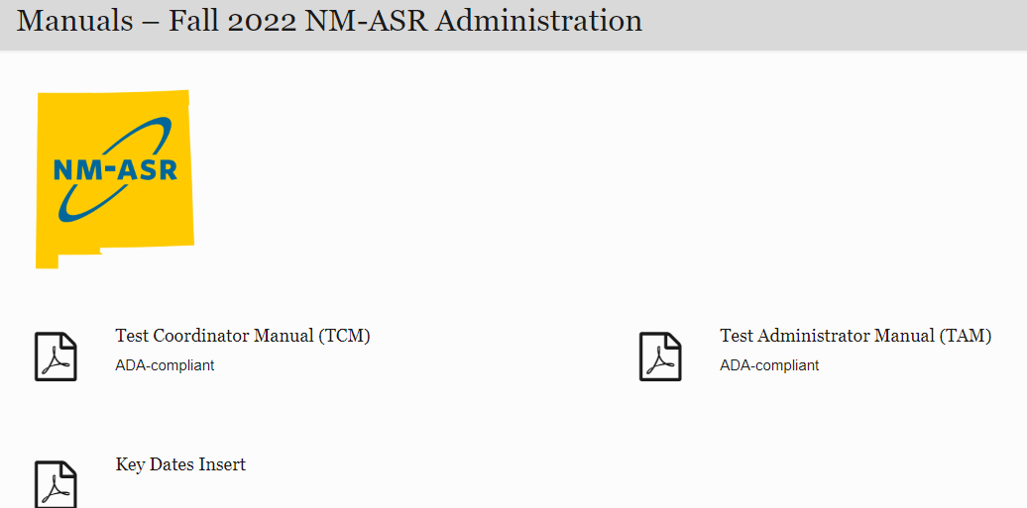
Where do I Find Resources or Ask for Help?
Link to the Cognia NM Help & Support site: https://newmexico.onlinehelp.cognia.org/

Slide 17
Q & A
PED Team
Nick Salazar: Assessment Coordinator
Nicholas.Salazar@ped.nm.gov
Axel Hernandez: Senior Program Coordinator
Axel.Hernandez@ped.nm.gov
Cognia Team
Larry Ehret: Lead Program Manager
Larry.Ehret@Cognia.org
Mara Allaire: Program Manager
Mara.Allaire@Cognia.org
Sarah Owens: Senior Program Manager
Sarah.Owens@Cognia.org

Slide 18
Questions for PED?
Questions
If time allows, we will identify a few questions
We will review questions during Q & A session in the afternoon
Questions submitted into Google docs will be posted as FAQs in Canvas

