Slide 1
Terms and Acronyms
iTester: eMetric test administration system used with Cognia assessments (iMSSA, Formative, NM-MSSA, NM-ASR)
New Mexico PED Assessments (NMPEDA) Portal (aka “Portal”)
New Mexico PED Assessments Student Test Interface
Kiosk (Web Browser option for Interim/Formative)
Data Interaction: eMetric reporting system for LEAs, accessed via the Portal
Family Portal: eMetric reporting system for parents
Roles:
DTC: District Test Coordinator
STC: School Test Coordinator
TA: Test Administrator (or teacher)
ITC: Information Technology Coordinator
RA: Report Access
See online video tutorials for demonstrations!

Slide 2
New Mexico Assessments Portal:
Online Test Administration System
New Mexico Assessments Student Test Interface:
Student Test Delivery System

Slide 3
New Mexico Assessments Portal:
Online Test Administration System
https://newmexico.cognia.org/
Manage user accounts
Add and update students, assign accommodations (DTC/STC only)
View student rosters
Create classes
Schedule classes for a test
Print student log-in tickets
Monitor student testing
View and download reports in Data Interaction
See online video tutorials for demonstrations!

Slide 4
New Mexico Assessments Student Test Interface:
Student Test Delivery System
Two ways to access this:
New Mexico Public Education Department Assessments Kiosk
Must be downloaded and installed onto each student test device
Required for summative
Optional for interim and formative
New Windows kiosk AY 2022-2023 released 11 Nov 2022
New Mac kiosk release 12 Dec 2022
Chrome and iPad Kiosks available from app stores, automatically updated after initial install
Web browser:
https://newmexico.cognia.org/student
Practice tests
Interim and Formative only!

Slide 5
Test Preparation Process
ITC
Download and Install kiosks (if required)
Complete Site Readiness Test
DTC/STC
Add/edit/transfer students
Assign accessibility features and accommodations
DTC/STC
Make classes
Schedule classes for test (20 March 2023)
Print/distribute log-in tickets
Students
Launch kiosk
Log-in and test
When test window opens on 27 March 2023
During or after testing…
DTC/STC
If needed, add test report codes and invalidate tests
DTC/STC/RAO
View Reports

Slide 6
2022-2023 Key Dates
Annual system maintenance/cleanup window in June
Previous school year students, classes, test sessions removed
Upload 2022-2023 rosters anytime
Once a student is in the Portal, they can be used for all subsequent assessment windows in the school year.
Reporting data remains in Data Interaction in definitely
New Windows kiosk available to download | 11 Nov 2022
New Mac kiosk available to download | 12 Dec 2022
MOY Interim Window | 5 December 2022 – 20 January 2023
State Pre-ID upload (Pre-ID window temporarily closed) | 21 Jan – 25 Jan 2023
Window for identifying paper testers in the NMPEDA Portal | 26 Jan – 3 Feb (5p.m. MT) 2023
MSSA/ASR tests available to schedule | 20 March 2023
Pre-ID Upload Turned-off | 24 March 2023
MSSA/ASR testing begins | 27 March 2023

Slide 7
Key differences between Summative (MSSA and ASR) and Interim/Formative (iMSSA)
Summative | Formative/Interim
Students must use kiosk to access test | Students can access tests using a web browser or kiosk
Session Access Codes and Proctor Passwords are used | Session Access Codes and Proctor Passwords are NOT used
ASL, Spanish tests and TTS available | No ASL, limited Spanish tests and TTS
Machine or professionally scored tests with later reporting | Interim: next day reporting Formative: teacher scoring and near real-time results

Slide 8
User Accounts and Access
New DTC: account will be created by Cognia & credentials e-mailed to you
Already have a user account? Continue to use it!
Not a DTC, don’t have an account?
STC/ITC/RAO/TA: request account from your DTC
Notes:
Usernames must be unique
New users will receive two automated emails, one with username and one with temporary password from nmtechsupport@cognia.org
When an account is reactivated or deactivated, the user will receive an e-mail
Know your username, ensure the e-mail address associated with the username is correct
Users have access to all programs by default. Remove program access if the user should not have access to the program.
Programs: ASR, MSSA, iMSSA, Formative
DTCs and STCs must review all accounts in their organization and deactivate any un-used accounts!
See online video tutorials for demonstrations!

Slide 9
User Accounts and Access
Access | DTC | STC (for orgs assigned) | ITC (for orgs assigned) | TA (for orgs assigned) | RAO (for orgs assigned)
Manage Users | Yes | Yes | Yes | View TAs only | No
Access Site Readiness Links | Yes | Yes | Yes | No | No
Access Proctor Password | Yes | Yes | No | No | No
Access Students | Yes | Yes | No | Limited | No
Edit Student | Yes | Yes | No | No | No
Access Roster Upload | Yes | No | No | No | No
Access Classes | Yes | Yes | No | Yes | No
Access Test Sessions | Yes | Yes | No | Yes | No
Download Test Completion Status | Yes | Yes | No | No | No
Student Enrollment Transfer | Yes* | Yes* | No | No | No
Access Dashboard | Yes | Yes | No | No | No
Reports | Yes | Yes | No | Yes (classes only) | Yes (for assigned orgs)
*DTCs can access all student enrollment transfer functions, STCs have limited permissions

Slide 10
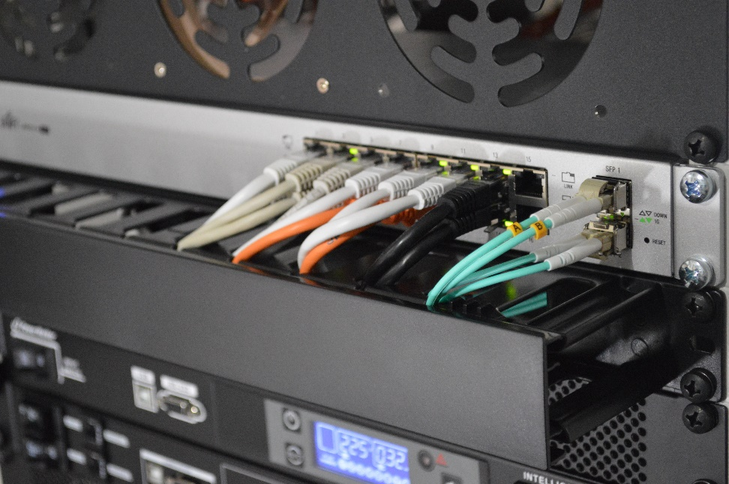
Site Technology Preparation

Slide 11
Kiosk Requirements
Windows and Mac Applications
Available to download in Portal
Newest Windows app version released 11 Nov 2022
Newest Mac app version to be released 12 Dec 2022
iPad and Chromebook Applications
Download directly from App Stores
Download “iTester” iPad app and select state on 1st log-in
iPad and Chrome apps will auto-update to the newest iTester version
Browser (practice test, interim and formative only)
Available on Chrome, Safari, Firefox, and Microsoft Edge
If the last kiosk application you installed was prior to the release dates above, you need to download and install the newest version and complete site readiness testing with that version.
The newest Windows version is 3.28. Windows version 3.27 can also be used but this version does not have a feature that prevents a student from using Spanish TTS unless they have Cepstral installed.
The newest Mac version is 3.29.2 Mac versions 3.27.2 and 3.28 can also be used but these versions do not have a feature that prevents a student from using Spanish TTS unless they have Cepstral installed and these versions do not have a bug fix that may fixes a bug that prevents network connection to the test servers on Mac OS 12.1 and above.
We strongly recommend ITCs complete Site Readiness Testing prior to the MSSA/ASR testing!

Slide 12
System Requirements
Updated!
System Requirements – All Hardware
Connectivity | Must be able to connect to the internet via wired or wireless networks
Screen Size | 9.7” screen size or larger/ “10-inch class” tablets or larger
Screen Resolution | 1024 X 768
Headphone/Earphone/Ear Buds | Headphones/earphones/ear buds are required for students who have a text-to-speech accommodation
Browser Requirements (Portal and Practice Tests)
Chrome™ 108 or newer Firefox® 107 or newer Safari® 16 or newer Microsoft Edge™ 107 or newer | Chrome™ 88 or newer Firefox® 84 or newer Safari® 14 or newer Microsoft Edge™ 88 or newer
Updated Dec 5th, 2022. Check the Cognia help and support site for more recent updates.

Slide 13
Desktop and Laptop Specific Requirements
CPU | 1.3 GHz
Memory | 2 GB (4GB strongly recommended)
Input Device | Keyboard – wired or wireless/Bluetooth® mouse or touchpad
Windows® | Windows 10 (20H2; 21H1; 21H2), 11
Mac® | Mac OS® 11.6, 12.6, 13 (64-bit only)
Tablet and Chromebook Specific Requirements
iPad® | iPadOS® 14, 15.7, 16.1
Chromebook™ notebook computer | Chrome OSTM LTS 102 Chrome OSTM Stable channel 105, 106, 107
Updated!
Google releases new versions to the stable channel every four weeks and new versions to the Long-term Support (LTS) channel every six months. eMetric strongly recommends the use of the LTS channel. The LTS channel offers more stability with fewer releases but devices will continue to receive frequent security fixes.

Slide 14
Practice Test Options
1. Use internet-based practice test with web browser
Best option for:
Practice testing with browser or on devices that do not have a testing kiosk installed
Note: all accommodations except allow accessibility mode and screen zoom are available
To access the practice test in web browser:
Launch Browser
go to https://nmpracticetest.cognia.org
Use the drop-down menu to select the practice test and click on “Go” button
2. Use internet-based practice test with student kiosk
Best option for:
Realistic practice testing in secure kiosk
Note: all accommodations are available except allow accessibility mode
To access the practice test in student testing kiosk:
Launch Kiosk
Click on the “Access the Practice Test” link
Use the drop-down menu to select the practice test and click on “Go” button

Slide 15
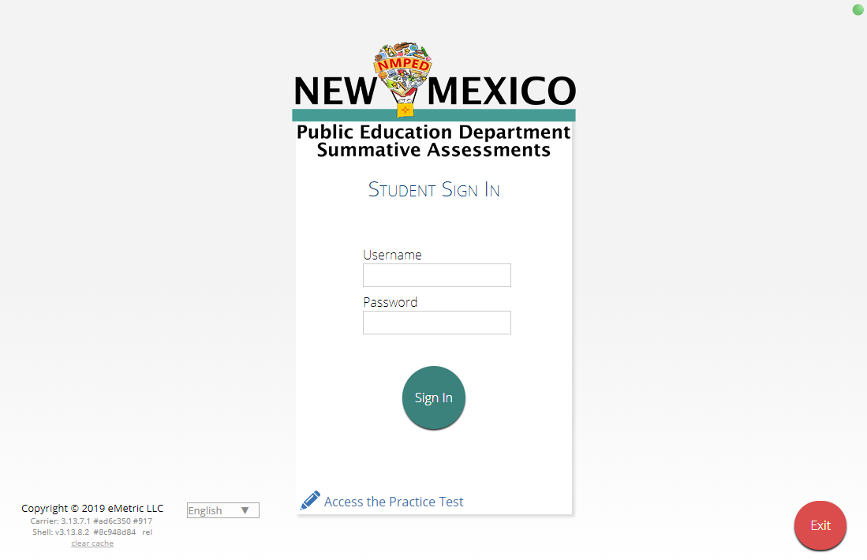
Practice Test

Slide 16
Additional Training Resources
Help Guides
Name
NMPED Assessments Portal User Guide
NMPED Assessments Kiosk Installation Guide
NMPED Assessments Technology Guidelines
NMPED Assessments Quickstart Scheduling Test Sessions
NMPED Assessments QuickStart Printing Student Log-ins
NMPED Assessments QuickStart Student Interface
NMPED Assessments QuickStart Practice Site
NMPED Assessments Kiosk User Guide
NMPED Assessments Testing with Third Party Assistive Technology
NMPED Assessments Technical Guide for Spanish Language Support
NMPED Reporting Guide

Slide 17
Additional Resources
Tutorial videos (https://newmexico.onlinehelp.cognia.org/cbt-tutorials)
Certifying Your Site
Adding Students & Downloading School Rosters
Creating and Editing Portal User Accounts
Deactivating User Accounts
Uploading and Exporting User Accounts
Uploading Pre-ID Files
Resolving Pre-ID Errors
Support Desk
Portal Practice Site:
url: https://intro.emetric.net/
DTC login: NMADTC/N3wM3xico!
STC login: NMASTC/N3wM3xico!
TA login: NMATA/N3wM3xico!
View various menus and tabs
Pre-loaded students and classes
Can schedule classes for a test
Nightly Clean-up
Not New Mexico-specific

Slide 18
iTester Changes and Updates
“Read Aloud to Self” is now an accessibility option (previously it was an accommodation).
Students cannot log in to invalidated test sessions. If a test session is invalidated the student will receive an error message when they select the test session after logging into the student test interface.
On the student record information tab, the Test Mode option “Both” has been removed.
The test mode options for ELA Test Mode, SLA Test Mode, Math Test Mode, and Science Test Mode are now “Paper”, “Online”, or “Not Applicable”.
“Both” is also no longer a valid option on Pre-ID upload files.
Test Report Codes have been updated as follows:

Slide 19
Data Interaction Changes and Updates
“All Grades Report” is available – DTCs can view and download roster report with multiple/all grades in one report
BOY and MOY iMSSA Projection Level adjusted to project MSSA performance
ASR Fall Retest reports are available - select 2022-2023 admin, Fall window
Total points possible and total points earned are now available in MSSA/ASR reports
New Feature: Data Suppression option is available for summary reports

Slide 20
Remember!
DTCs/STCs:
Review accounts and deactivate unused accounts
Once a student has been added in a Pre-ID upload or manually, they can be used in any assessment (MSSA, ASR, iMSSA, Cognia Formative)
ITCs:
New Windows kiosk released 11 Nov 2022
New Mac release 12 Dec 2022
Chrome LTS channel is strongly recommended!
Make sure network management tools don’t delete stored response folder

Slide 21
Questions?

