Slide 1
Program Overview:
Measures of Student Success & Achievement (MSSA),
Assessment of Science Readiness (ASR),
Spanish Reading SBA
December 13, 2022
Nick Salazar, Asst. Director of Assessment
Larry Ehret, Mara Allaire, Sarah Owens, Cognia
Liam Kinnison, eMetric
Investing for tomorrow, delivering today.
Notes:
To change the image on this slide, select the picture and delete it. Then click the Pictures icon in the placeholder to insert your own image.

Slide 2
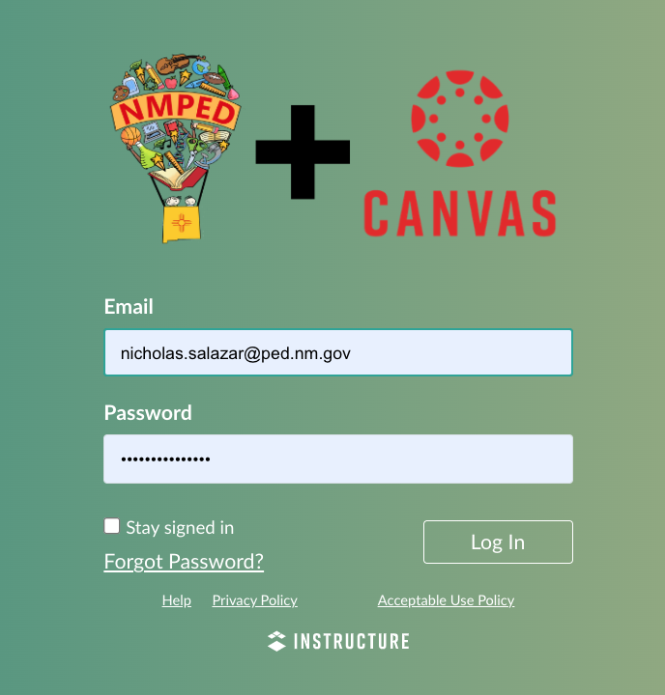
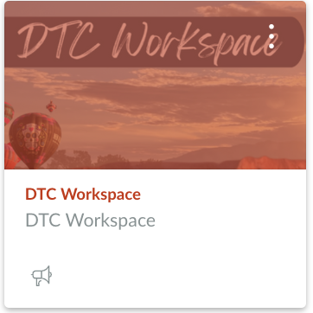
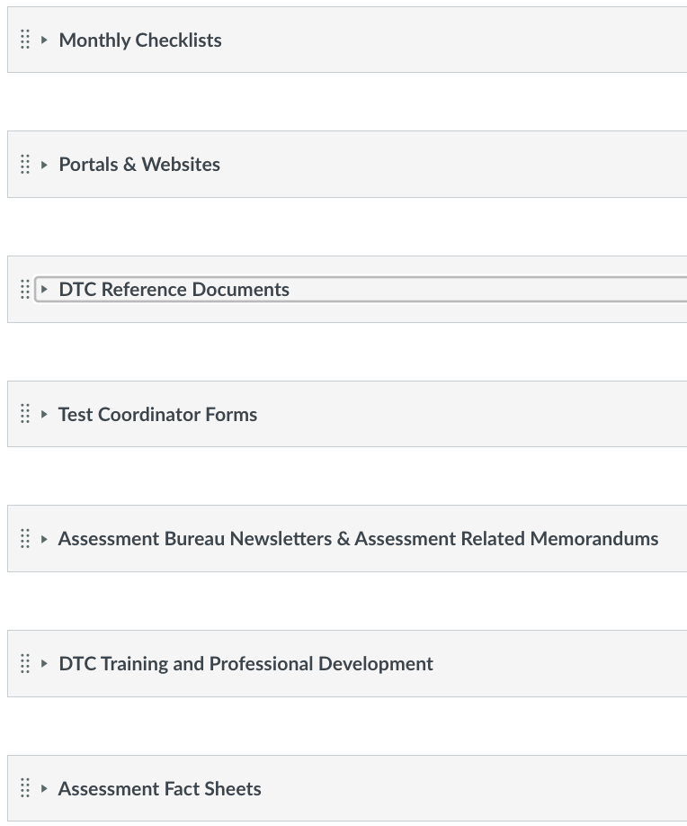
All Resources- DTC Workspace
All resources highlighted in this presentation are in the DTC Workspace in Canvas; This slide deck and a recording of today’s session are/will be available in the DTC Training and PD module.
Notes:
Lynn

Slide 3
New Mexico’s ESSA (Title 1) Assessments?
Only Those w/the Most Significant Cognitive Disabilities, Including ELs
Only ELs in General Education, Including Students w/Disabilities
General Education, Including ELs & Students w/Disabilities
ACCESS for ELLs
Measures of Student Success & Achievement (MSSA)
SAT School Day
Dynamic Learning Maps (DLM)
ELP* K-12
Math 3-8
Math 11
Math 3-8, & 11
*ELP = English Language Proficiency
ELA 3-8
Reading 11
Science 5, 8, & 11
ELA 3-8, & 11
Assessment of Science Readiness (ASR)
Standardized Based Assessment (SBA)
Only ELs w/the Most Significant Cognitive Disabilities
Science 5, 8, 11
Spanish Reading 11
Alternate ACCESS for ELLs
ELP* 1-12
Notes:
Lynn

Slide 4
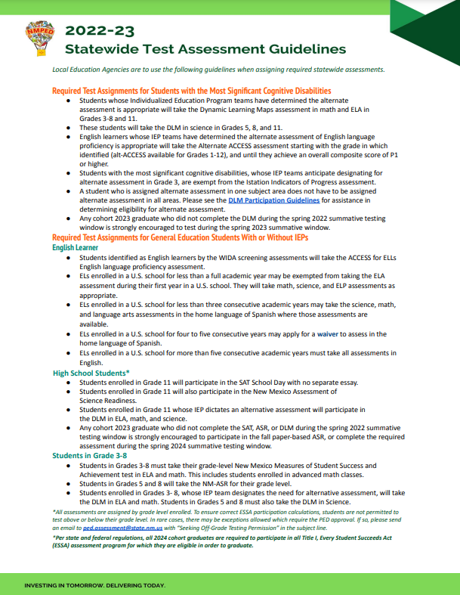
Follow the Test Assignment Guidance
NM-MSSA
All students, not designated for Alt.- Assessment, in grades 3-8
NM-ASR
All students, not designated for Alt.- Assessment, in grades 5, 8, 11, 12*
Spanish Reading SBA
11 and 12* grade EL students for whom the SAT-School Day ELA assessment is not appropriate.
*Cohort 2023 graduates who have not completed the ASR or SAT/Spanish Reading SBA can be uploaded and rostered for the assessment.
Notes:
Lynn

Slide 5
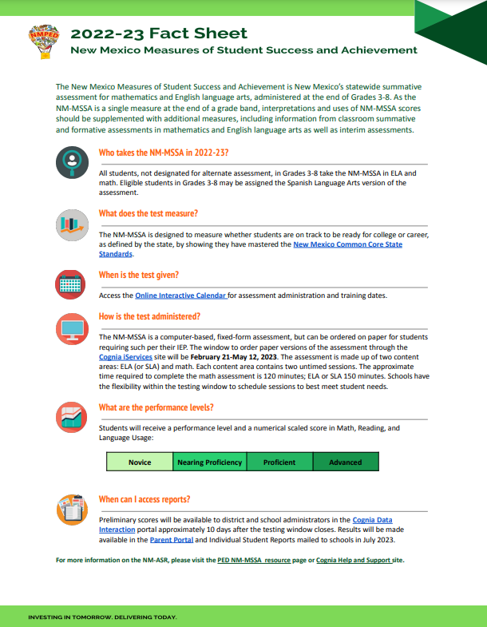
Overview- Assessment Fact Sheets
Each assessment Fact Sheet contains the following information:
A brief summary of the assessment
Guidance on which students are required to take the assessment
Information on what the test measures
Timeline for when the assessment is to be given and how the test is administered
What the performance-levels are
Where can score reports be accessed

Slide 6
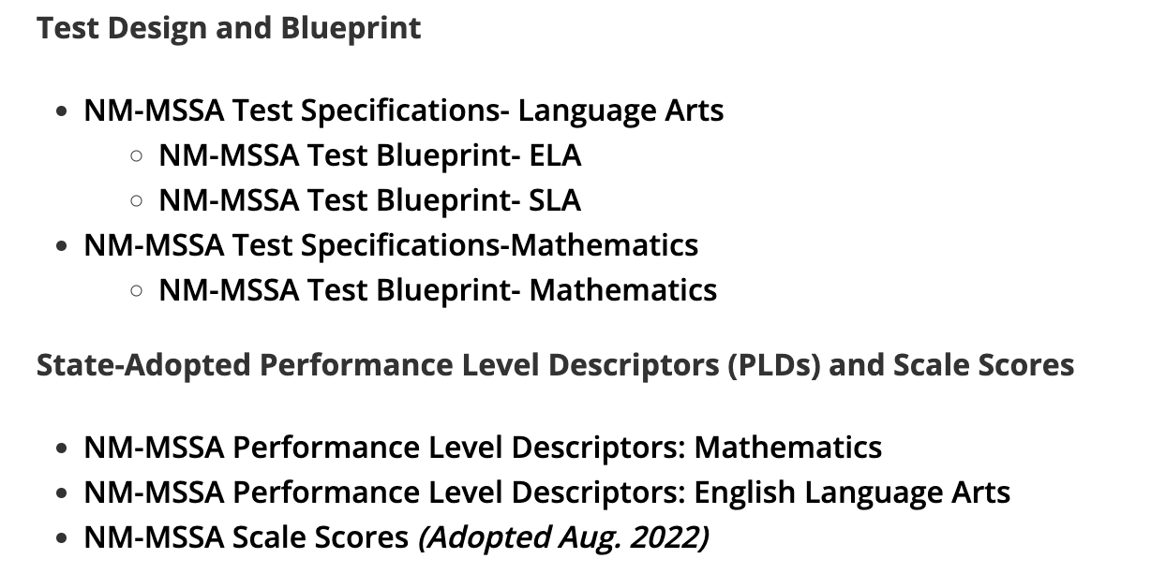
Overview- State Assessment Website
Make-up of the test, question types, complexity levels
Knowledge, skills, and abilities within each performance levels

Slide 7
Overview- State Assessment Website
Accommodations info.
Practice test information

Slide 8
Key Websites- iServices

Slide 9
Key Websites- Ed. Portal/Data Interaction
Educator Portal/Data Interaction is used to complete the administrative functions for the MSSA and ASR- rostering, test assignment, monitoring. This portal can also be used to view/download MSSA, ASR, and SAT-School Day student results.

Slide 10
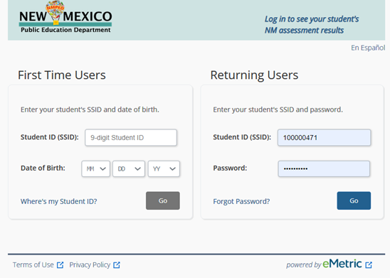
Key Websites- Family Portal
Family Portal is used by family members to access their student(s)’ test results. There is a Family Portal User Guide in English and Spanish as well as demonstration login accounts for teachers and administrators in the Family Portal Resources page.

Slide 11
Key Websites- Help & Support
The Help and Support site provides resources about all the assessments. The Cognia service desk can be contacted at 877-676-6722 or via email at nmtechsupport@cognia.org, Mon.-Fri. between 7-3p.m. (MST). A live chat function is also available.

Slide 12
Overview-MSSA
Test | Domain | Sessions | Estimated Time | Questions
NM-MSSA | ELA/SLA | Session 1 Reading | Untimed (60 min.) | 26
 |  | Session 2 Lang. Usage & Writing | Untimed (90 min.) | 18 plus 1 Writing Prompt (one of 3 purposes for writing)
 | Math | Session 1 No calculator | Untimed (60 min.) | 43 (Grades 3-5) 46 (Grade 6 and 7) 47 (Grade 8)
 |  | Session 2 Calculator | Untimed (60 min.)

Slide 13
Overview-ASR
Test | Sessions | Estimated Time | Questions
NM-ASR | Session 1 | Untimed (50-55 min.) | 17 (Grades 5&8) 18 (Grade 11)
 | Session 2 | Untimed (50-55 min.) | 17 (Grades 5&8) 17 (Grade 11)
 | Session 3 | Untimed (50-55 min.) | 14 (Grades 5&8) 16 (Grade 11)

Slide 14
Overview-Spanish Reading SBA
Test | Sessions | Estimated Time | Questions
Spanish Reading SBA High School | Session 1 | 60 minutes | 19
 | Session 2 | 60 minutes | 16
 | Session 3 | 60 minutes | 17
Total: | 3 Sessions | 180 minutes | 52

Slide 15
2022-23 Key Dates
Date | Activity | CBT or PBT | Activity Explained
24/7, all year | NM-MSSA and NM-ASR Practice Tests | CBT, PBT | Educators and students have access to both CBT and PBT practice tests
Dec. 5-Feb. 10 | Initial Materials Ordering Window | CBT, PBT | Order all testing materials
Jan. 20 (9pm) -Jan. 25 | Student Upload | CBT, PBT | PED uploads all students; portal will be closed to LEAs
Jan. 26-Feb 10 | Roster clean-up window | CBT | LEAs update and edit student information; assign appropriate accommodations

Slide 16
2022-23 Key Dates
Date | Activity | CBT or PBT | Activity Explained
Jan. 26-Feb. 3 | Paper Test ID | PBT | LEA must identify which students will test on paper.
Jan. 26-May 12 | Manual roster upload | CBT | LEAs can manually enter students throughout the testing window
March 6-May 11 | Additional Materials Ordering window | CBT, PBT | Window to order any additional materials required for testing
March 13 | Testing Materials Arrive | PBT | All materials ordered during initial window arrive at LEAs two weeks prior to the start of the administration

Slide 17
2022-23 Key Dates
Date | Activity | CBT or PBT | Activity Explained
March 20 | CBT Scheduling | CBT | LEAs receive the ability to schedule tests in online portal
March 27-May 12 | Summative Testing Window | CBT, PBT | LEAs must administer the MSSA, ASR, and/or SBA to all eligible students
April 3-May 9 | UPS Pick-Up Window | PBT | All paper testing materials must be returned via UPS
May 8; 1:00pm (MST) | Deadline to Schedule UPS Pick-Up | PBT | All UPS pick-ups must be scheduled at iServices site

Slide 18
2022-23 Key Dates
Date | Activity | CBT or PBT | Activity Explained
May 15-17 | Post-testing administrative work | CBT | LEAs should enter an exit code where appropriate
May 17; 5:00pm (MST) | Deadline to complete post testing work | CBT | LEAs will lose the ability to make changes to student information and/or exit codes
June | Results | CBT, PBT | LEAs can expect some results much sooner than during SP22

Slide 19
Roles and Responsibilities-DTCs
The DTC serves as the primary liaison with the PED Assessment Bureau and the testing vendors and is responsible for all forms that must be submitted to the PED.
The DTC is the primary source of assessment information for district staff, school staff, parents, and the community.
It is the DTC’s responsibility to keep the local educational agency (LEA) informed about current assessment policy and changes and to provide teachers with available resources for content area assessments.

Slide 20
Roles and Responsibilities-STCs
The STC is appointed at the local level, and there is no need to inform PED. The STC’s point of contact for matters relating to assessment is the DTC.
In some smaller districts, the DTC serves as STC for one or more schools in the district. Some districts and some test vendors use the term Building Test Coordinator (BTC) but this manual uses the term STC.

Slide 21
Roles and Responsibilities-TAs
The TA administers the assessment to the students by following the procedures provided in the TA manual.
Per 6.10.7 NMAC only licensed school instructors, counselors, student success advisors, administrators and instructional support providers shall administer a standardized test.
Substitutes, educational assistants, school nurses, and coaches shall not administer standardized tests unless the individual holds valid licensure to serve as a teacher, counselor, student success advisor, administrator, or instructional support provider.
Long-term substitutes who have taken over the teaching responsibilities of a class for a significant portion of time, who have been adequately trained in assessment security procedures and maintain one of the appropriate licenses, may serve as a test administrator.

Slide 22
Roles and Responsibilities-Proctor
Proctors assist TAs but may not act as a TA. Proctors are generally Educational Assistants (EAs) but can be anyone who does not hold one of the approved PED licenses. No proctor should assist with a group that has a child who is a close relative (child, grandchild, niece/nephew, etc.).
EAs may be permitted to support testing accommodations for a one-to-one and small group (under 5 students) testing under the supervision of a test administrator.

Slide 23
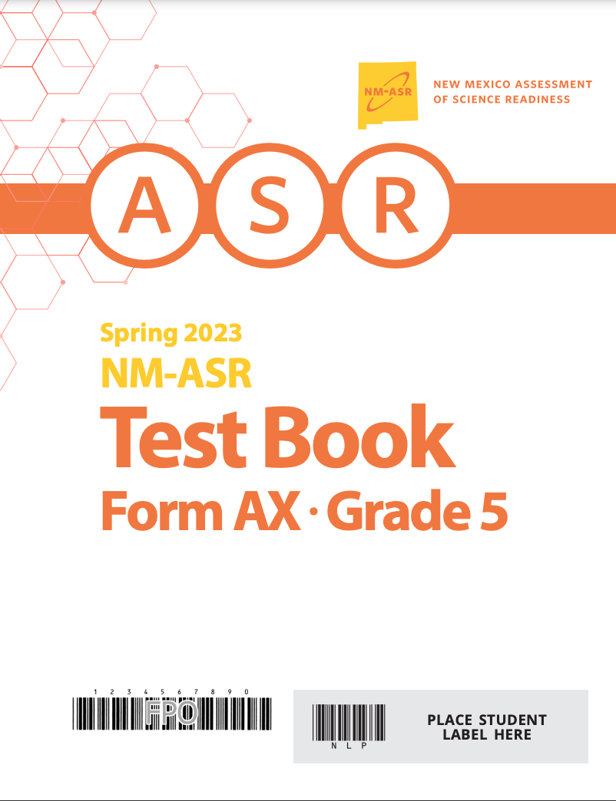
Ordering Testing Materials
The following materials must be ordered:
NM-ASR (CBT and PBT)
Spanish Reading SBA (Only available in PBT)
NM-MSSA (PBT)
NM-MSSA standard print
NM-MSSA certain accommodated versions (e.g. Braille, Human Reader kits, etc)
Extra copies of TCMs and TAMs
The following materials do NOT have to be ordered:
NM-MSSA (CBT)
NM-MSSA Spanish/SLA Versions (CBT)

Slide 24
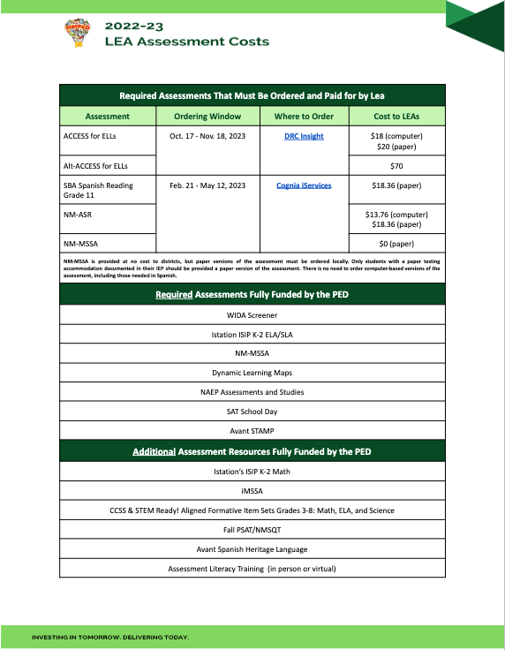
Ordering Testing Materials
All testing materials should be ordered through the Cognia iServices site
A PO is needed to complete materials ordering
The LEA cost for each assessment is outlined on the Assessment Costs sheet located in the DTC Workspace
LEAs will receive one TAM for every 25 students being administered the assessment and one TCM for every school administering the test; additional copies must be ordered at no additional cost
Online versions of TAM and TCM will available online on the Help and Support page on Jan. 11

Slide 25
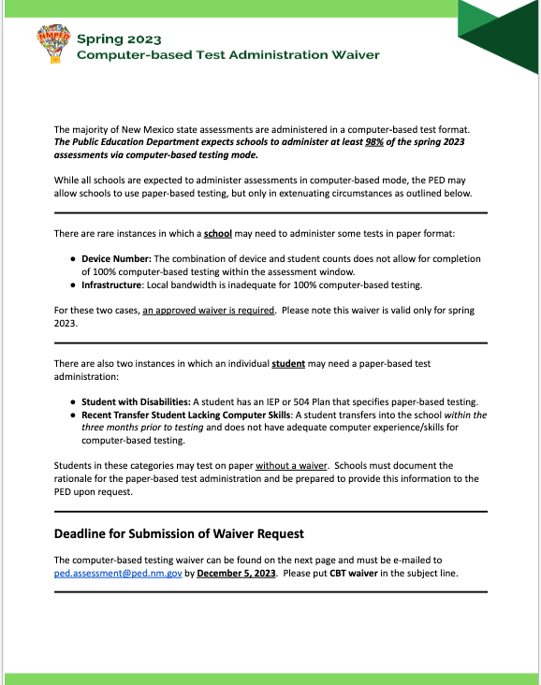
Testing Modes
New Mexico is a computer-based testing state meaning that LEAs should plan to test all students electronically
Only students with a paper-based testing need documented in his or her IEP should be allowed to test on paper
For LEAs who need to test entirely on paper due to serious IT issues, please complete the CBT Testing Administration Waiver located in the DTC Workspace
An LEA should not order mass PBTs prior to getting PED approval of the submitted waiver

Slide 26
Test Monitoring Using Educator Portal
Both NM-MSSA and NM-ASR are Title I, ESSA-required assessment. LEAs are required to test >95% of eligible students. DTCs are responsible for ensuring that every student at every school is tested.

Slide 27
Test Monitoring Using Educator Portal

Slide 28
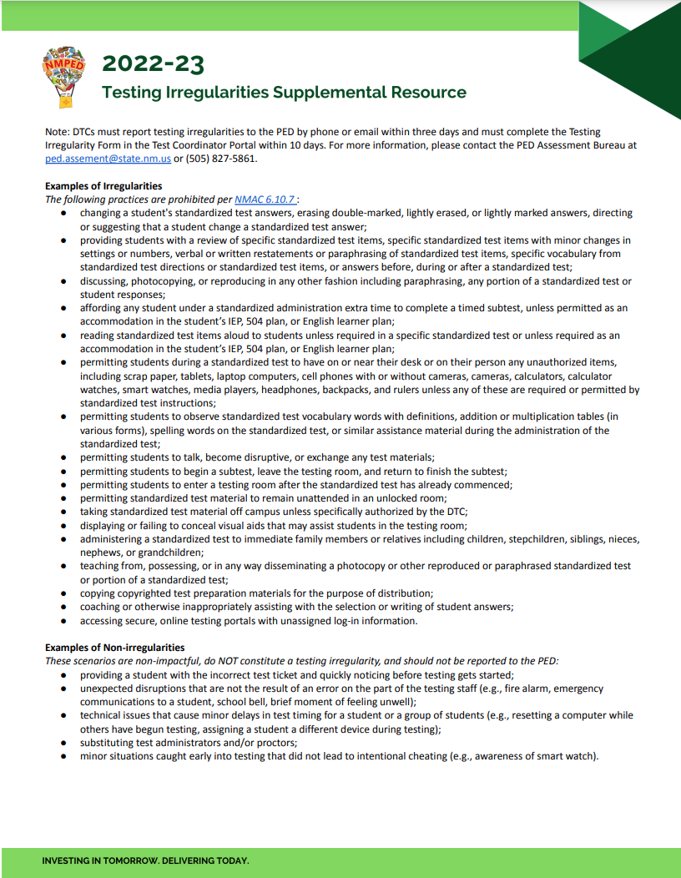
Testing Irregularities
All irregularities should be reported through the DTC portal
The Testing Irregularities Supplemental Resource is available to help determine if an action qualifies as a reportable irregularity
Please specify on your irregularity report whether you believe the session should be invalidated
The Assessment Bureau will make the final determination if an irregularity warrants a testing invalidation

Slide 29
General Rules-Testing Invalidation
If a test can be valid, it is valid; Try to not penalize a student by making them take an assessment multiple times
Invalidations are warranted for the following circumstances:
A student completes an assessment without accommodations documented in IEP, 504, or EL Plan
A student completes an assessment with accommodations not in an IEP, 504, or EL Plan
There is evidence that a student used a phone or electronic device to cheat or compromise test security
There is evidence that the TA or proctor did not follow the standardized testing procedures outlined in the TAM

Slide 30
General Rules-Testing Invalidation
Invalidations are not warranted for the following circumstances:
A student must leave the assessment before completion; in this case, simply allow the student to pick up where they left off when they return to school, but ask TA to monitor that the student does revisit previously completed questions
Student is caught with a phone or other electronic device, but no evidence of cheating or a test security breach can be found
A student accidentally submits the assessment before finishing; in this case, you must send an email to PED, and they will authorize Cognia Help and Support to “re-open” the test
Students test using another’s testing ticket; in this case, email PED and have them request a score swap

Slide 31
Test Completion Status
Withdrew Before Test Completion: Student withdrew from LEA before beginning and/or completing the assessment
Language Exempt for Reading: Student is an EL student in his or
PED-Approved Medical Exemption: LEA has an approved medical exemption on file for the student
Parental Refusal/Non-compliance: Despite LEA’s best efforts, parent refuses to bring student in to test or student refuses to sit and complete the assessment
PED-Approved Test Invalidation: An invalidation was warranted and student has a duplicate test with a valid score
Absent During Window/Chronically Absent: Student and/or family was in quarantine; student was absent during the duration of window; student is chronically absent

Slide 32
Additional MSSA, ASR, SBA Trainings
Date | Training | Potential Topics
Week of Jan. 30 | Office Hours | Materials ordering, manual uploads
Week of Feb. 20 | Office Hours | Materials ordering, manual uploads
Week of March 6 | Office Hours | Test Scheduling/Accommodations
Week of March 20 | Office Hours | Final Preparations
Weekly Throughout the Testing Window | Office Hours | Monitoring, Exit Codes, Materials Ship Back

Slide 33
Primary Contacts for MSSA, ASR, SBA
PED Team
Nick Salazar: Asst. Director of Assessment
Nicholas.Salazar@state.nm.us
Axel Hernandez: Senior Program Coordinator
Axel.Hernandez@Cognia.org
Xavier DeLeon: Program Manager Cognia
Xavier.DeLeon@state.nm.us
Cognia Team
Larry Ehret: Lead Program Manager
Larry.Ehret@Cognia.org
Mara Allaire: Program Manager
Mara.Allaire@Cognia.org
Sarah Owens: Senior Program Manager
Sarah.Owens@Cognia.org

Slide 34
Questions for PED?
Questions
If time allows, we will identify a few questions
We will review questions during Q & A session in the afternoon
Questions submitted into Google docs will be posted as FAQs in Canvas

