Slide 1
2022 Fall DTC Training
Assessment Bureau Team
Investing for tomorrow, delivering today.
Notes:
To change the image on this slide, select the picture and delete it. Then click the Pictures icon in the placeholder to insert your own image.

Slide 2
Welcome and Updates
2022-23 summative assessment results are available
Individual student results available in Cognia DI portal
Participation rates available in SOAP
The Cognia Family Portal will open on September 16
Paper ISRs will be delivered to schools by October 25
Avant STAMP now managed by Assessment Bureau
KOT now co-managed by Literacy and Humanities & Assessment Bureau
Notes:
LV Slides 2-3 (10 minutes)

Slide 3
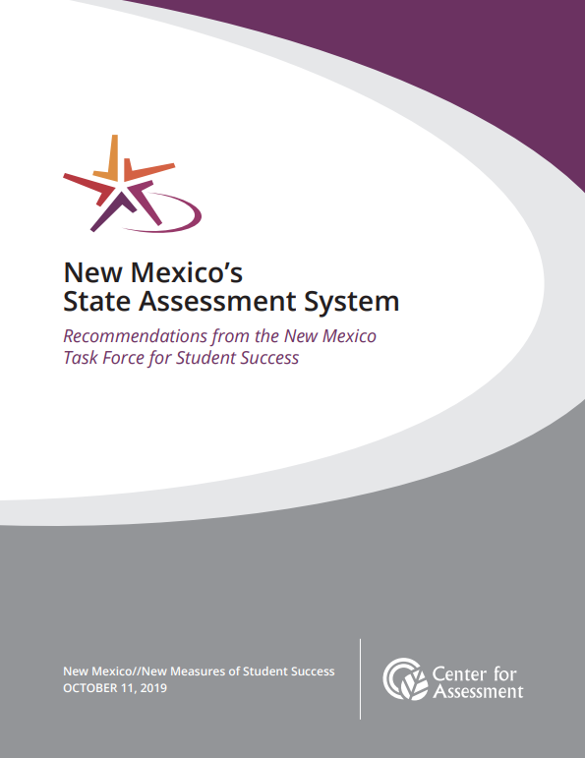
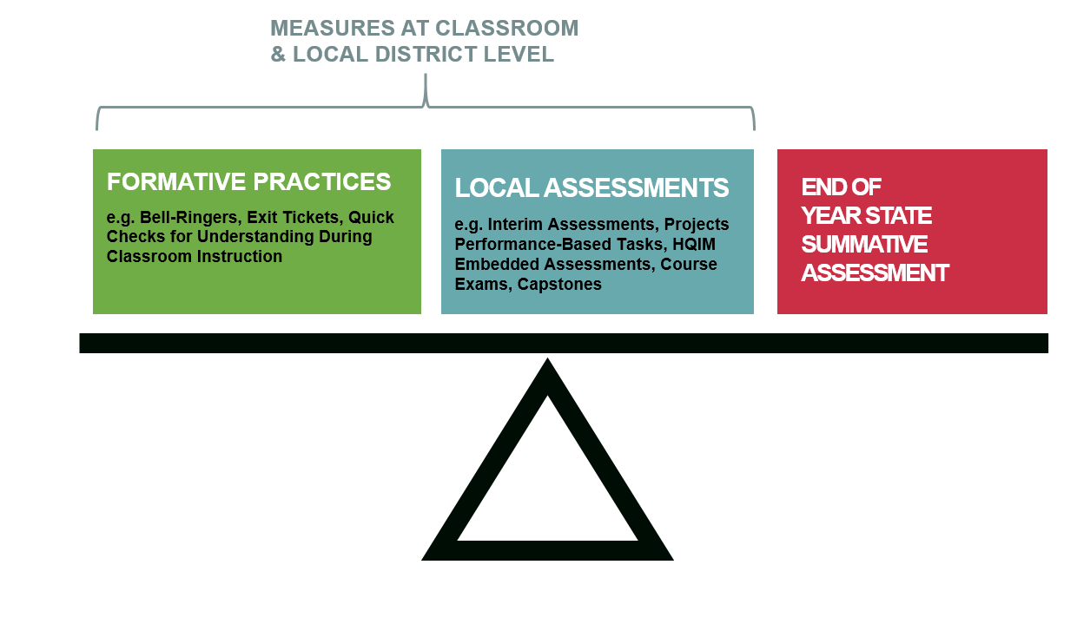
New Mexico Balanced Assessment System
Achievement
Accountability
Assessment for Learning
Assessment of Learning
Notes:
Engagement with the Field- voice of the field

Slide 4
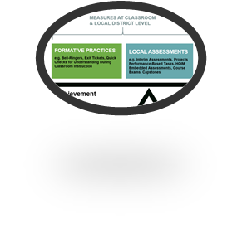
Within-Year Formative Assessment Resources
Grade K-2 Progress Monitoring Tools Early Literacy and Numeracy | Grades 3-8 Math, ELA, and Science Formative Exemplars and Interim Assessment | Grades 9-12 Math, ELA, and Science | Alternate SWD Populations (3-12) Math, ELA, and Science
•K-3 ELA and SLA •K-2 math •K-2 early literacy* monthly progress monitoring required statewide | •3-8 Formative Item Sets math, ELA, and science •3-8 Interim Assessments* •NAEP Item sets | •Khan Academy •8 full length practice test •3,500 Teacher Item Bank (PSAT 8/9, PSAT 10, SAT) •AP Released Items | •Instructionally Embedded Formative Assessments for students with significant cognitive disabilities
*Required at BOY, MOY, and EOY statewide

Slide 5
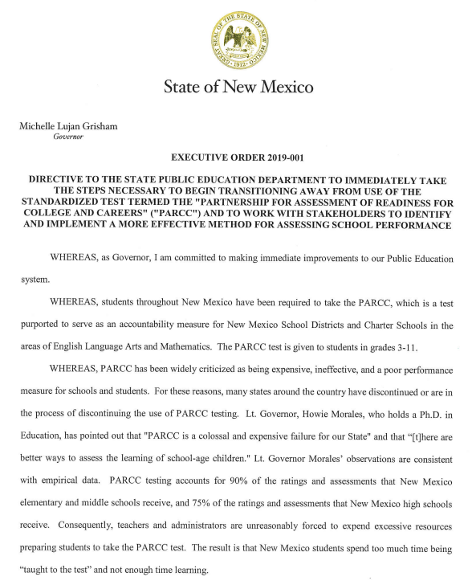
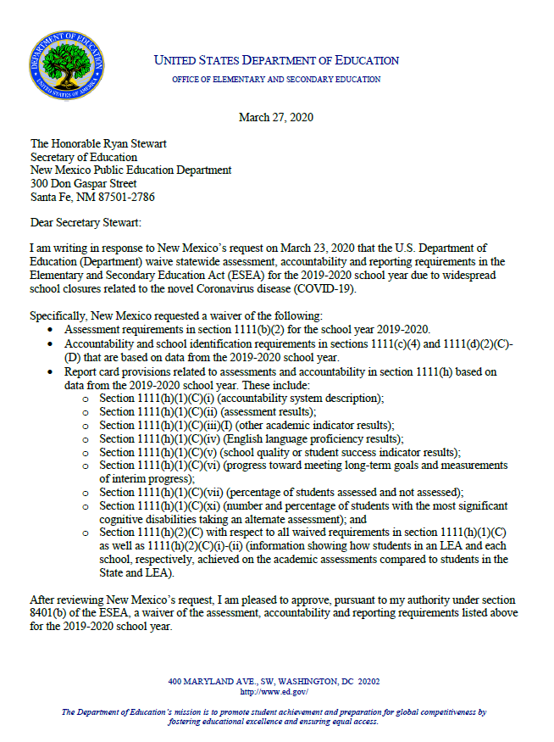
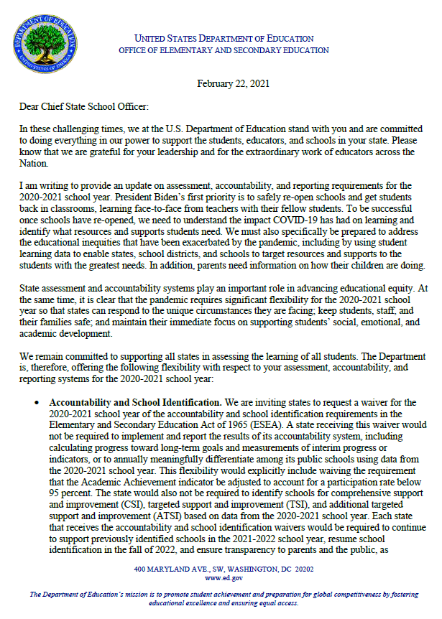
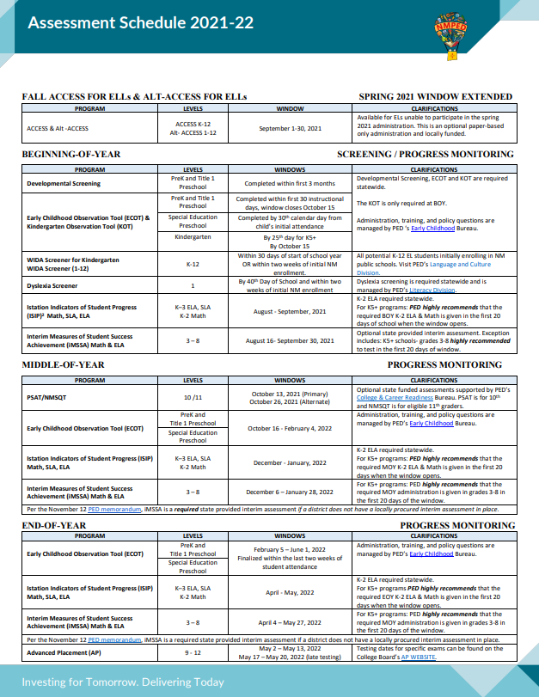
2019 Executive Order
Pandemic Year 1: Early Cancellation of ESSA Testing
Pandemic Year 2: Limited ESSA Testing
Spring 2022 : ESSA Testing Resumes
Spring 2019
PARCC/ TAMELA DATA
Spring 2020
U.S. ED Assessment & Accountability Waivers for states
NO DATA
Spring 2021
U.S. ED Released Accountability Waivers for all states
LIMITED/CONFOUNDED DATA
Spring 2022
DATA
Notes:
Lynn

Slide 6
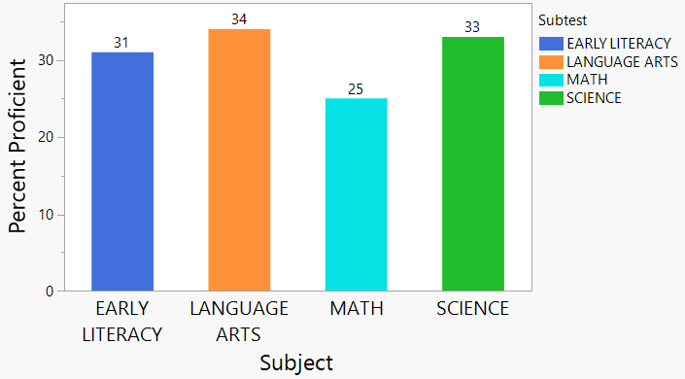
New Baselines: Overall Results
Nearly 476,000 end-of-year assessments were administered across New Mexico.
Overall Academic Achievement
Topline Results
31% proficient/advanced K-2 Early Literacy
34% proficient/advanced 3-8, 11 Language Arts
25% proficient/advanced 3-8, 11 Mathematics
33% proficient/advanced 5, 8, 11 Science
Data Application
Drives strategic planning
Development of long term goals
Allocation of resources
*Overall results for all grades tested

Slide 7
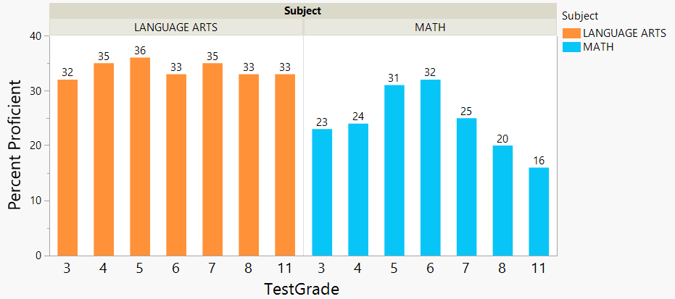
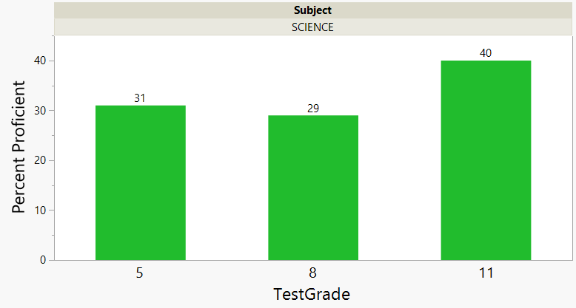
New Baselines: By Grade Level
Academic Achievement by Grade and Subject Area
Grade | Lang. Arts | Math | Sci
3 | 32% | 23% | N/A
4 | 35% | 24% | N/A
5 | 36% | 31% | 31%
6 | 33% | 32% | N/A
7 | 35% | 25% | N/A
8 | 33% | 20% | 29%
11 | 33% | 16% | 40%
Notes:
National trends in student performance:
Math performance tends to decline as students get older.
Students generally perform higher in reading/language arts compared to math.
In reading/language arts, students tend to plateau in the middle grades.

Slide 8
Assessment Models Comparison: 2022 v. 2019
Math, ELA, and Science* Proficiency Assessment System Differences
2022 model compared to 2019 model
Rigorous Measure of Math and ELA Proficiency | Fewer Grades Tested | Reduced Testing Time | Changes to Item Types & Test Design | Decision Makers | Stakeholder Achievement Levels
NMBAS Assessments Now | Seven Grade Levels Tested | 3.25 -5 Hours of Testing Per Grade | Primarily Multiple Choice with Limited Open-ended Tasks | New Mexico Educators | Four
Assessments Pre-pandemic | Nine Grade Levels Tested | 8-11 Hours of Testing Per Grade | Extensive Use of Complex Open-ended Tasks | Educators Across Multiple States | Five
*Science assessment: New standards resulted in new tests and assessed grade levels now 5, 8, and 11.
Notes:
To make legitimate comparisons, we need test items in common or students in common….

Slide 9
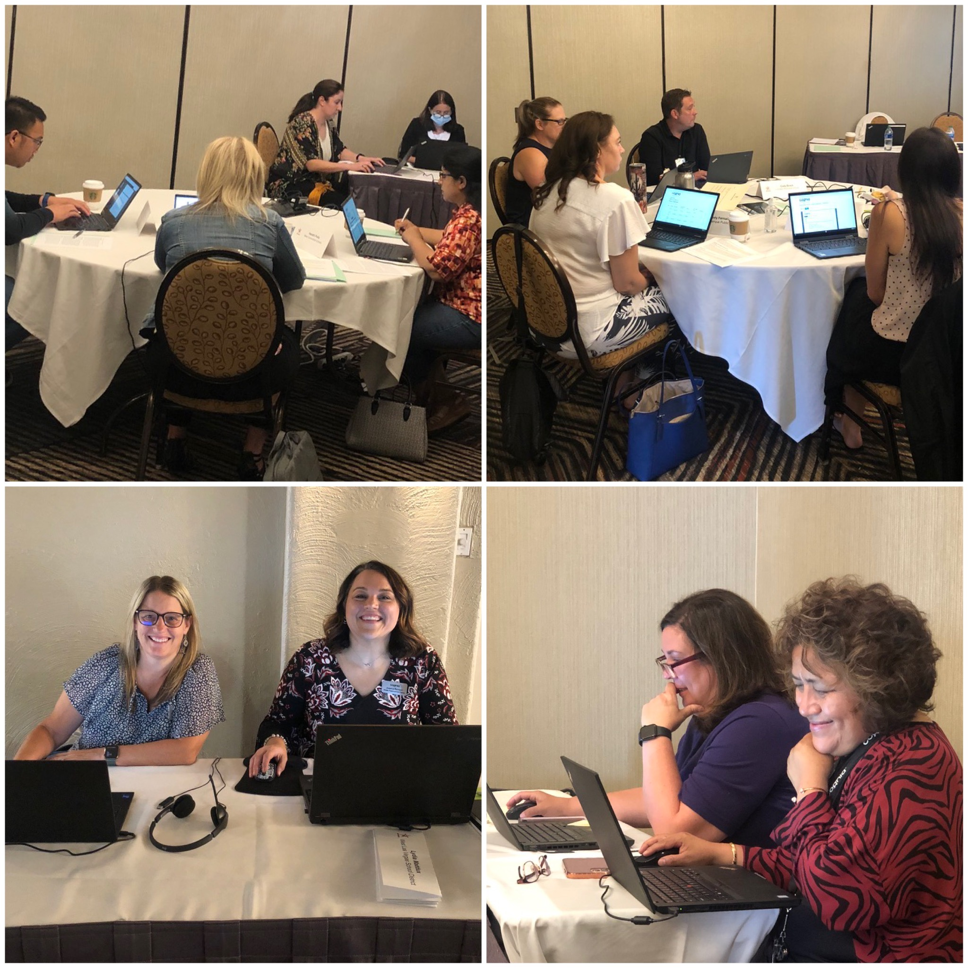
NMBAS: Establishing Proficiency Levels
Standard Setting is a formal process where New Mexico educators examine the knowledge, skills, and abilities student must demonstrate at each of the four performance levels of the state assessments and determine where the cuts are placed.
89 educators representing 41 districts and charters participated in this process for MSSA, ASR, and SAT.
MSSA and ASR
SAT School Day

Slide 10
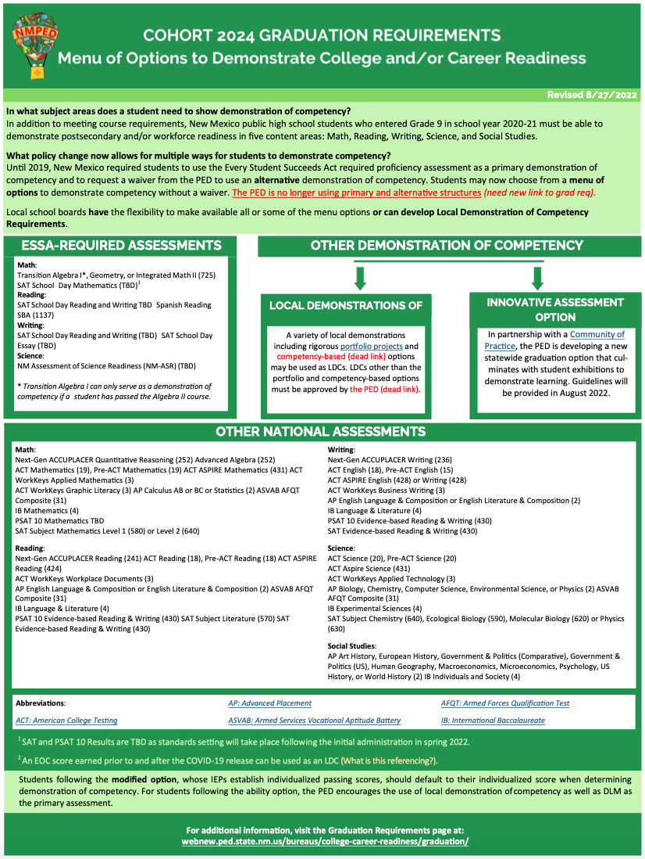
Menu of Options for Cohort 2024 Graduates
Due to the disruption caused by the Covid-19 pandemic, PED issued a memorandum that waived the demonstration of competency requirement for cohorts 2022 and 2023 graduates
During the Fall of 2022, PED staff put forth a graduation proposal to the NM Legislature that would require students to the pass a course and participate in all required state assessments in order graduate
Currently, all cohorts 2024 and beyond will need to demonstrate competency
Notes:
LV or NS slide 26 (10 minutes)

Slide 11
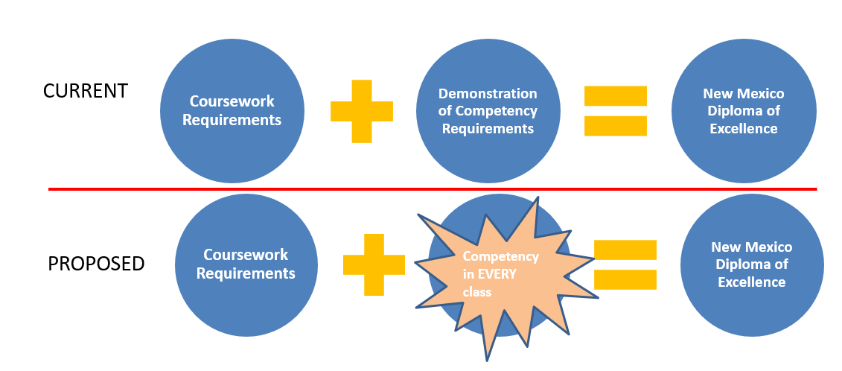
Future Graduation Requirements: TBD

Slide 12
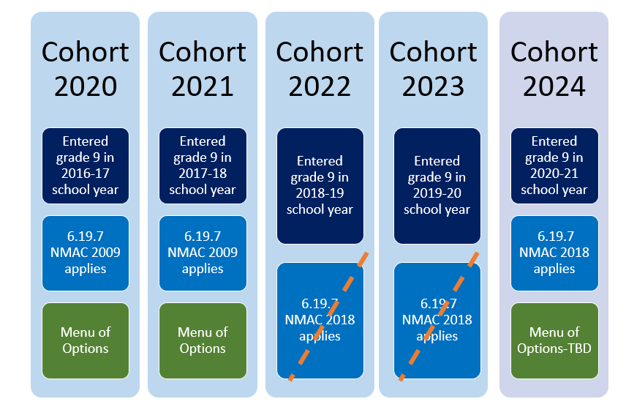
Cohort 2024 Graduation Demonstration of Competency

Slide 13
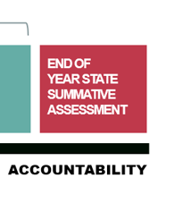
New Mexico’s Federal ESSA (Title 1) Assessments*
Only ELs in General Education, Including Students w/Disabilities
General Education, Including ELs & Students w/Disabilities
Only Those w/the Most Significant Cognitive Disabilities, Including ELs
ACCESS for ELLs
Measures of Student Success & Achievement (MSSA)
SAT School Day
Dynamic Learning Maps (DLM)
ELP K-12
Math 3-8
Math 11
Math 3-8, & 11
ELP = English Language Proficiency
ELA 3-8
Reading 11
Science 5, 8, & 11
ELA 3-8, & 11
Assessment of Science Readiness (ASR)
*
Only ELs w/the Most Significant Cognitive Disabilities
Science 5, 8, 11
Alternate ACCESS for ELLs
ELP* 1-12
Notes:
LV or NS slides 15-23 (20 minutes)

Slide 14
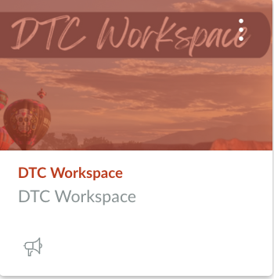
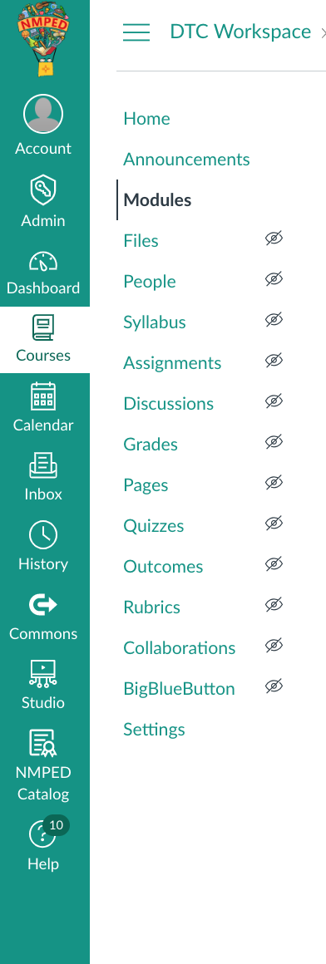
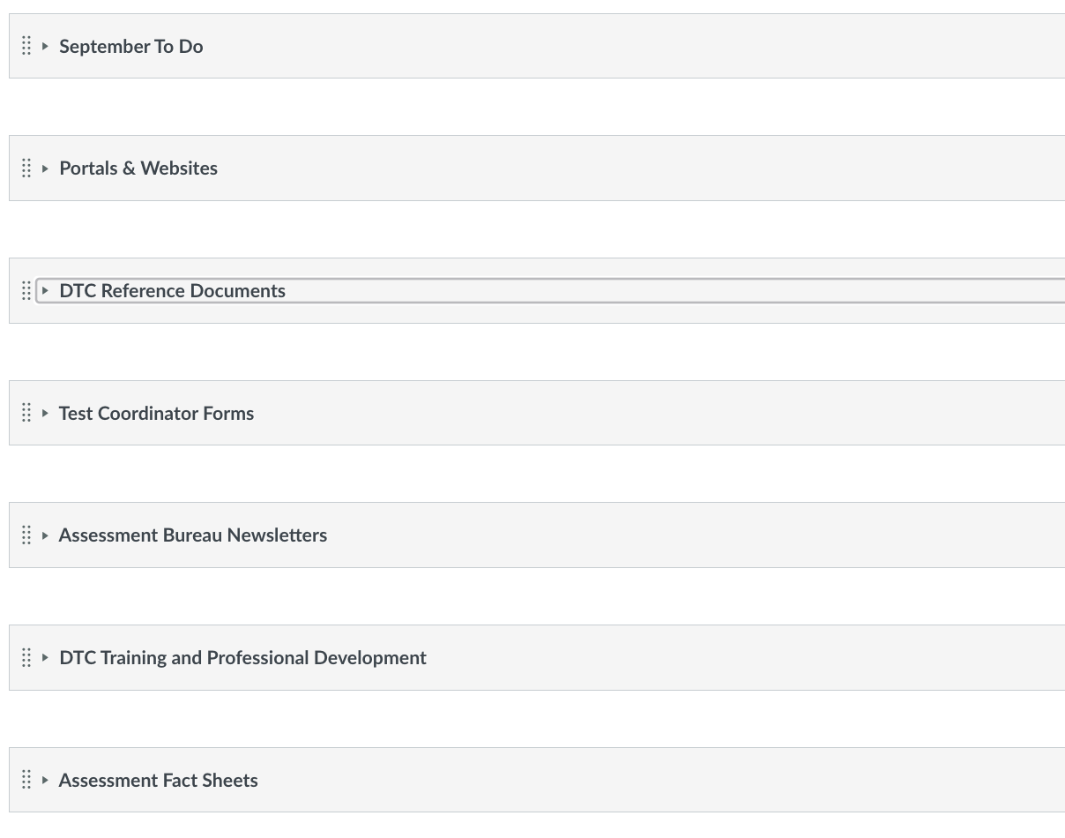
Presenting the New DTC Workspace

Slide 15
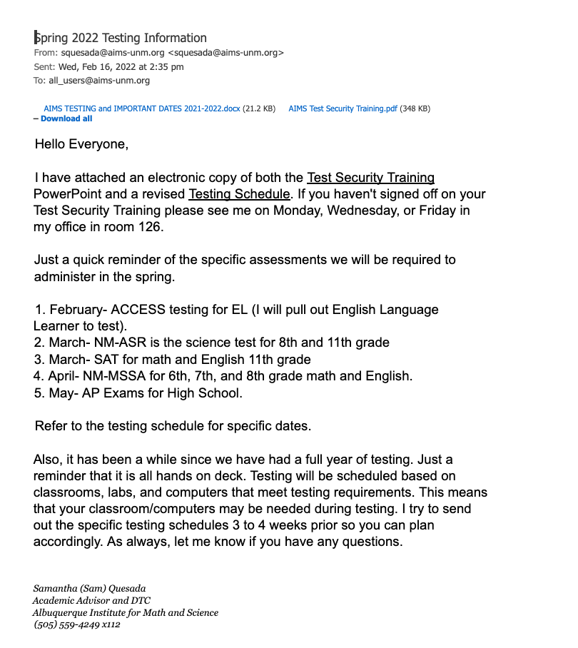
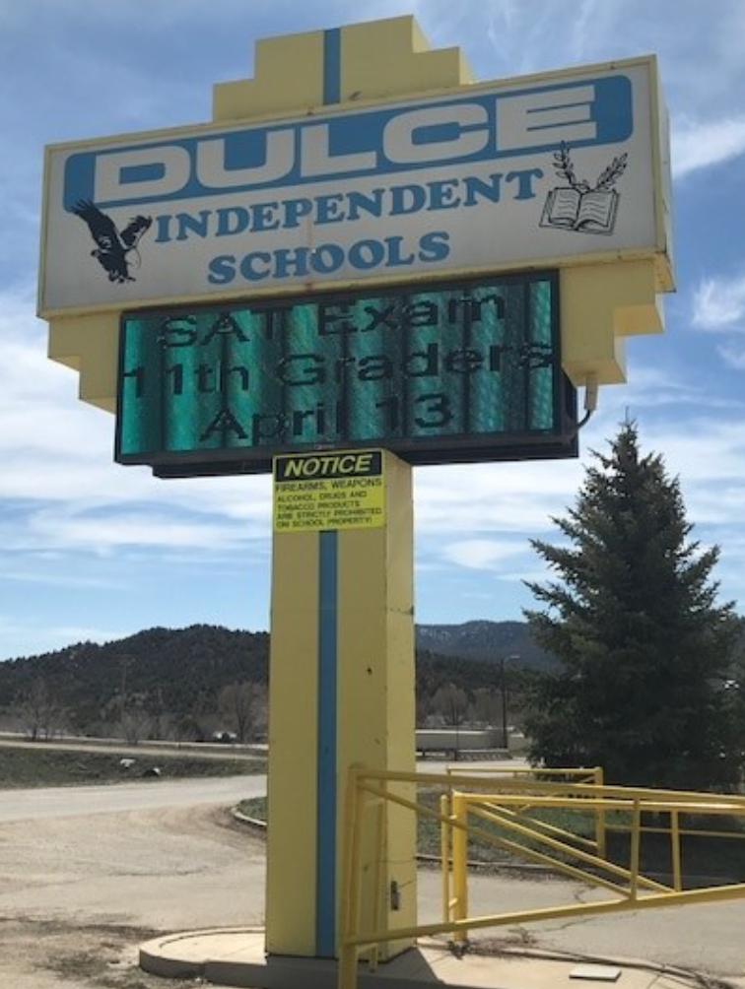
DTC Responsibilities: Communication
DTCs are responsible for creating a communication flow between the Assessment Bureau and assessment vendors to STCs, TAs, staff, parents, and community members.
ABQ. INSTITUTE OF MATH & SCIENCE
Samantha Quesada, former DTC
DULCE INDEPENDENT SCHOOLS
Katie Cachucha, DTC
Notes:
XD Slides 8-17 (20 minutes)

Slide 16
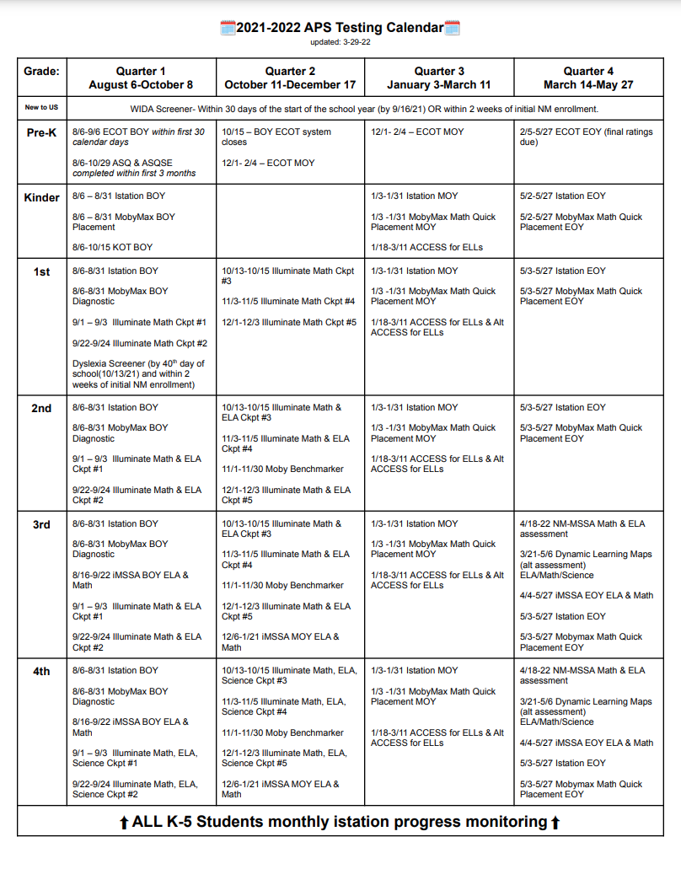
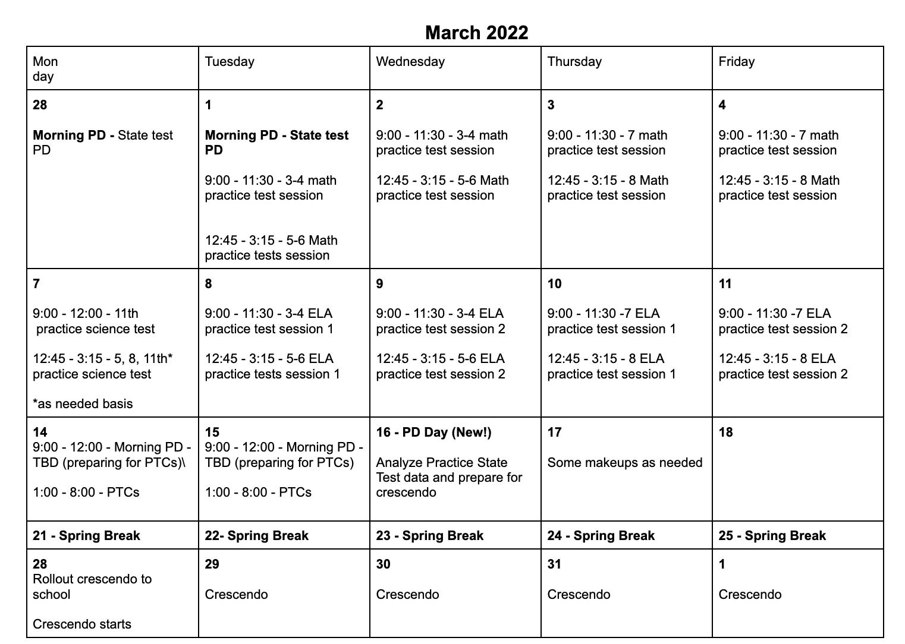
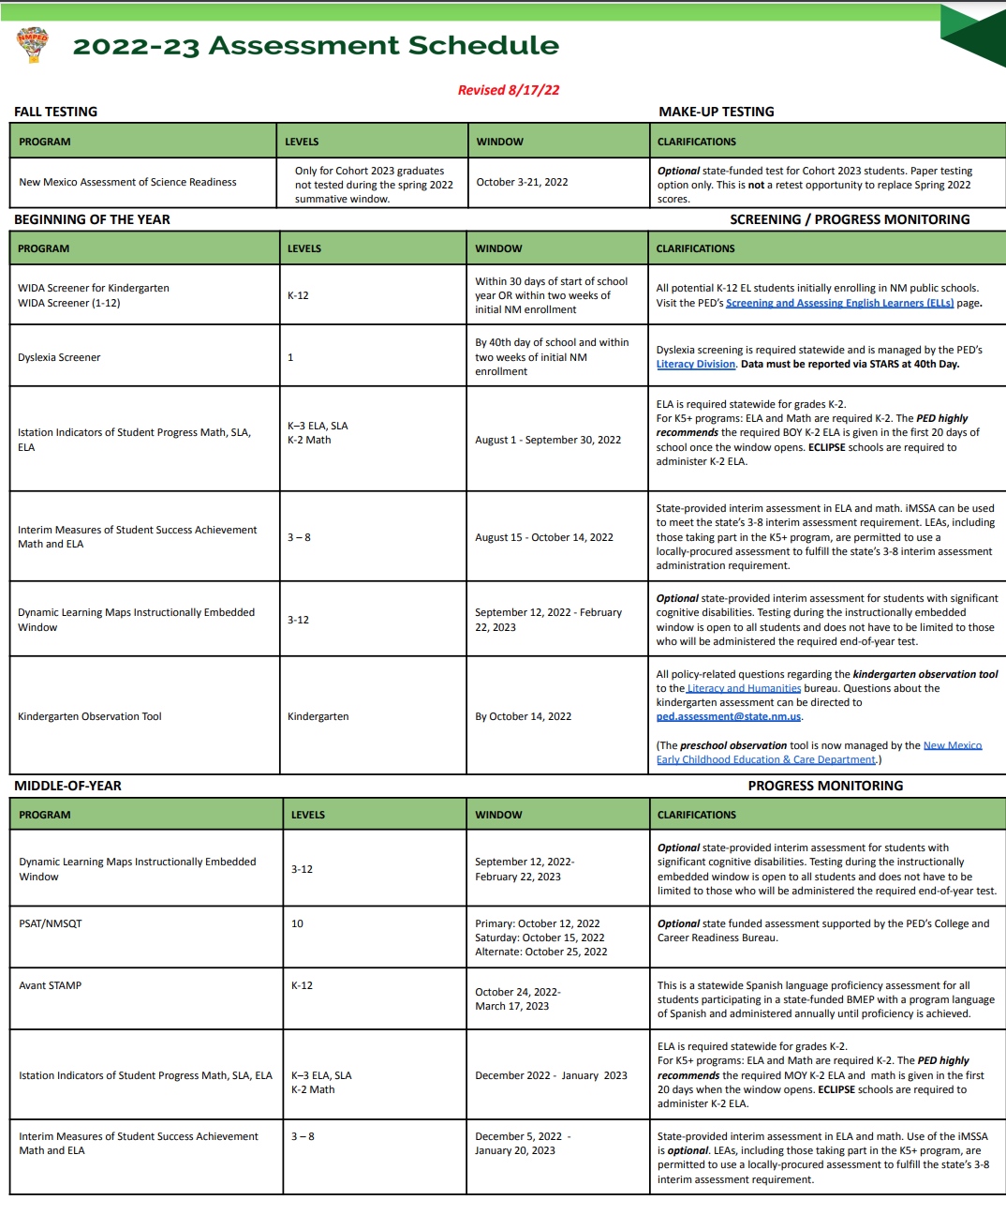
DTC Responsibilities: Communication
DTCs should use the 2022-23 Assessment Schedule to create a customized schedule to fit district needs.
ALAMOGORDO PUBLIC SCHOOLS
Carrie Rowe, DTC
MAS CHARTER SCHOOL
Sherrye Hubbard, DTC

Slide 17
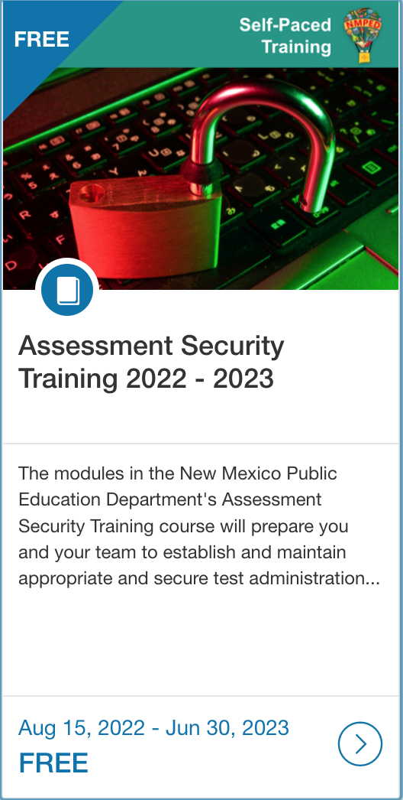
DTC Responsibilities: Staff Training
BERNALILLO PUBLIC SCHOOLS
Jennifer Trujillo, DTC
PED RESOURCE COURSES
Open Enrollment
DTCs must ensure and document that all staff are adequately trained in test administration, test security, and testing accommodations.

Slide 18
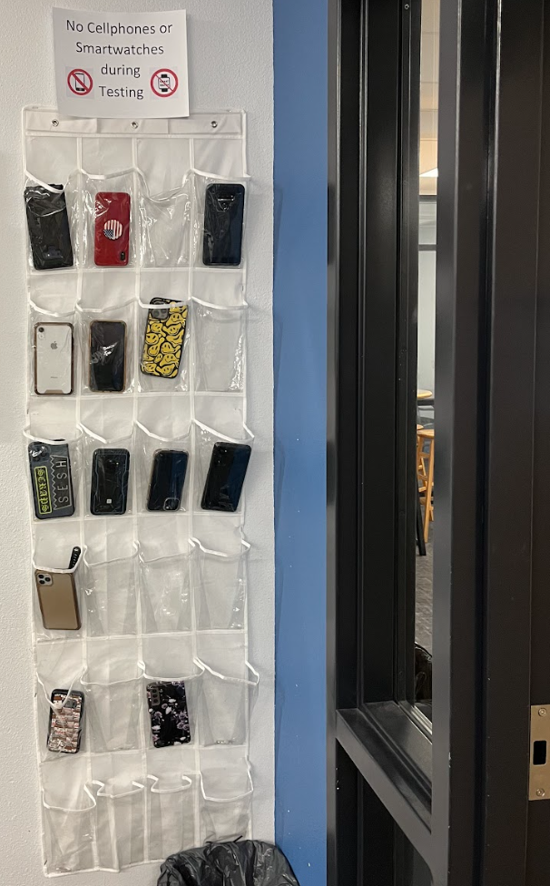
DTC Responsibilities: Create & Monitor Test Security Procedures
DTCs should create localized test security procedures and closely monitor sites to ensure those procedures are being followed.
materials check-out
materials securely locked-up
chain of custody record for all materials
DULCE INDEPENDENT SCHOOLS
Katie Cachucha, DTC
ABQ. INSTITUTE OF MATH & SCIENCE
Samantha Quesada, former DTC

Slide 19
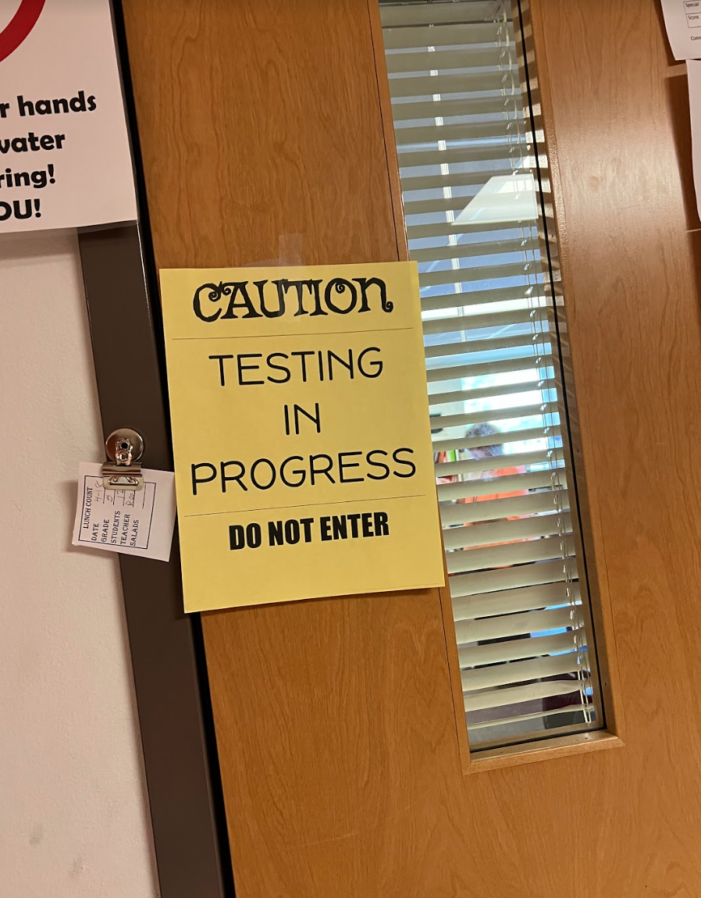
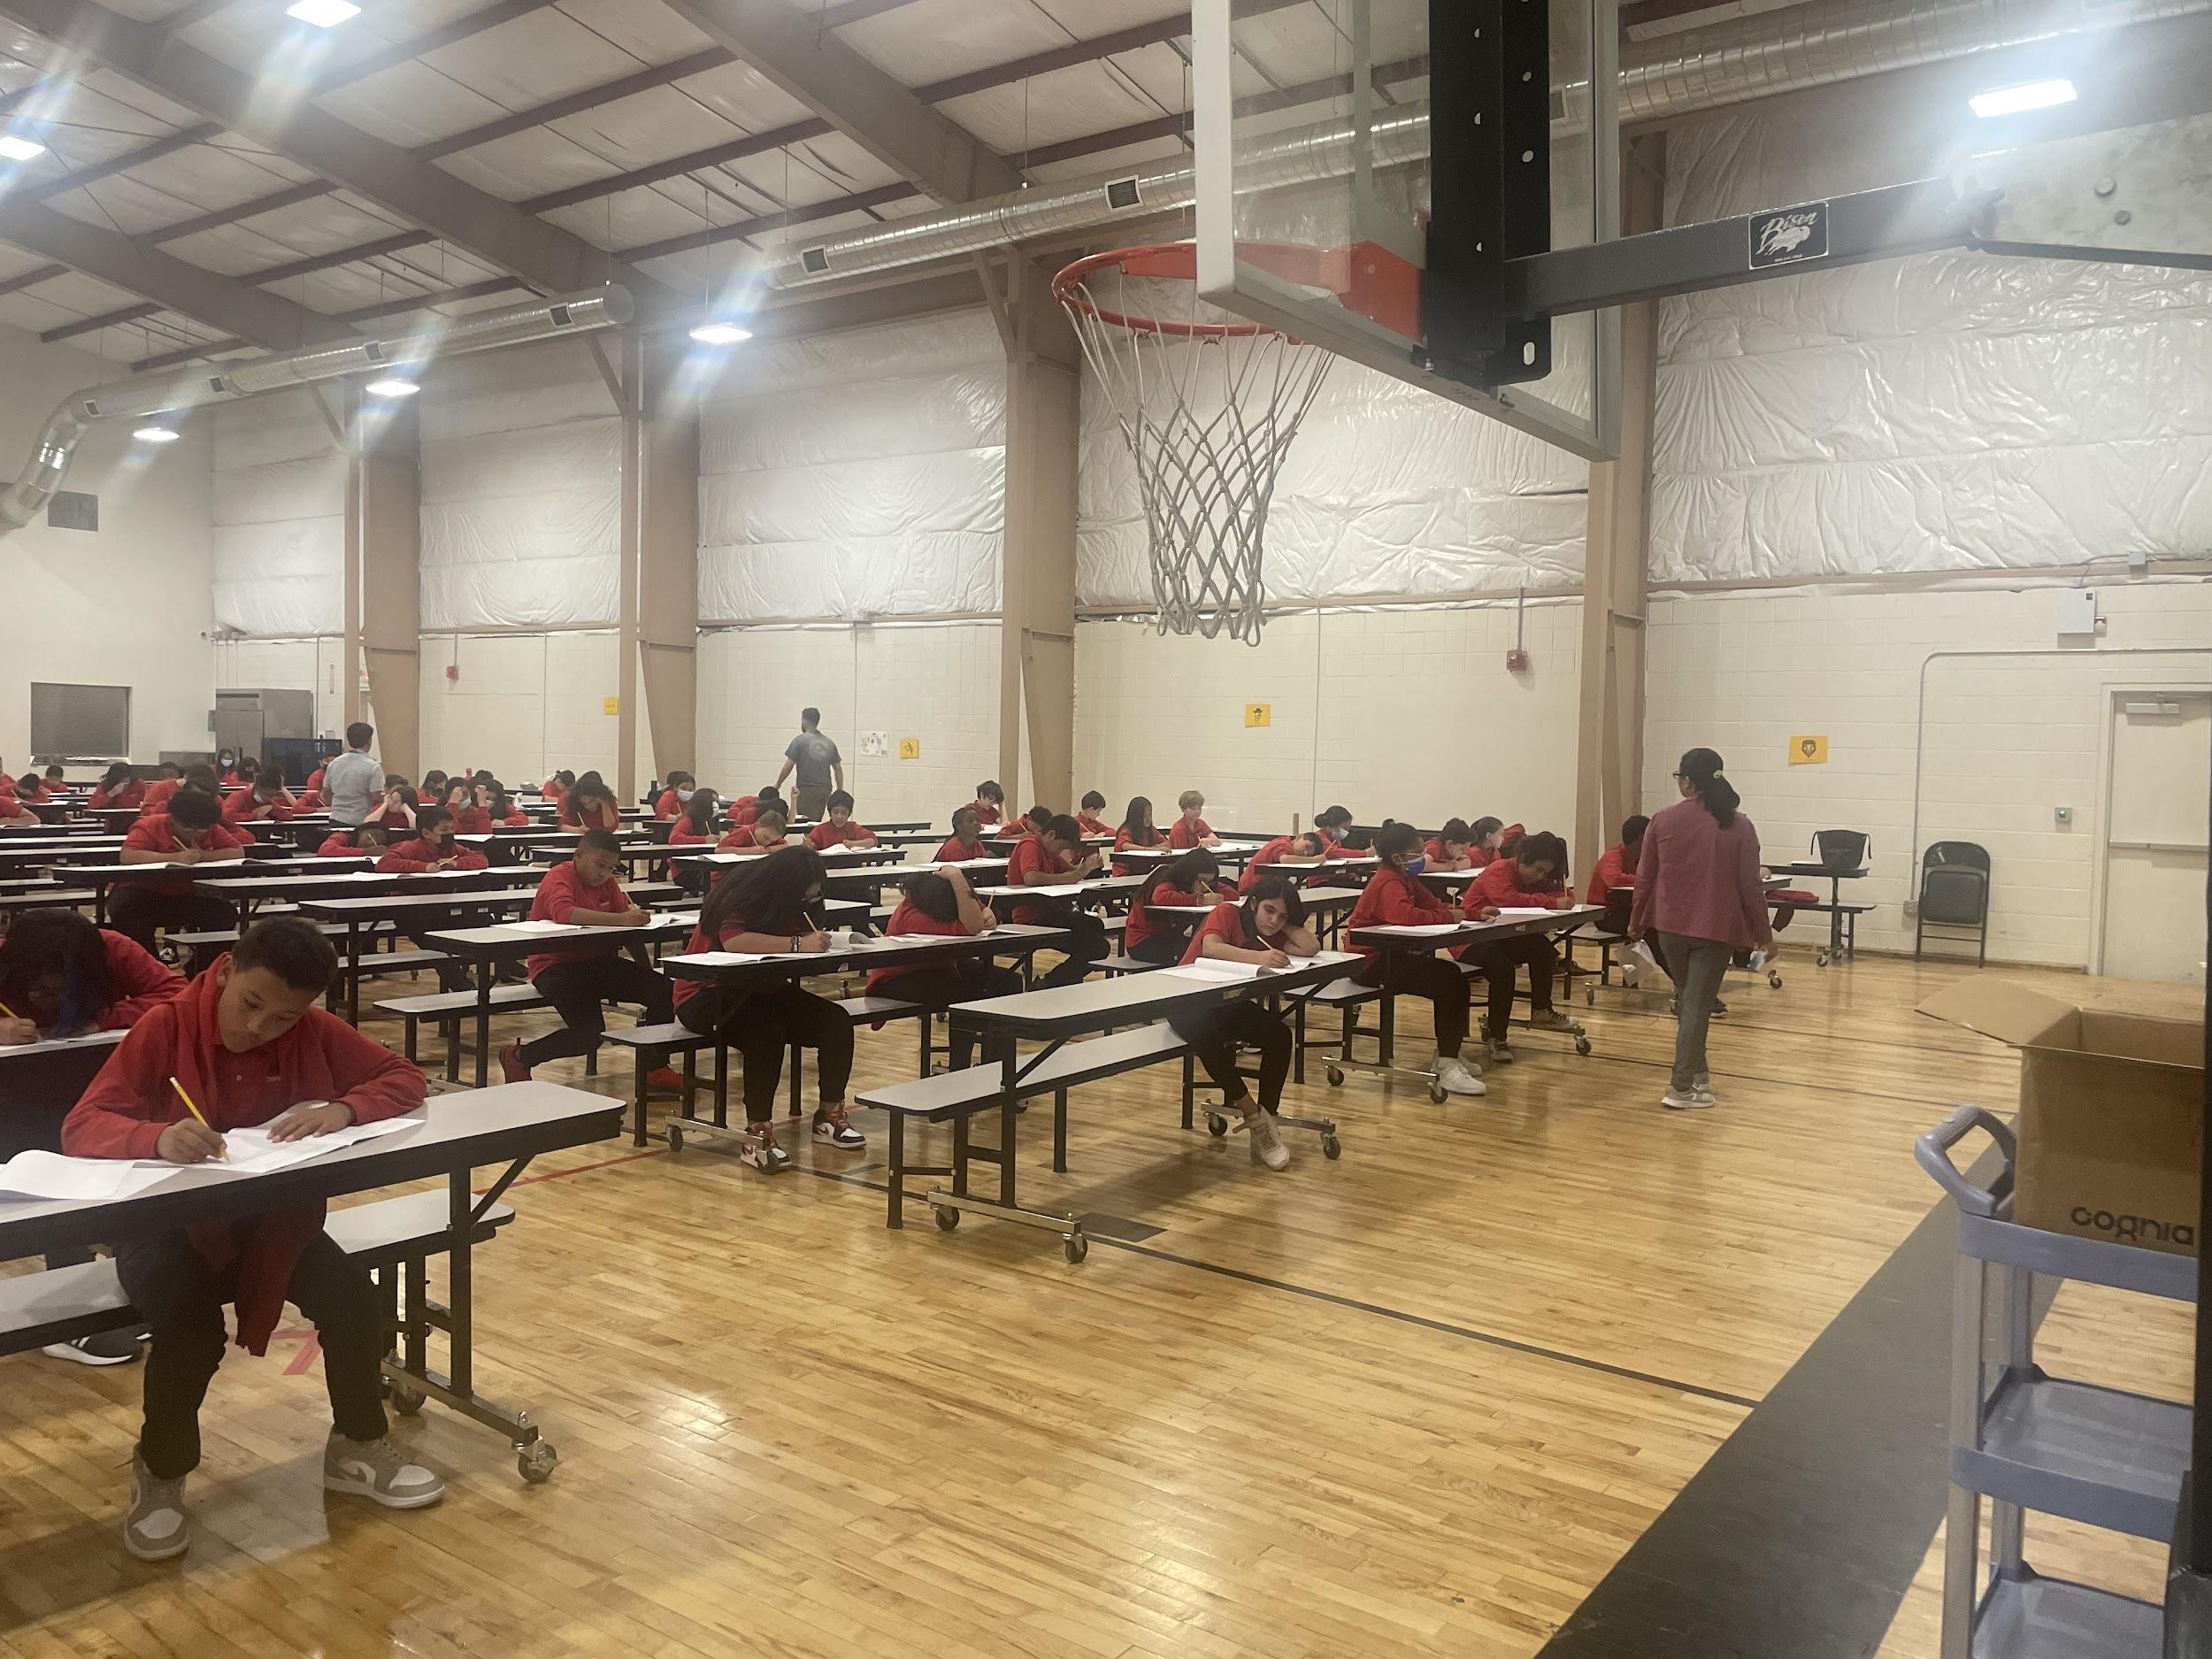
DTC Responsibilities: Create & Monitor Proper Testing Environment
The DTC should create a testing environment conducive to student success. This environment should be carefully monitored during the testing window.
ALAMOGORDO PUBLIC SCHOOLS
Carrie Rowe, DTC
MAS CHARTER SCHOOL
Sherrye Hubbard, DTC

Slide 20
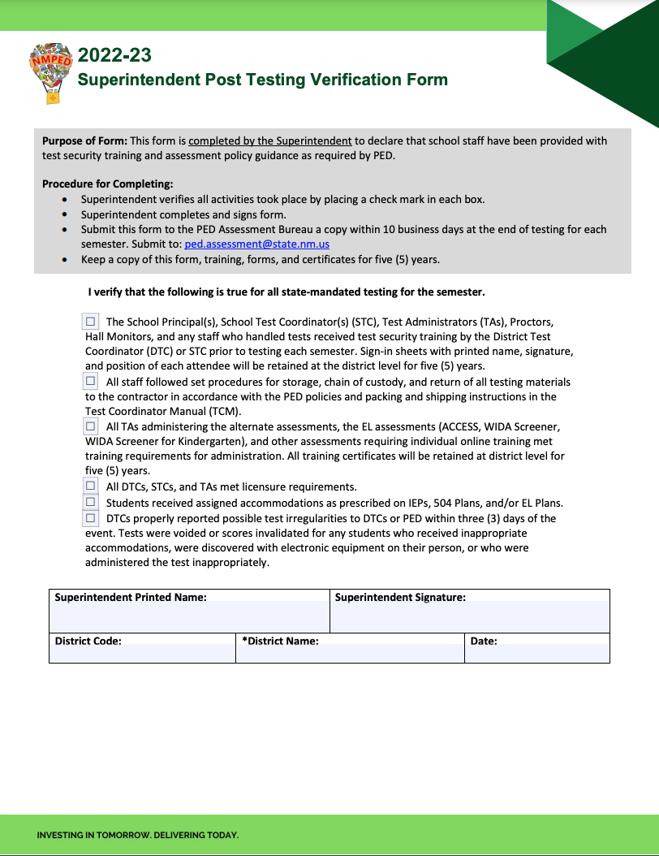
DTC Responsibilities: Monitor Participation & Verification
During a testing window, DTCs should carefully monitor overall district participation to ensure 95% of eligible students complete required assessments
Cognia DI Portal

Slide 21
Other DTC Responsibilities
Attends all PED DTC trainings and mandatory meetings
Must be completely knowledgeable of 6.10.7 NMAC
Disseminates 6.10.7 NMAC to all staff
Responsible for test material orders, inventory, security, and return of materials to vendor.
Ensures all planning for standardized test administration
Provides manuals in advance of training and reviews manuals during training

Slide 22
DTC Responsibilities
Ensures STCs, TAs, and Proctors are certified, trained, and have signed Confidentiality Agreements
Coordinates availability of locally-provided test materials (e.g., calculators, scratch paper) to school staff
Inspects correct assignment of student test sessions and student demographic information
Inspects schools’ accommodations documents
Reports irregularities to PED and conducts investigations

Slide 23
PED Site Monitoring Process
Monitoring visits ensure that all state and federally required assessment programs are conducted according to state and federal regulations.
The assessment bureau conducts visits as needed, and will contact you prior to scheduling a visit
DTCs will be asked a series of interview questions, and be required to provide artifacts documenting communication, staff training, test security, test environment, and participation.

Slide 24
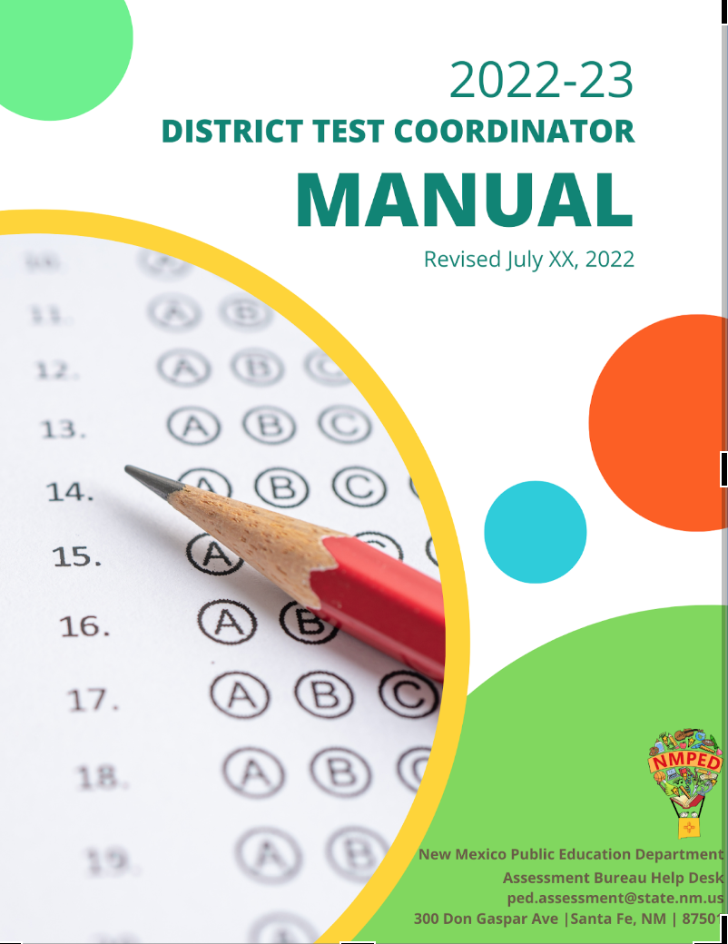
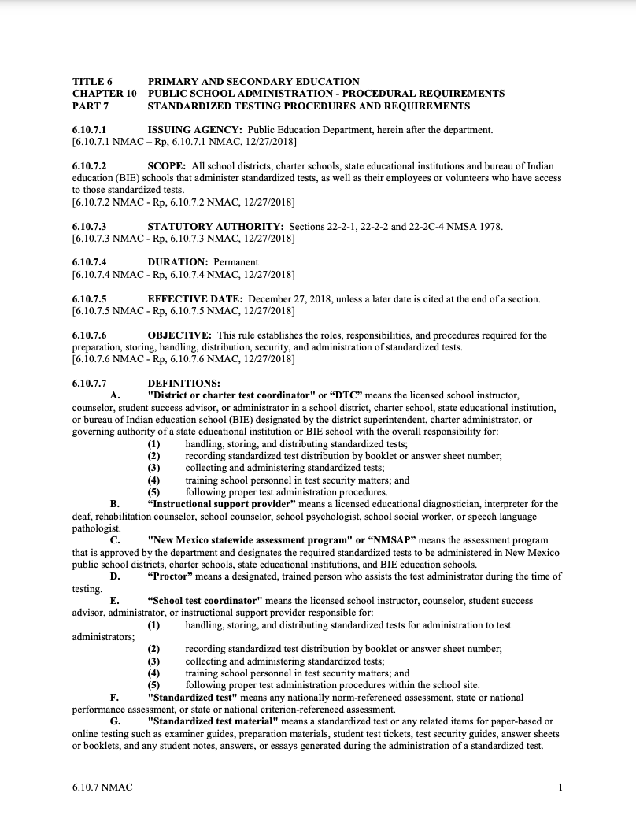
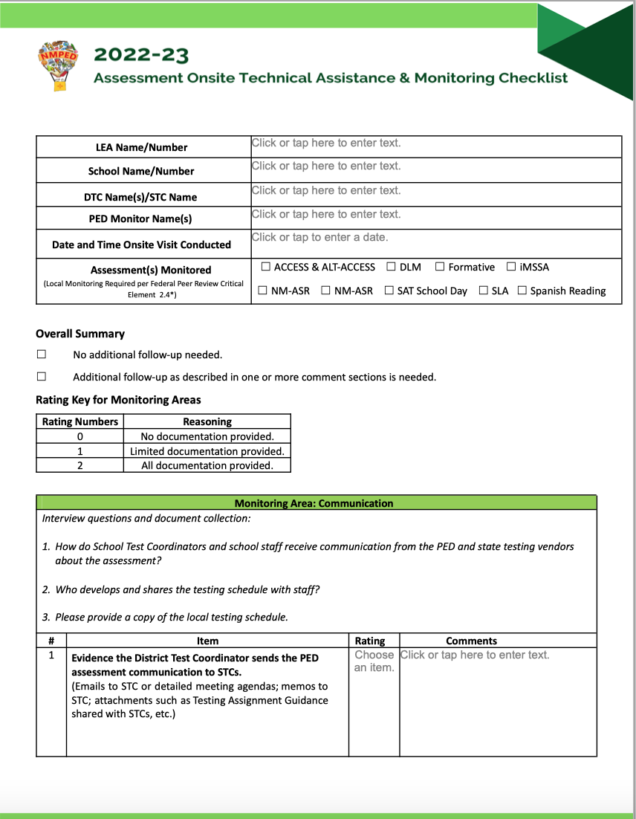
The DTC Manual, 6.10.7 NMAC & On-site Checklist
The DTC Manual, 6.10.7 NMAC, and the On-site Technical Assistance and Monitoring Checklist provide a comprehensive view at all DTC responsibilities.

Slide 25
BREAK
Notes:
Break 10:50-11:00am

Slide 26
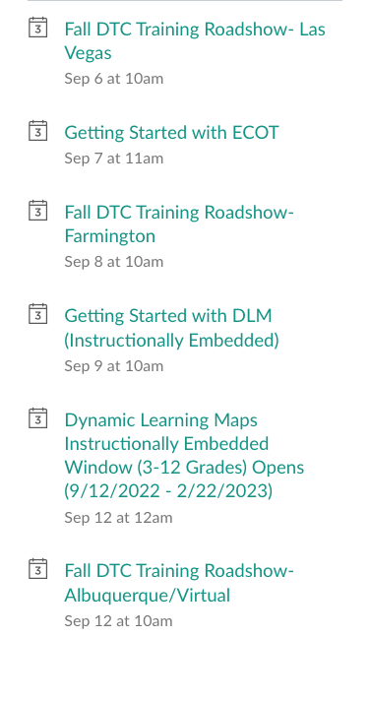
Assessment Schedule 2022-23

Slide 27
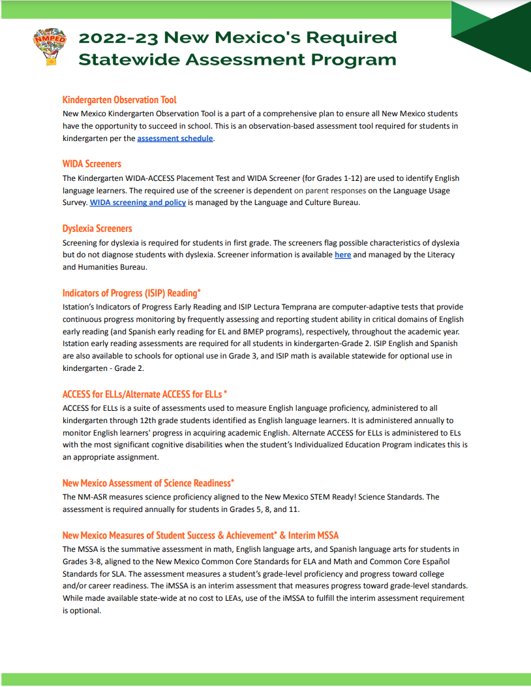
Required Assessments in 2022-23
Kindergarten Observation Tool (KOT): all Kindergarten students; observations loaded into ECOT portal by 30th school day
WIDA Screener: all potential EL students identified via parent responses to the LUS
Dyslexia Screener: All 1st grade students; not intended diagnose dyslexia; results loaded into STARS by 40th school day
ISIP Reading: Required for all students in grades K-2; available in Spanish for EL and BMEP programs

Slide 28
Required Assessments in 2022-23
ACCESS for ELLs: all students in grades K-12 identified as an ELL
Alt. ACCESS for ELLs: all students in grades 1-12 identified as an ELL with significant cognitive disabilities designated for alternate assessment in the IEP
NM Assessment of Science Readiness (ASR): all students in grades 5, 8, and 11 not designated for alternate assessment
NM Measures of Student Success and Achievement (MSSA): ELA and Math required of all students in grades 3-8 not designated for alternate assessment; SLA available for eligible students

Slide 29
Required Assessments in 2022-23
National Assessment of Educational Programs (NAEP) and Other Studies: Only for selected schools and students
SAT School Day: all students in grade 11 not designated for alternate assessment
Dynamic Learning Maps (DLM): ELA and Math is required of all students in grades 3-8 and 11; science is required of students in grades 5, 8, and 11; students with significant cognitive disabilities designated for alternate assessment in the IEP
Avant Stamp: All students enrolled in a Spanish-bilingual program who have not previously achieved language proficiency

Slide 30
Optional Assessments in 2022-23
ISIP Math: available statewide for all students in grades K-3
ISIP Reading: available statewide for for all 3rd graders
Dynamic Learning Maps (DLM) Instructionally Embedded: available statewide for all students in grades 3-12; students with significant cognitive disabilities designated for alternate assessment in the IEP; does not impact end of year assessment
Fall PSAT/NMSQT: State funded assessment for 10th graders
iMSSA: State funded interim assessment in Reading, Language Usage, and Math for students in grades 3-8
Formative Item Sets: resources available in ELA, Math, Science, and Social Studies
Avant Stamp: Available in 30 languages to fulfil State Seal of Bilingualism and Biliteracy (SSBB) assessment requirement

Slide 31
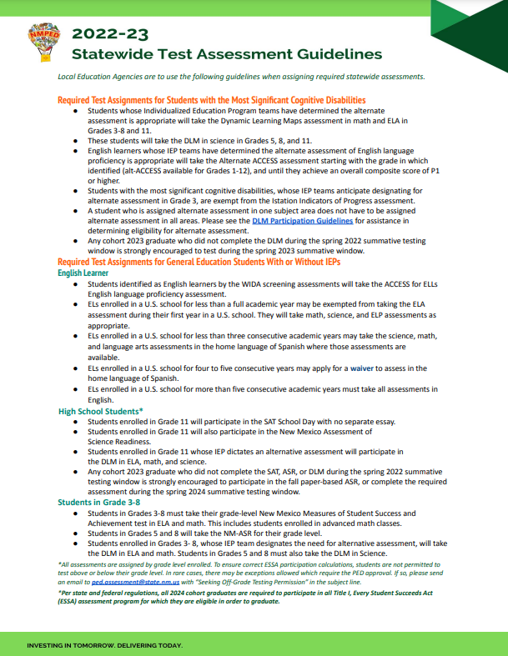
Test Assignment: Test Assignment Guide
Each assessment has its own unique student populations. Every student does not have to take every assessment, every year.
DTCs should work closely with educators and other school personnel to ensure that each student is being issued the appropriate assessments and that each assessment is being administered using the appropriate accommodations when necessary.
Notes:
Lynn

Slide 32
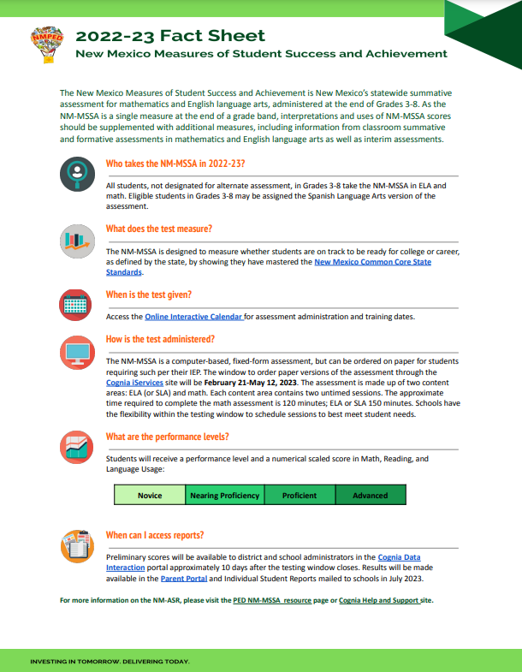
Test Assignment: Assessment Fact Sheets
Each assessment Fact Sheet contains the following information:
A brief summary of the assessment
Guidance on which students are required to take the assessment
Information on what the test measures
Timeline for when the assessment is to be given and how the test is administered
What the performance-levels are
Where can score reports be accessed
Notes:
PED Pandemic Waiver:
Dyslexia Screener Memo information is available
ECOT

Slide 33
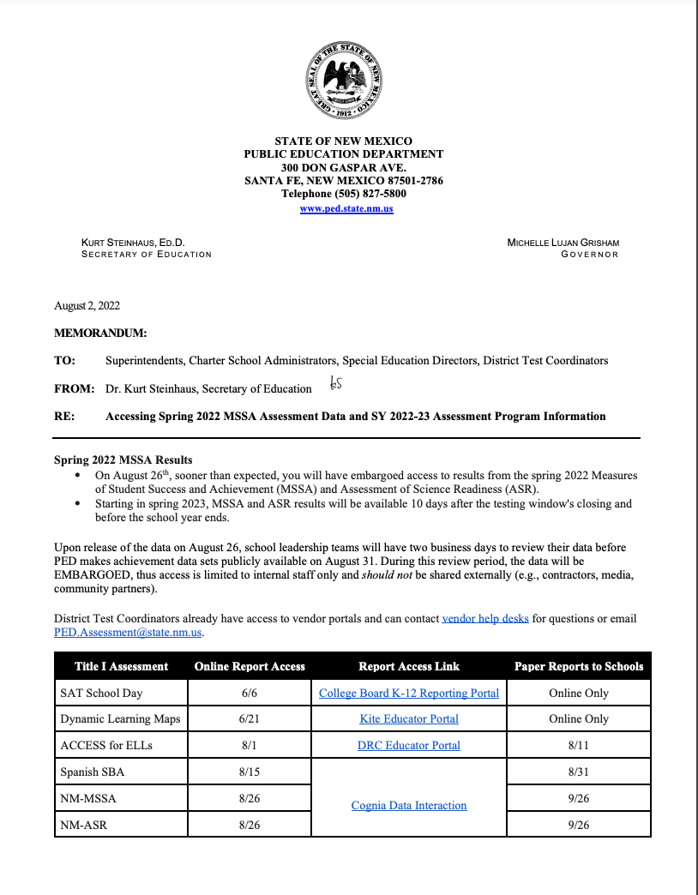
Interim Assessment Requirement
The August 2 Memorandum issued by PED continues the interim assessment requirement for all students in grades 3-8
iMSSA is provided by the state to LEAs to fulfill this requirement
A locally procured interim assessment administered during regular intervals throughout the year with proficiency level descriptors can also be used
Notes:
AR slides 23-25 (10 minutes)

Slide 34
Interim Assessment Requirement
If a locally procured interim assessment is used, LEAs will be asked to sign a data-sharing agreement with PED
Data from the assessment should be submitted via SOAP

Slide 35
Testing for Cohort 2023 Graduates
Due to the disruption caused by the Covid-19 pandemic, participation in assessments for cohort 2023 graduates is strongly encouraged but not required
These administrations are only for those students who did not test during the 2022 summative administration window. This is not a re-test opportunity for students to improve scores.
NM-ASR: Fall paper-only testing option or Spring computer-based option (w/Cohort 2024 graduates)
SAT School Day: Spring testing option (w/Cohort 2024 graduates)
DLM: Spring testing option (w/Cohort 2024 graduates)
Notes:
AR Slides 21-22 (5 minutes)

Slide 36
LUNCH
Notes:
LUNCH 11:45-12:20

Slide 37
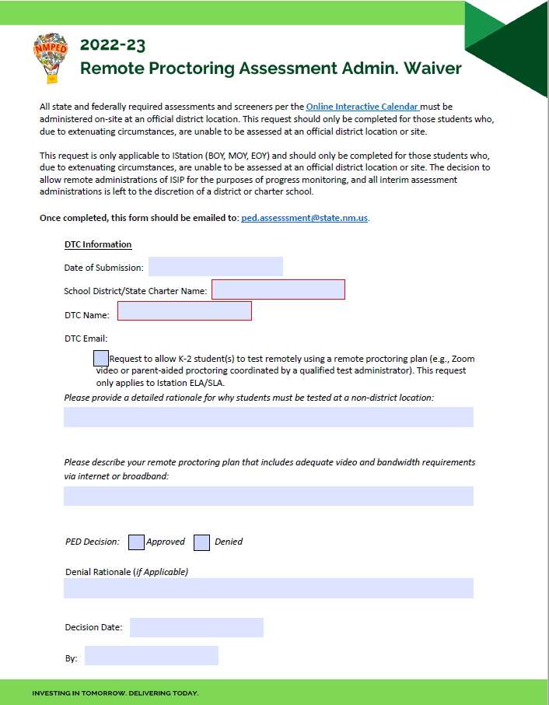
Remote Proctoring Assessment Administration Waiver
For 2022-23 this option is only available for Istation (BOY, MOY, EOY administrations)
This waiver should only be completed in the event that extenuating circumstances prevent a student from being administered the assessment at an official district location
A remote proctoring plan is required
Completed forms should be submitted to Xavier.Deleon@state.nm.us
Notes:
NS slides 20-32 (20 minutes)

Slide 38
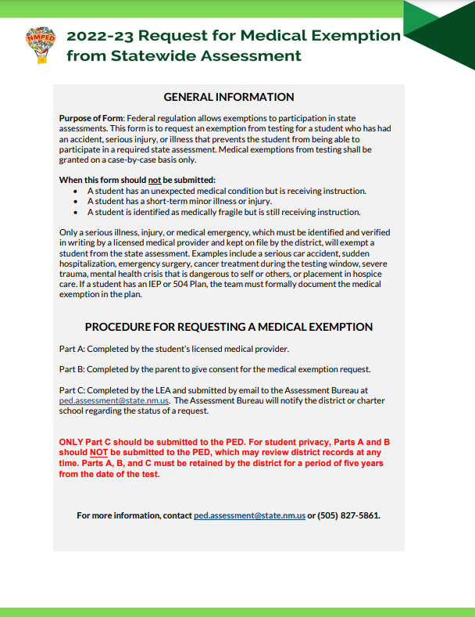
Medical Exemptions
Medical Exemptions requests are considered on a case-by-case basis
This exemption should only be submitted for PED consideration if:
The student suffers a sudden and unexpected serious medical illness, injury, or medical crisis
The condition alters the student’s ability to receive remote or in-person instruction for a significant amount of time
The student is admitted to a hospital or medical facility during the testing window and cannot test at an official district location
The student is expected to fully participate in testing the following year

Slide 39
Medical Exemptions
Parts A and B should be completed and signed by a licensed medical provider and the student’s parent/guardian
Only Part C should be submitted to the Assessment Bureau through the DTC portal
The assessment bureau reserves the right to ask the DTC to clarify specific information about a student’s condition prior to making a decision on the exemption

Slide 40
Non-Standard Accommodation Request
Non-Standard Accommodation requests are considered on a case-by-case basis
This request should only be submitted for PED consideration if:
A student will need a testing accommodation not documented in a legal plan
A last-minute, unforeseen circumstance forces a student to need an accommodation without adequate time to document in a legal plan
This request should be submitted to the Assessment Bureau through the DTC portal

Slide 41
EL Waivers
ELs enrolled in a U.S. school for less than a full academic year may be exempted from taking the ELA assessment during their first year in a U.S. school. They will take math, science, and ELP assessments as appropriate.
ELs enrolled in a U.S. school for less than three consecutive academic years may take the science, math, and language arts assessments in the home language of Spanish where those assessments are available.
ELs enrolled in a U.S. school for four to five consecutive years may apply for a waiver to assess in the home language of Spanish.
ELs enrolled in a U.S. school for more than five consecutive academic years must take all assessments in English.

Slide 42
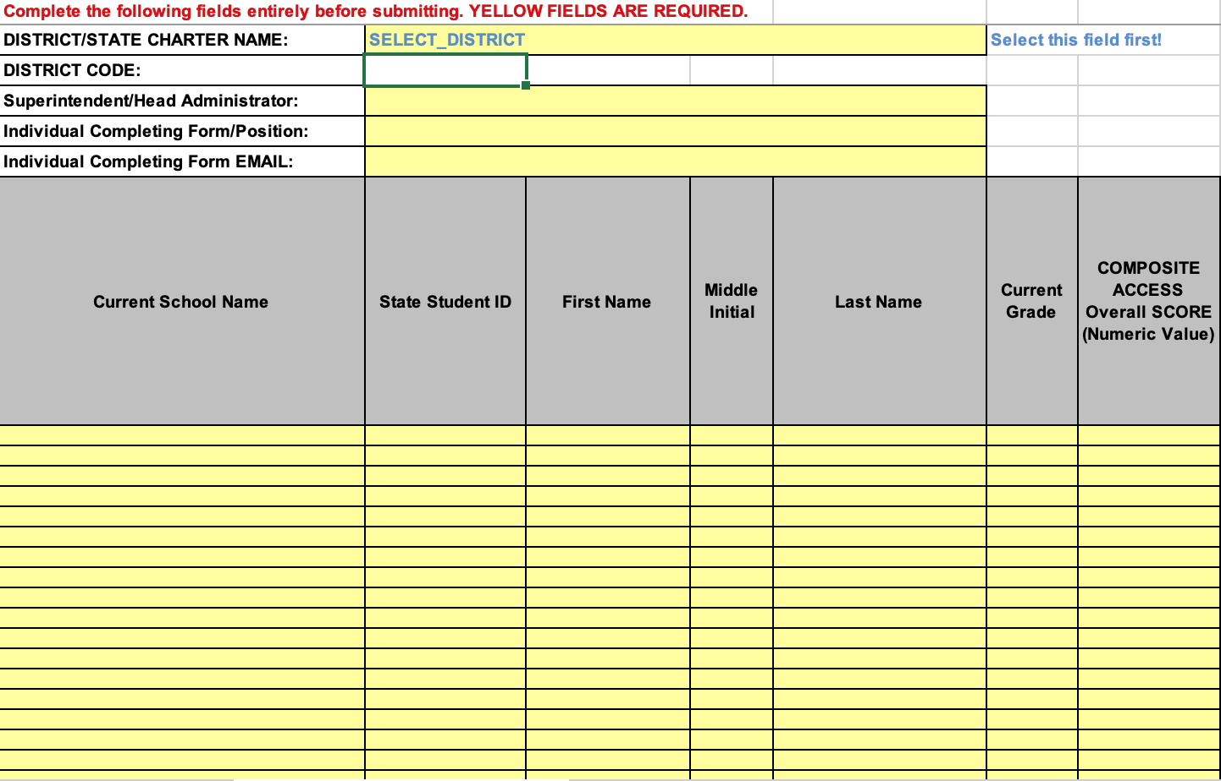
EL Waivers
EL Waiver requests are considered on a case-by-case basis
This waiver should only be submitted for PED consideration if:
The student has attended a US school for three consecutive years or more
The home language of Spanish would yield more accurate and reliable information about the student's knowledge of a subject.
Completed requests should be uploaded to SOAP
Deadline to submit is January 31, 2023

Slide 43
Off-Grade Testing Request
Off-Grade Testing requests are considered on a case-by-case basis
This request should only be submitted for PED consideration if:
The student is expected to graduate early
the student must receive sufficient content instruction prior to or during the testing window
This request should be submitted to the Assessment Bureau at ped.assessment@state.nm.us by the deadline of February 8, 2023

Slide 44
Test Security
Why Test Security Matters
Ensures a student’s responses is a true representation of what the student’s own skills and abilities
Ensures assessment data used for accountability are valid and accurate
Ensures that test items can be used across years to allow for comparability
Ensures investments of resources, time, and energy are protected
Students
You
Ensuring Test Security Protocols Protects
Staff
Test
Notes:
So, why does test security even matter? Well…READ SLIDE

Slide 45
Preparing for Secure Administration
Prepare Yourself | Develop a localized test security plan Identify local training structure and dates Identify who needs training; identify roles for each assessment Identify a place to store and lock-up secure testing materials Develop a chain of custody (sign-in/sign out) process Consider potential problems and develop solutions Establish a baseline of expectations for all stakeholders- support staff, students, and parents
Prepare the Staff | Optional: online test security course Provide localized test security training for all STC, TAs, leaders, proctors, instructional assistants, school staff Document participation in all trainings
Notes:
When preparing to conduct an secure test administration, here are a few things to keep in mind ….READ SLIDE

Slide 46
Preparing for Secure Administration
Prepare the Students | Inform them of the instructional alignment to the assessments being taken Communicate the resources available for students to practice for the assessments Communicate testing day expectations (where to go, how to behave, what accommodations they should expect)
Prepare the Building | Distraction free zone Cover all instructional materials and signage
Notes:
When preparing to conduct an secure test administration, here are a few things to keep in mind ….READ SLIDE

Slide 47
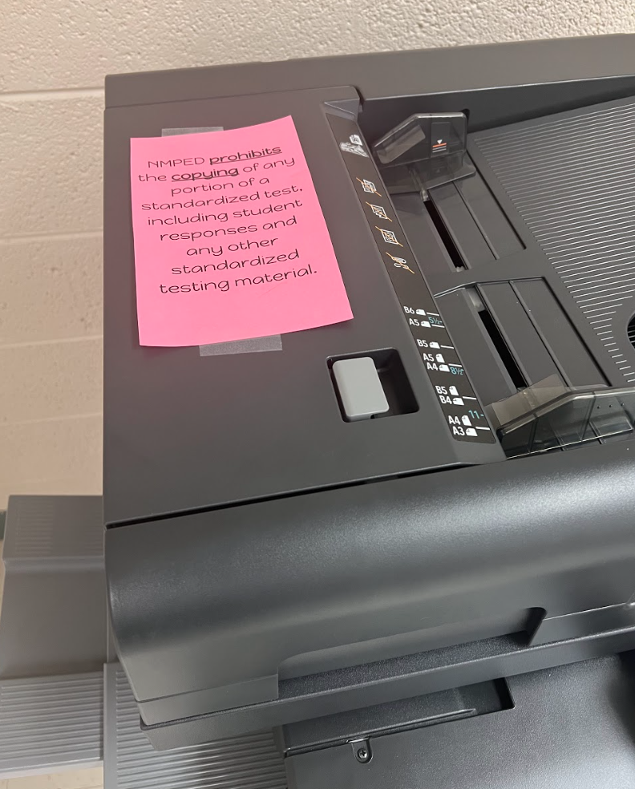
Prohibited Practices (6.10.7 NMAC)
Using secure test questions, or altered version of the assessment
Revealing, copying, or reproducing secure assessment questions, materials or student responses
Repeated drilling of content identical to what is found in state assessments
Example: Practice items should be used organically in instruction; not to drill for the assessment
Placing undue stress on a student before, during or after the test
ALAMOGORDO PUBLIC SCHOOLS
Carrie Rowe, DTC
ALAMOGORDO PUBLIC SCHOOLS
Carrie Rowe, DTC
Notes:
Within NMAC 6.10.7 there are 18 prohibited practices when administering assessments, and I only intend to highlight a few. READ SLIDE

Slide 48
Testing Environment
Distraction free testing environment | The school shall designate an area for the test administration that provides an environment that minimizes distractions and disruptions for students (e.g., classroom, computer lab, or library).
Instructional materials removed or covered | Posters, charts, visuals that might include related: content displays word lists writing formulas definitions mathematical formulas/theorems
Notes:
READ SLIDE

Slide 49
Testing Environment
Active Monitoring of students | Test Administrators and Proctors must move through the room and monitor the students’ work area during testing; give full attention to students. The Test Administrators and Proctors should avoid distracting behaviors such as: holding extended conversations with one another reading newspapers or books eating working on a computer, using a cell phone, iPad, etc. tending to unrelated duties
Notes:
READ SLIDE

Slide 50
Testing Environment
No student access to electronic devices | Permitting students during a standardized test to have on or near their desk or on their person, any unauthorized items, including scrap paper, tablets, laptop computers, cell phones with or without cameras, cameras, calculators, calculator watches, smart watches, media players, headphones, backpacks, and rulers unless any of these are required or permitted by standardized test instructions or non-standardized accommodations request.
Notes:
READ SLIDE

Slide 51
Testing Environment
Secure test materials | All secure test materials must be kept secure at all times.
Permitted room attendance | Only staff involved in administering the test and the students taking the test can be in the testing room.
Notes:
READ SLIDE

Slide 52
Testing Irregularities
TEST IRREGULARITY
Any incident that results in a deviation from documented test administration procedures
File an Irregularity report through the DTC portal
Non-Impactful
Impactful
Valid Test
Valid Test
Invalid Test
Notes:
READ SLIDE

Slide 53
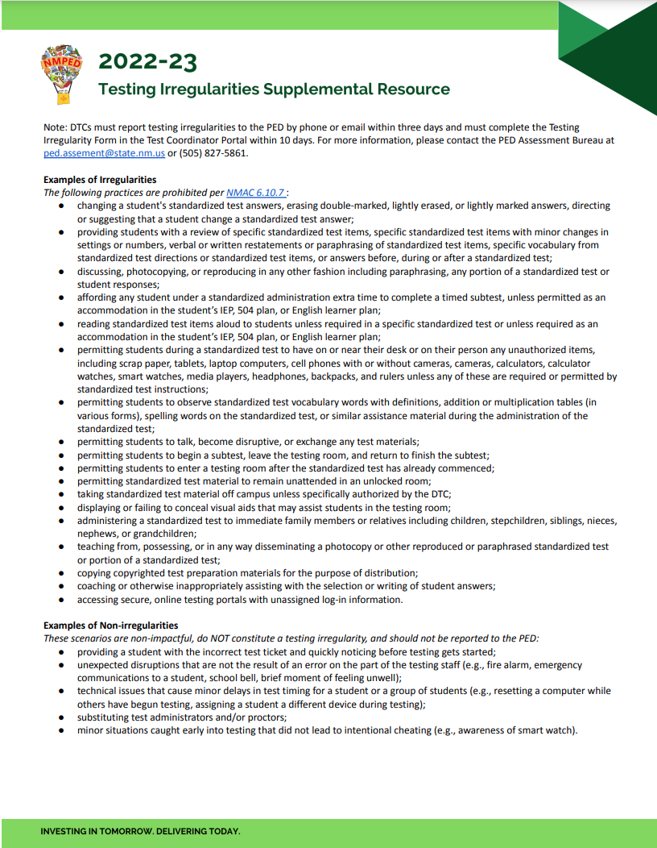
Testing Irregularities
All irregularities should be reported through the DTC portal
The Testing Irregularities Supplemental Resource is available to help determine if an action qualifies as a reportable irregularity
The Assessment Bureau will make the final determination if an irregularity warrants a testing invalidation
Testing irregularities that occur during interim assessments/progress monitoring can be handled locally and do not have to be reported the Assessment Bureau
Notes:
READ SLIDE

Slide 54
Testing Irregularities
DTCs are expected to investigate and report the circumstances behind an irregularity and provide a recommendation about the decision to invalidate a test
If the investigation reveals wrongdoing by a TA, the DTC can recommend that the PED legal team complete a licensure investigation
using actual test questions to prepare students for the tests
erasing students’ wrong answers and filling in the correct answers
indicating the correct answers to students during testing
allowing students to change answers after giving them the correct answers
allowing students to discuss answers with each other
Using accommodations inappropriately
Notes:
READ SLIDE

Slide 55
2021-2022 NM MSSA Achievement Data
Greg Howell
Director Mountain Region
© 2020 Cognia, Inc.
Notes:
Materials Needed
Participants will receive handouts packet.
Printouts: See handouts file “assessment literacy handouts”; Print “what makes a strong assessment item” on legal paper
Groupings
Groupings will occur in breakout rooms. This session will be delivered regionally so special attention will need to be given to grouping teachers by like schools/classrooms/students as much as possible

Slide 56
‘21-’22 Mathematics Achievement Summary
 | 3rd Grade | 4th Grade | 5th Grade | 6th Grade | 7th Grade | 8th Grade
Novice | 46% | 48% | 44% | 41% | 49% | 38%
Near Proficiency | 31% | 27% | 25% | 26% | 26% | 42%
Proficient | 19% | 20% | 21% | 26% | 14% | 17%
Advanced | 4% | 5% | 10% | 7% | 11% | 2%
NM MSSA ‘21-’22
Notes:
Overall Mathematics achievement summary

Slide 57
‘21-’22 Language Arts Achievement Summary
 | 3rd Grade | 4th Grade | 5th Grade | 6th Grade | 7th Grade | 8th Grade
Novice | 27% | 30% | 34% | 22% | 20% | 33%
Near Proficiency | 42% | 34% | 30% | 45% | 45% | 33%
Proficient | 16% | 22% | 22% | 20% | 21% | 16%
Advanced | 16% | 14% | 14% | 13% | 14% | 17%
NM MSSA ‘21-’22
Notes:
Overall Mathematics achievement summary

Slide 58
‘21-’22 Science Achievement Summary
 | 5th Grade | 8th Grade | 11th Grade
Novice | 28% | 19% | 31%
Near Proficiency | 40% | 51% | 29%
Proficient | 24% | 28% | 40%
Advanced | 7% | 1% | 1%
NM MSSA ‘21-’22
Notes:
Overall Mathematics achievement summary

Slide 59
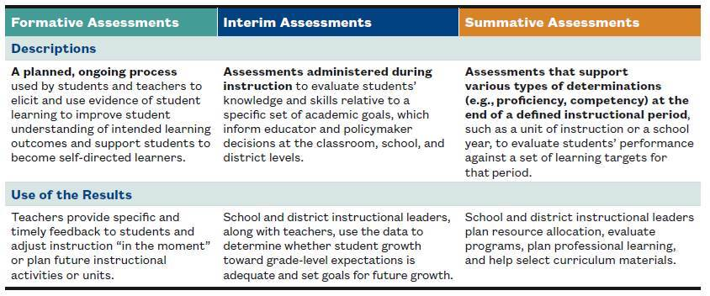
Balanced Assessment System

Slide 60
Assessment Literacy Objectives
Offer support to NM Educators:
Through providing an overview of the NM Balanced Assessment System (BAS)
In helping grow awareness of what assessment resources are available to them
In facilitating understanding of the data that is available and how it aligns to the (BAS)
In developing practices that use data to drive instructional decisions.

Slide 61
What is Assessment Literacy?
“Assessment Literacy is defined as the knowledge about how to assess what students know and can do, interpret the results of these assessments, and apply these results to improve student learning and program effectiveness.”
https://www.michiganassessmentconsortium.org/assessment-literacy-standards/
Notes:
t.

Slide 62
NM MSSA Achievement Data
SY ‘21-’22
Mathematics

Slide 63
Percent of Students Scoring Below Grade Level Expectations
 | Problem Solving/Reasoning & Argument | Measurement and Data/Geometry | Model/Structure & Repeated Reasoning | N & O Base Ten & Fractions | Operations and Algebraic Thinking
Grade 3 | 64% | 60% | 62% | 64% | 65%
Grade 4 | 61% | 39% | 62% | 64% | 61%
Grade 5 | 48% | 49% | 47% | 62% | 37%
NM MSSA ‘21-’22
Notes:
Data broken down by reporting categories from overall achievement data pull
Overall we have a higher percentage of students scoring below grade level expectation in the highlighted areas

Slide 64
Percent of Students Scoring Below Grade Level Expectations
 | Problem Solving/Reasoning & Argument | Geometry/ Stats & Prob | Model/Structure & Repeated Reasoning | The Number system/Expressions & Equations | Ratios & Proportional Relationships
Grade 6 | 48% | 35% | 49% | 57% | 51%
Grade 7 | 59% | 57% | 48% | 56% | 55%
Grade 8 | 55% | 58% | 61% | 60% | Functions 66%
NM MSSA ‘21-’22
Notes:
Data broken down by reporting categories from overall achievement data pull
Overall we have a higher percentage of students scoring below grade level expectation in the highlighted areas

Slide 65
NM MSSA Achievement Data
SY ‘21-’22
Language Arts

Slide 66
Percent of Students Scoring Below Grade Level Expectations
 | Literacy Text | Informational Text | Comprehension | Analysis and Interpretation
Grade 3 | 49% | 41% | 47% | 45%
Grade 4 | 44% | 38% | 51% | 41%
Grade 5 | 44% | 42% | 54% | 45%
NM MSSA ‘21-’22
Notes:
Data broken down by reporting categories from overall achievement data pull
Overall we have a higher percentage of students scoring below grade level expectation in the highlighted areas

Slide 67
Percent of Students Scoring Below Grade Level Expectations
 | Literacy Text | Informational Text | Comprehension | Analysis and Interpretation
Grade 6 | 37% | 47% | 35% | 50%
Grade 7 | 43% | 36% | 37% | 39%
Grade 8 | 48% | 44% | 52% | 51%
NM MSSA ‘21-’22
Notes:
Data broken down by reporting categories from overall achievement data pull
Overall we have a higher percentage of students scoring below grade level expectation in the highlighted areas

Slide 68
NM MSSA Achievement Data
SY ‘21-’22
Science

Slide 69
Percent of Students Scoring Below Grade Level Expectations
 | Physical Science | Life Science | Earth and Space Science
Grade 5 | 51% | 56% | 48%
Grade 8 | 50% | 49% | 49%
Grade 11 | 34% | 43% | 42%
NM MSSA ‘21-’22
Notes:
Data broken down by reporting categories from overall achievement data pull
Overall we have a higher percentage of students scoring below grade level expectation in the highlighted areas

Slide 70
Available Resources
Tailored Professional Learning
Dedicated Help and Support Site
Practice Test Materials
rubrics, writing prompts, sample questions
Formative Item Sets
Grades 3-8 Math, ELA, Science
High School Social Studies
SAT Suite Question Bank (SSQB)
NM Instructional Scope
formative examples, writing prompts

Slide 71
Professional Learning SY ‘22-’23
Assessment Literacy support for schools and districts
In-person
Webinar
Assessment Literacy Canvas Courses
Offerings sent out to Superintendents
Developing Formative Practices in the Classroom
iMSSA Data Next Steps
Reflections on Assessment Literacy (reflection CoPs based on completion of Canvas courses)

Slide 72
How can I support you?
Greg Howell
gregory.howell@cognia.org
505.235.7454

Slide 73
Testing Assignment - Activity
Student 12345 is a new 8th grade ELL to your district or school. She has no IEP and requires no other accommodations.
What initial questions should you ask as you prepare to assign tests to this student?
What tests should you assign?
How might you go about insuring this student receives a Spanish version of the test through Cognia?
Student 12345
Notes:
READ SLIDE

Slide 74
Testing Assignment - Activity
An instructor in your district calls and asks for your advice. She wants your help in determining if one of her students should be on alternate assessment. She’s says she worried about assigning alternate assessment because she does not want the district to go over the 1% alternate assessment cap.
What criteria should be used in determining if alternate assessment is appropriate for a student?
What role can a DTC play in this decision? Parents?
Suppose the student took the DLM last year and was proficient. What role does last year’s score play in this year’s decision?
Teacher
Notes:
READ SLIDE

Slide 75
Question and Answer

Slide 76
Homework: BOY Survey
Please complete the DTC BOY Survey:
5 questions
Interim Assessment choice, satisfaction of today’s training
Due Oct. 21

Slide 77
Assessment Team Contacts
Lynn Vasquez Division Director of Assessment & LMS
Nick Salazar Assistant Director of Assessment
Xavier DeLeon NAEP Coordinator
Axel Hernandez Assessment Coordinator
Adam Rios Assessment Coordinator
Tori Gilpin Assessment Coordinator
Vanessa Gurule Bureau Operations
PED.assessment@state.nm.us General inquiries
Canvas.admin@state.nm.us Canvas Help Desk

