Slide 1
New Mexico PED Assessments
Test Administration Platform Orientation for
New Mexico MSSA (Summative), iMSSA (Interim) and Formative Assessments
Part 1: Test Administration

Slide 2
Agenda
Training plan and additional training resources
Overview of system and testing process
Portal orientation
Managing user accounts
Managing student records and rosters
Setting up classes and test sessions
Monitoring testing and completing tests
Invalidating tests and assigning test report codes
Adding accommodations and accessibility tools

Slide 3
Training
For end-to-end overview of MSSA and iMSSA testing with the iTester platform, view:
Test Administration Platform Orientation for New Mexico MSSA (Summative), iMSSA (Interim) and Formative Assessments Part 1: Test Administration
Test Administration Platform Orientation for New Mexico MSSA (Summative), iMSSA (Interim) and Formative Assessments Part 2: Student Test Interface
Test Administration Platform Orientation for New Mexico MSSA (Summative), iMSSA (Interim) and Formative Assessments Part 3: Kiosk Installation and Site Readiness Testing
View tutorial videos to see demonstration of specific tasks to include:
Certifying Your Site
Creating Classes
Assigning Accessibility Features and Accommodations
Scheduling Test Sessions
Adding Students & Downloading School Rosters
Creating and Editing Portal User Accounts
Deactivating User Accounts
Uploading and Exporting User Accounts
Uploading Pre-ID Files
Resolving Pre-ID Errors
Viewing Reports in Data Interaction
Available at https://newmexico.onlinehelp.cognia.org/cbt-tutorials/

Slide 4
Training
Consult user guides for additional information:
NMPED Assessments Portal User Guide
NMPED Assessments Kiosk Installation Guide
NMPED Assessments Technology Guidelines
NMPED Assessments QuickStart Scheduling Test Sessions
NMPED Assessments QuickStart Printing Student Log-ins
NMPED Assessments QuickStart Student Interface
NMPED Assessments QuickStart Practice Site
NMPED Assessments Kiosk User Guide
NMPED Assessments Testing with Third Party Assistive Technology
NMPED Assessments Technical Guide for Spanish Language Support
NMPED Reporting Guide
CBT guides are available at https://newmexico.onlinehelp.cognia.org/cbt-guides/
Support Desk
Portal Practice Site:
url: https://intro.emetric.net/
DTC login: NMADTC/N3wM3xico!
STC login: NMASTC/N3wM3xico!
TA login: NMATA/N3wM3xico!
View various menus and tabs
Pre-loaded students and classes
Can schedule classes for a test
Nightly Clean-up
Not New Mexico-specific

Slide 5
Terms and Acronyms
iTester: eMetric test administration system used with Cognia assessments (NM-MSSA Math, ELA, SLA; iMSSA Math (English and Spanish), and ELA; Formative Math, ELA, Science, and Social Studies
New Mexico PED Assessments Portal (aka “Portal”)
New Mexico PED Assessments Student Test Interface
Kiosk application (Web browser option for Interim/Formative)
Data Interaction: eMetric reporting system for LEAs, accessed via the Portal
Family Portal: eMetric reporting website for parents and legal guardians, includes ISRs for NM-MSSA, iMSSA, and College Board SAT
User Account Types:
DTC: District Test Coordinator
STC: School Test Coordinator
TA: Test Administrator (teacher or test proctor)
ITC: Information Technology Coordinator
RAO: Report Access Only
See online video tutorials for demonstrations!

Slide 6
Key differences between Summative (MSSA) and Interim (iMSSA)/Formative Item Sets
Summative | Formative/Interim
Students must use kiosk to access test | Students can access tests using a web browser or kiosk
Session Access Codes and Proctor Passwords are used | Session Access Codes and Proctor Passwords are NOT used
ASL, Spanish tests and TTS available | No ASL, limited Spanish tests and TTS
Machine or professionally scored tests with later reporting following score review and data cleanup | Interim: machine scoring with next-day reporting Formative: machine/teacher scoring and near real-time results
See the Formative User Guide and tutorial videos for more information on specialized Formative-specific features such as creating custom item sets and teacher scoring of human scored items.

Slide 7
Test Administration Timeline
A specific schedule for each school year will be published by PED
A general sequence of events for each school year is:
Early summer: test administration portion of the Portal is closed for a three week maintenance window to remove previous school year’s data (students, classes, test sessions removed) from administration portal (All test scores will continue to be available in Data Interaction.)
Mid summer: Pre-ID upload window opens, and Formative tests are available for upcoming school year
August: new student test kiosks are available to download and install for the upcoming school year, iMSSA Beginning of Year (BOY) window opens (8-week window)
December: iMSSA Middle of Year (MOY) window opens (8-week window)
January: State accountability office will upload Pre-ID for any schools who have not already uploaded students
March: Pre-ID upload window closes and MSSA (Summative) begins
April: iMSSA End of Year (EOY) window opens
May: MSSA and iMSSA EOY test windows close
Late May: early summative reporting released
Late Jun: final summative reporting released

Slide 8
iTester Testing Platform
Online System
Administration and Reporting Portal
https://newmexico.cognia.org
Users
Administration
Test Delivery
Student Test Interface
Kiosk
Site Setup
Students
Browser
Reporting
Classes
Test Sessions
Dashboard
Enrollment Transfer
Application
https://newmexico.cognia.org/student

Slide 9
New Mexico Assessments Student Test Interface
Two ways to access this:
New Mexico Public Education Department Assessments Kiosk
Required for summative
Optional for interim and formative
Must be downloaded and installed onto each student test device
Chrome and iPad Kiosks are available from app stores; automatically updated to newest version after initial install
Windows and Mac must be downloaded from portal and installed whenever a new version is available - usually once a year in August, exact date will be communicated by PED
For installation guidance see Test Administration Platform Orientation for New Mexico MSSA (Summative), iMSSA (Interim) and Formative Assessments Part 3: Kiosk Installation and Site Readiness Testing
Web browser:
https://newmexico.cognia.org/student
Can use with all Practice tests
Can use with Interim and Formative operational tests

Slide 10
Test Preparation Process
ITC
Download and install kiosks (if required)
Complete Site Readiness Test
DTC/STC
Add/edit/transfer students
Assign accessibility features and accommodations
Make classes
DTC/STC
Schedule classes for test
Print/distribute log-in tickets
Students
Launch kiosk
Log-in and test
When test window opens
During or after testing…
DTC/STC
If needed, add test report codes and invalidate tests
DTC/STC/RAO
View Reports
Formative: 10-15 min
Interim: next day
Summative: per schedule published by PED

Slide 11
New Mexico Assessments Portal:
Online Test Administration System
New Mexico Assessments Student Test Interface:
Student Test Delivery System
See the New Mexico Assessments Student Test Interface Overview tutorial for more information

Slide 12
User Accounts and Access
New DTC: account will be created by Cognia & credentials e-mailed to you
Already have a user account? Continue to use it!
Not a DTC, don’t have an account?
STC/ITC/RAO/TA: request account from your DTC
Notes:
Usernames must be unique
New users will receive two automated emails, one with username and one with temporary password from nmtechsupport@cognia.org
When an account is reactivated or deactivated, the user will receive an e-mail
Know your username, ensure the e-mail address associated with the username is correct
Give user access to the program(s) they will be working on.
Programs: MSSA, iMSSA, Formative
DTCs and STCs must review all accounts in their organization and deactivate any un-used accounts!
See online video tutorials for demonstrations!

Slide 13
User Accounts and Access
Access | DTC | STC (for orgs assigned) | ITC (for orgs assigned) | TA (for orgs assigned) | RAO (for orgs assigned)
Manage Users | Yes | Yes | Yes | View TAs only | No
Access Site Readiness Links | Yes | Yes | Yes | No | No
Access Proctor Password | Yes | Yes | No | No | No
Access Students | Yes | Yes | No | Limited | No
Edit Student | Yes | Yes | No | No | No
Access Roster Upload | Yes | No | No | No | No
Access Classes | Yes | Yes | No | Yes | No
Access Test Sessions | Yes | Yes | No | Yes | No
Download Test Completion Status | Yes | Yes | No | No | No
Student Enrollment Transfer | Yes* | Yes* | No | No | No
Access Dashboard | Yes | Yes | No | No | No
Reports | Yes | Yes | No | Yes (classes only) | Yes (for assigned orgs)
*DTCs can access all student enrollment transfer functions, STCs have limited permissions

Slide 14
User Accounts and Access
Portal url: https://newmexico.cognia.org/

Slide 15
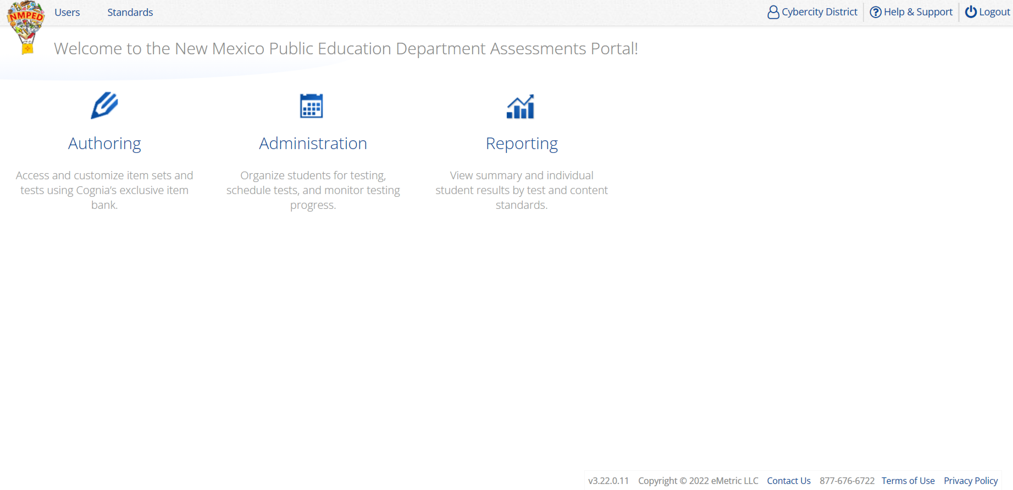
User Accounts and Access
Users
1
Portal url: https://newmexico.cognia.org/
Cognia Help and Support Site: https://newmexico.onlinehelp.cognia.org/

Slide 16
User Accounts and Access
2
3
4
1
5

Slide 17
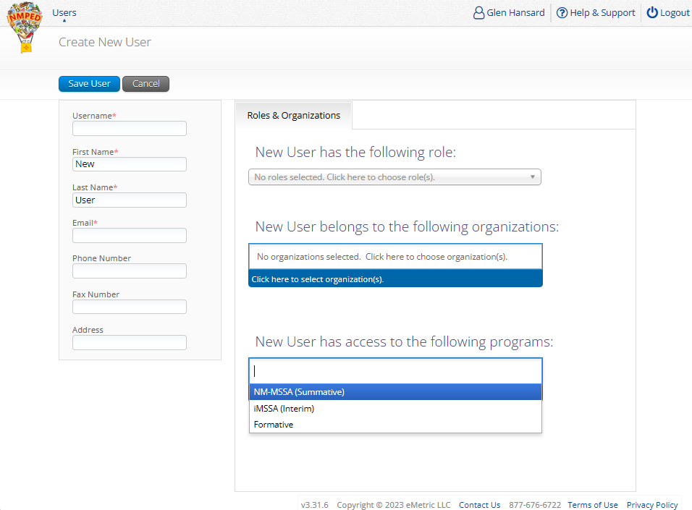
User Accounts and Access
5
TA Account:
At least one account is needed to create classes
Teachers using Formative
Staff assisting with any assessment
1
2
3
4

Slide 18
User Accounts and Access
Landing Page
Portal url: https://newmexico.cognia.org/
Cognia Help and Support Site: https://newmexico.onlinehelp.cognia.org/

Slide 19
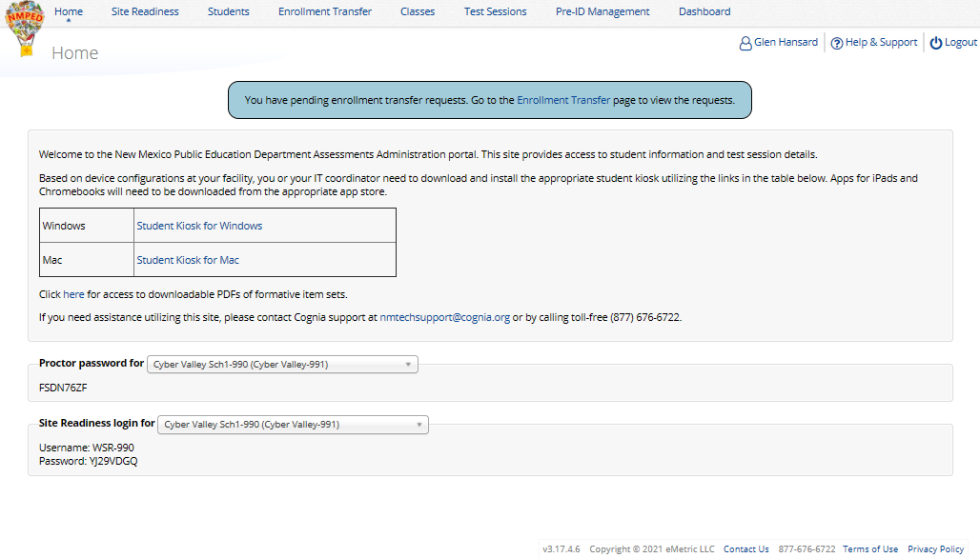
User Accounts and Access
Admin Page
1
3
2

Slide 20
Managing Students
Update rosters
DTCs may upload rosters in bulk anytime outside of the summative test window
DTCs may transfer students from one school to another within their district at any time
DTCs and STCs may request student transfer for students enrolled in other districts at any time
DTCs and STCs can add student individually at anytime
Check/update demographic information
Tips:
In Students tab: Download roster in csv at any time by selecting “Export Roster” under the “Exports” drop down (contains name, State Student ID and Grade)
In Pre-ID Management tab (DTC only): Download roster in Pre-ID upload format by selecting “Export Students”
Can’t add student? They may be enrolled in different school – initiate transfer request
See online video tutorials for demonstrations!

Slide 21
Managing Student Accommodations
Check/edit accommodations
Can add accommodations in Pre-ID file during Pre-ID upload
Edit student accommodations individually or
Use Upload Accommodations to edit multiple students' accommodations at one time
Use the Export Accommodations button to download list of all students and their currently assigned accommodations
Tip: Edit accommodations in the file downloaded in Export Accommodations and upload the edited file using the Upload Accommodations interface
Accommodations applied to the student will be applied to any assessment the student takes unless the accommodation is removed before they log into the assessment
See online video tutorials for demonstrations!

Slide 22
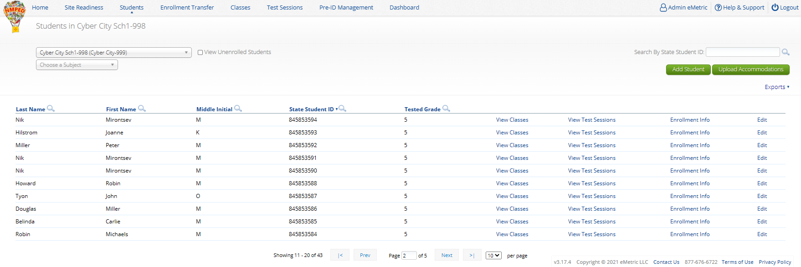
Managing Students
1
3
4
5
2

Slide 23
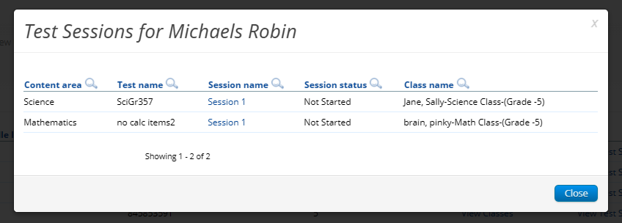
Managing Students
See online video tutorials for demonstrations!

Slide 24
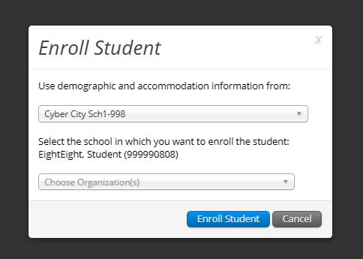
Managing Students
1
2
See online video tutorials for demonstrations!

Slide 25
Managing Students
1
3
4
5
2

Slide 26
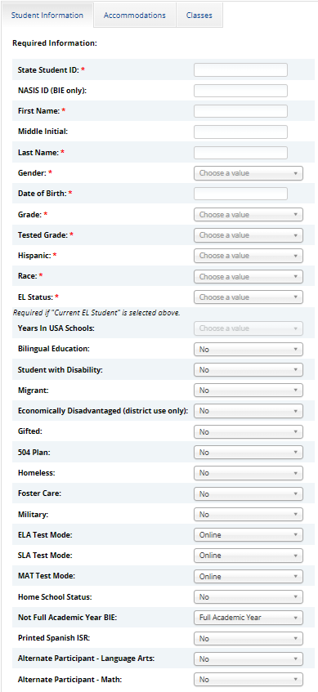
Managing Students
Fields with “*” are required
“Grade” is Student’s enrolled grade
“EL Status” and “Years in USA Schools” linked
Cognia help desk must change State Student ID if that needs to be corrected

Slide 27
Enrollment Transfer Requests
Request to transfer students into your school or district from another district
Permissions:
DTC can initiate, approve, reject and view requests for all schools in their district and can transfer students within their district
STCs can initiate request and view requests for their assigned school(s)
State or Cognia help desk approves unenrolled students
Workflow:
Requestor: Search by student ID, last name and DOB
If student is located, request transfer, add optional note
Receiver: e-mail and portal notification
Approve or Deny request (denial requires note)
Requestor: e-mail notification of approval/denial
Note:
All requests, approval, denials logged in Portal
Test Sessions are not transferred, use notes to indicate what sessions a student has already completed.
See online video tutorials for demonstrations!

Slide 28
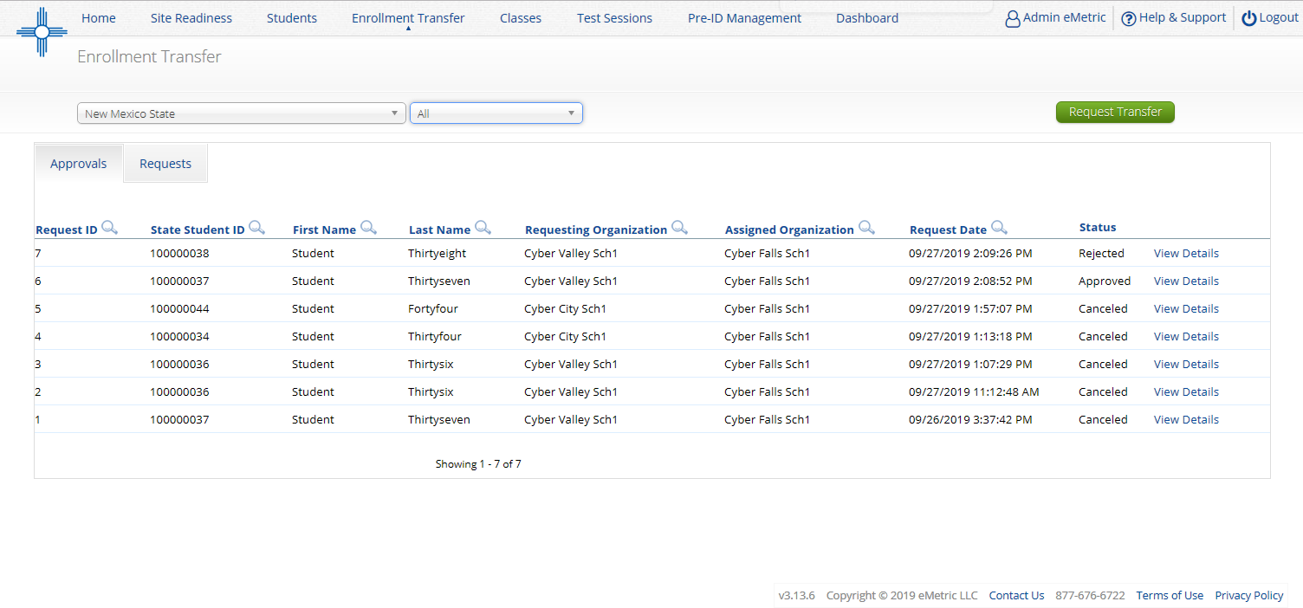
Enrollment Transfer Requests
Organization
Status:
Pending
Canceled
Approved
Rejected
Your requests
Requests sent to you from other organizations
See online video tutorials for demonstrations!

Slide 29
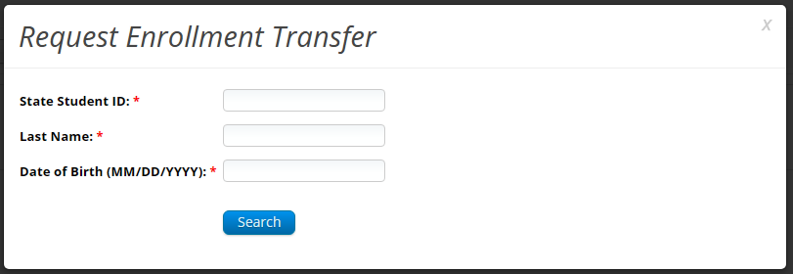
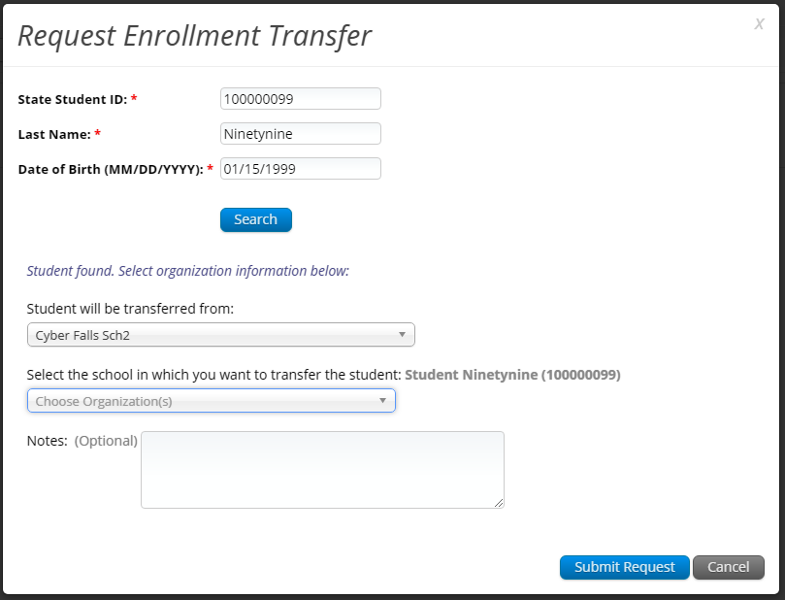
Enrollment Transfer Requests

Slide 30
Enrollment Transfer Requests
Enrollment request - requestor’s view
Enrollment request - receiver’s view
See online video tutorials for demonstrations!

Slide 31
Managing Classes
Groups of one or more students who will take a test
Create classes by grade and subject
(Grade 3 Math, Grade 3 ELA, Grade 3 Science, Grade 4 Math, Grade 4 ELA, Grade 4 Science, etc…)
Class can be deleted if it has not been scheduled for a test
If test session scheduled and no student has logged in, delete test session, then class
Separate class needed for English and Spanish testers
Do not place students in a class scheduled to take the Spanish version of the test unless they will take the Spanish version of the test
Students can be assigned to more than one class
If any student needs to retake the test, you must create a new class, put the student(s) in that new class and schedule that class for the test
See online video tutorials for demonstrations!

Slide 32
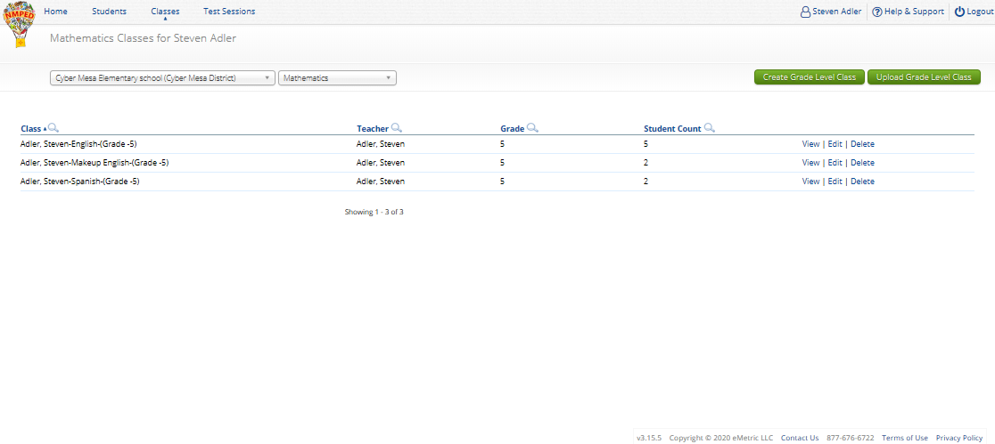
Managing Classes
1
2
3
4
5
See online video tutorials for demonstrations!

Slide 33
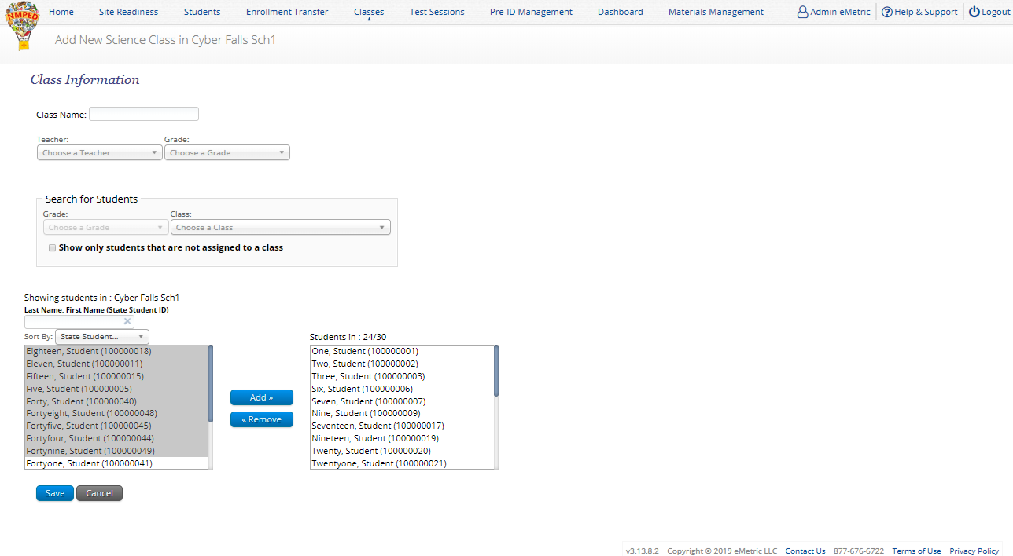
Managing Classes
Limit of 90 students per class
1
TA name and class grade will automatically be added to class name
2
Use this to prevent adding
students to more than one class
3
Shows number of students in class, and class limit; current limit is 90 students per class
4
See online video tutorials for demonstrations!

Slide 34
Managing Classes
Use Class Upload to save time and stay organized
Upload classes with different grades and subjects
DTC’s: Classes can be uploaded at district level
Note: you cannot use Class Upload while the test window is open
See online video tutorials for demonstrations!

Slide 35
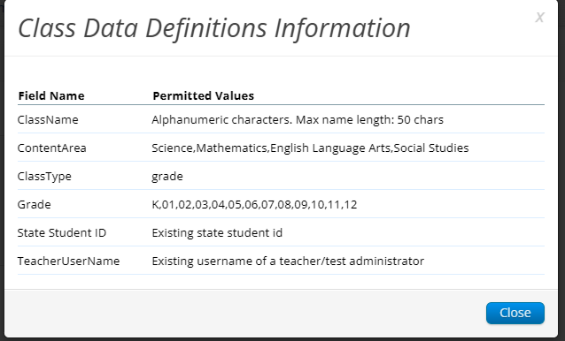
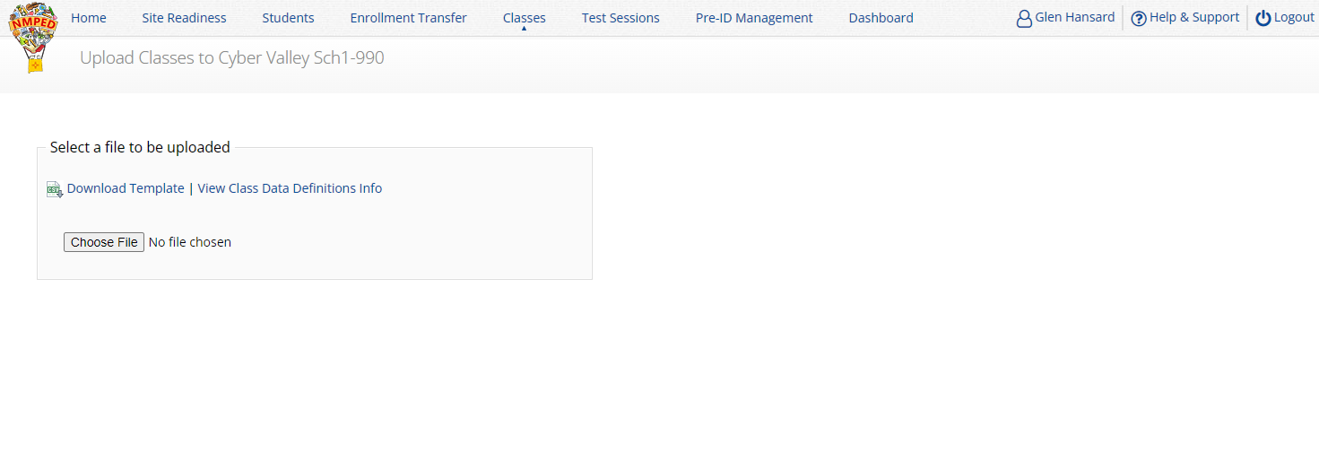
Managing Classes
See online video tutorials for demonstrations!

Slide 36
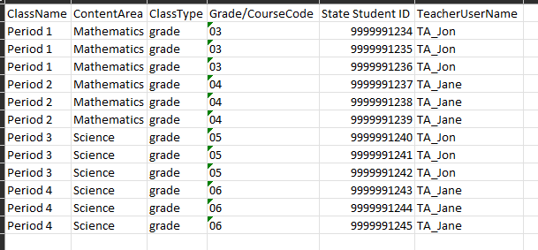
Managing Classes
Grade/CourseCode column should be changed to text type to ensure leading 0 in grade is retained
Save as csv
See online video tutorials for demonstrations!

Slide 37
Managing Test Sessions
Starting and monitoring testing
Schedule a test session (assign class to test)
Test available to schedule one week prior to admin window opening
Select program, subject, and then test
Check test name for language and grade
Students who will take Spanish test must be scheduled separately
Go to the test session details page to:
Review students in the test session
Check student forms (TTS)
Print test tickets with students’ usernames and passwords
Ensure student has accessibility/accommodations listed on test ticket cover sheet
Monitor test sessions, download test session information
Students do not have to test at the same time
Log-ins can be used at anytime during the test window as long as the student has not turned in the test
If a student inadvertently turns in a test early the help desk can reopen the session
See online video tutorials for demonstrations!

Slide 38
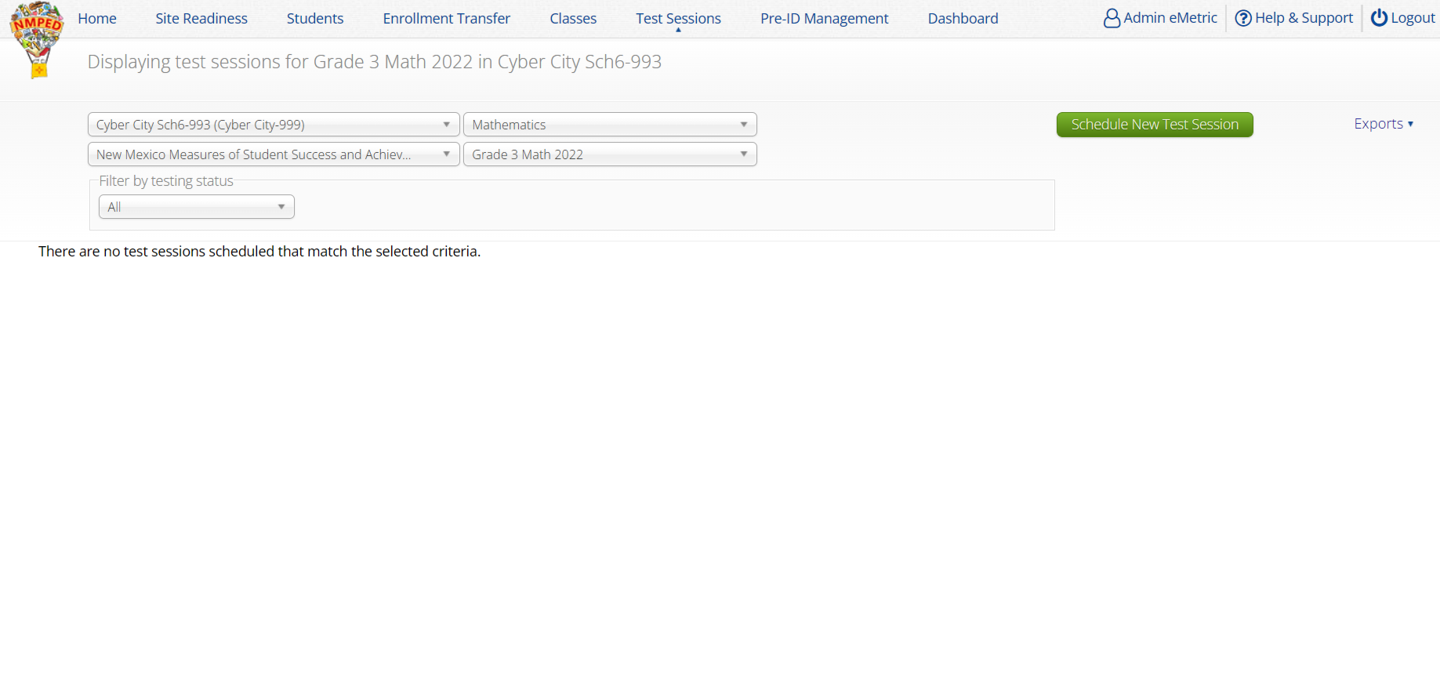
Managing Test Sessions
1
3
5
2
4
See online video tutorials for demonstrations!

Slide 39
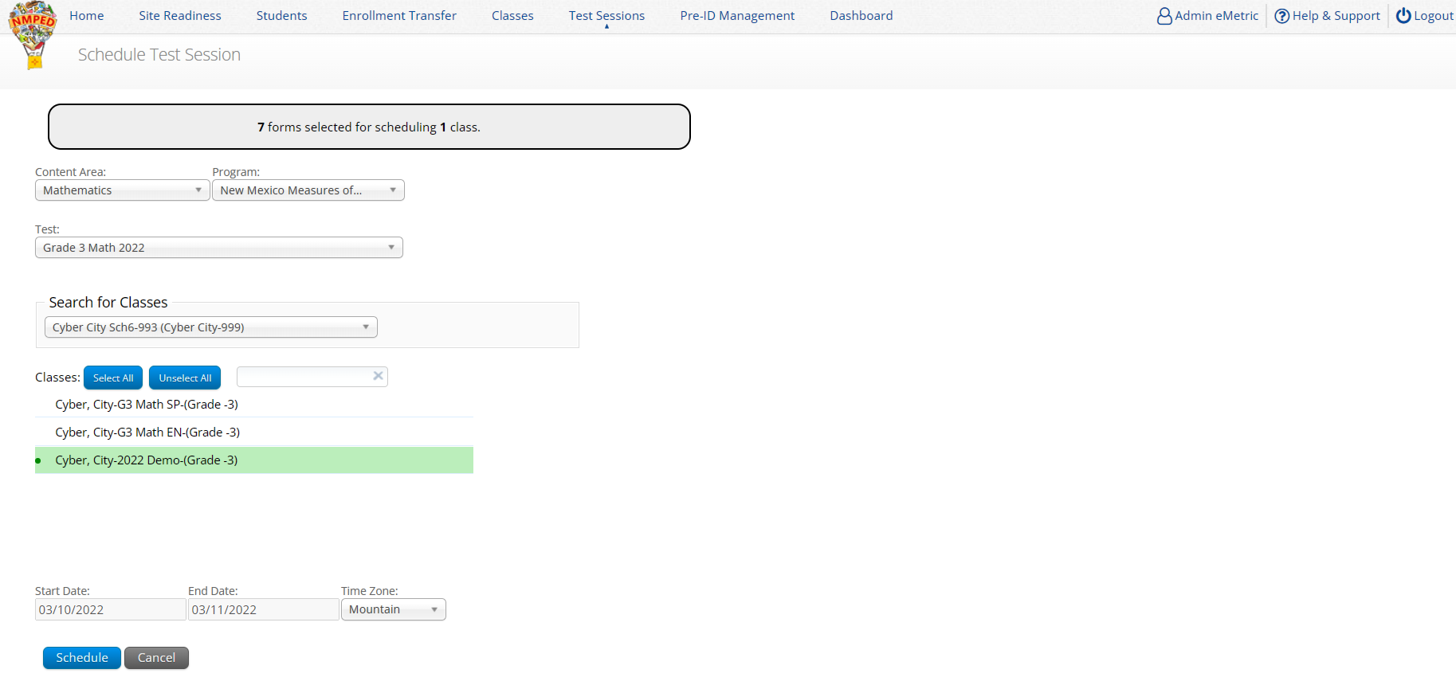
Managing Test Sessions
1
2
Class must be same grade level as test
If class has already been scheduled for a test, it cannot be scheduled again and will not show up in the classes list
Test window cannot be edited
3
4
See online video tutorials for demonstrations!

Slide 40
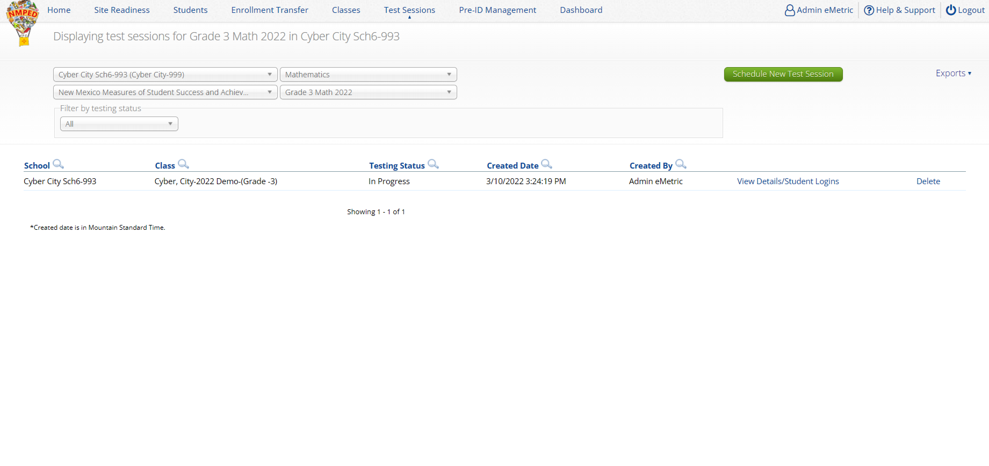
Managing Test Sessions
See online video tutorials for demonstrations!

Slide 41
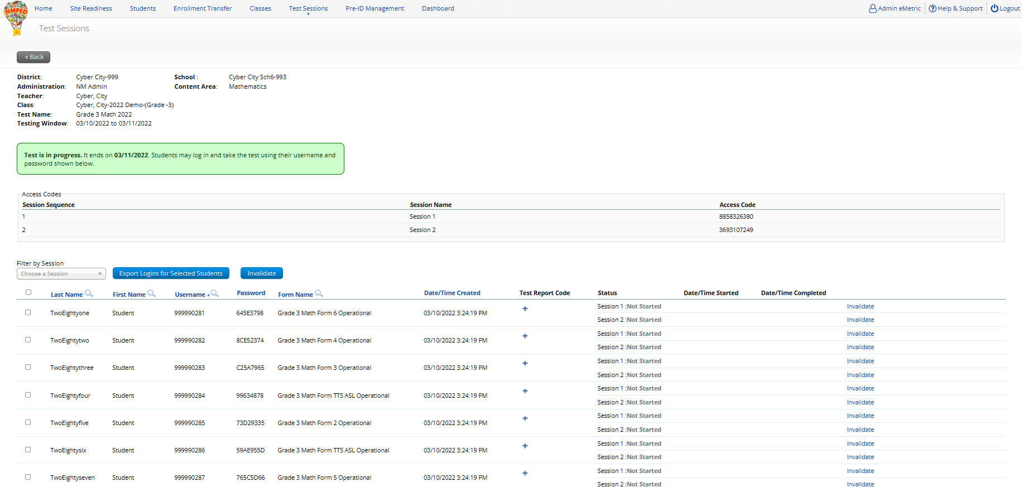
Managing Test Sessions
Session Access Code
Time Student was added
Form Name
Test Status
Login Credentials
See online video tutorials for demonstrations!

Slide 42
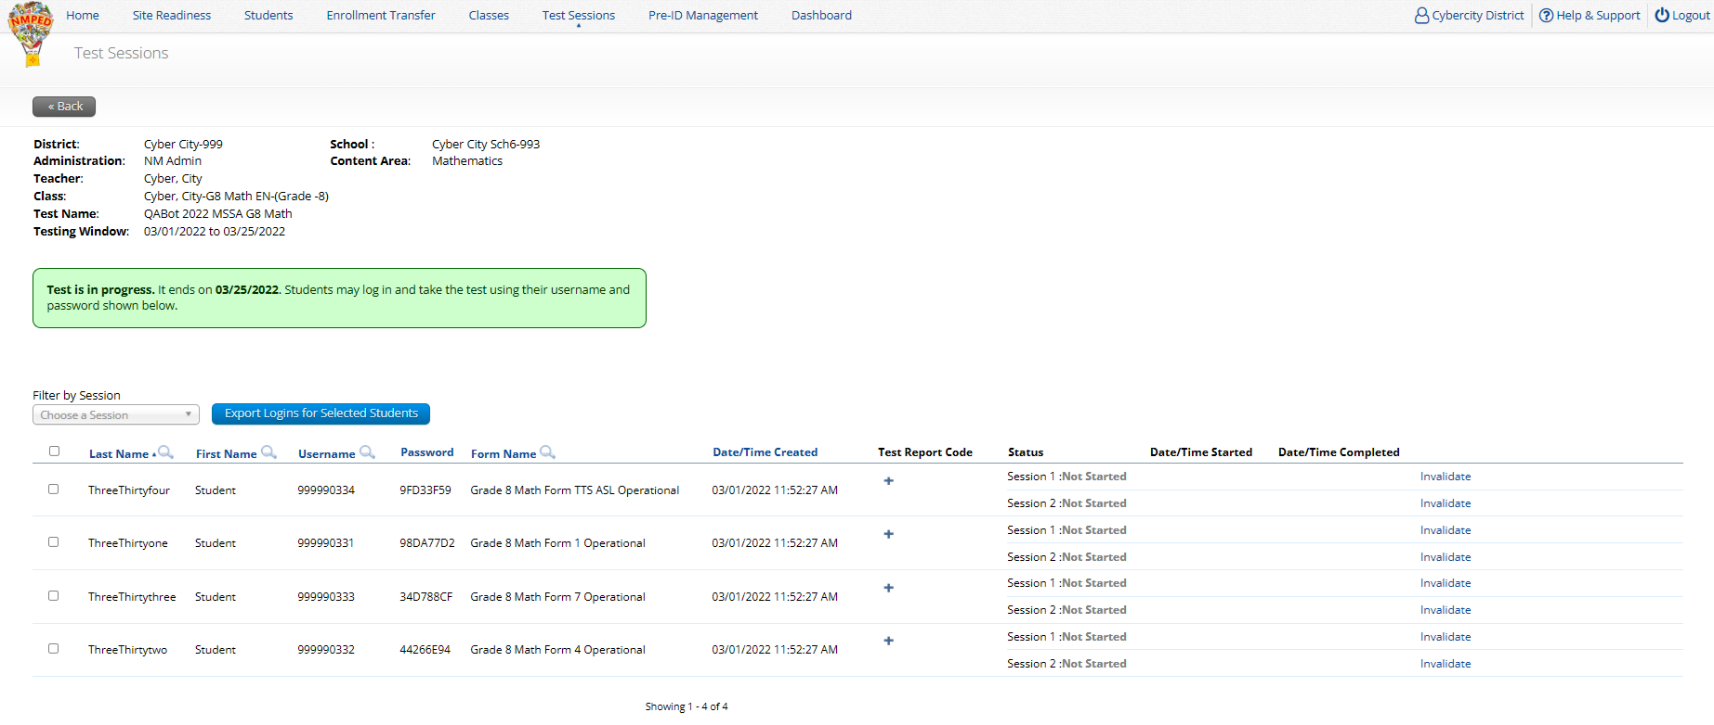
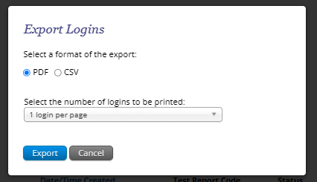
Managing Test Sessions

Slide 43
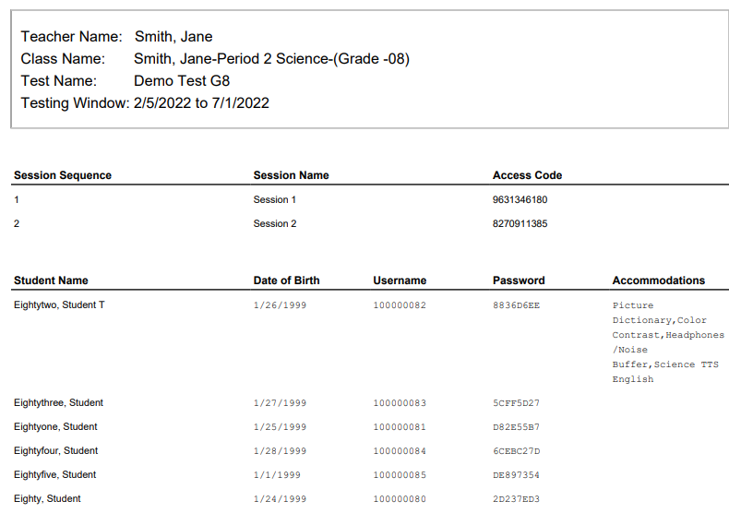
Managing Test Sessions

Slide 44
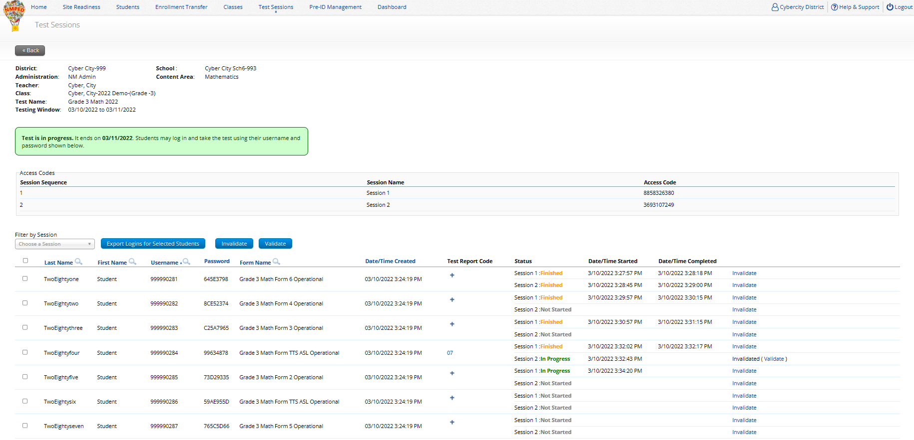
Managing Test Sessions
Test Status
See online video tutorials for demonstrations!

Slide 45
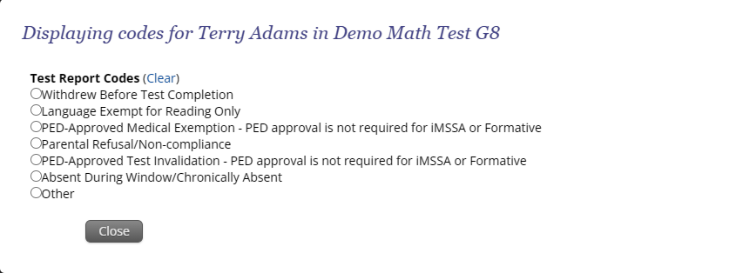
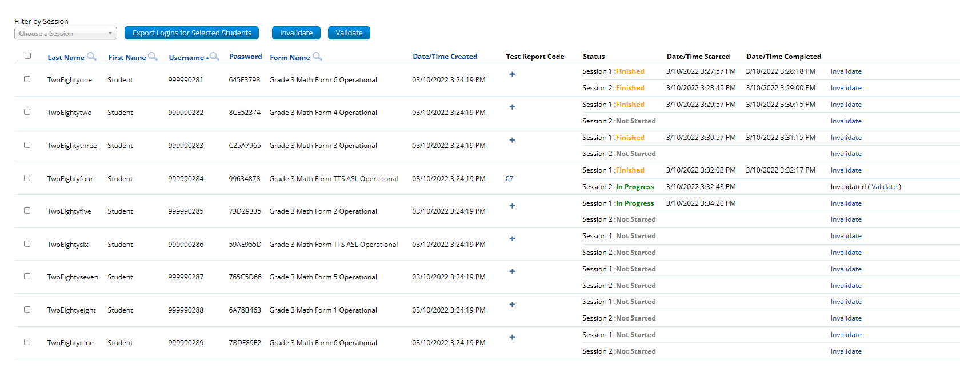
Managing Test Sessions
Test Report Code
Test Invalidation
See online video tutorials for demonstrations!

Slide 46
Monitoring Testing
Dashboard: District and School-level dashboard for monitoring testing
Not to be used for accountability purposes!
“Export Test Status” Download list of all students with their test status (time each session started, completed) in a csv file
See online video tutorials for demonstrations!

Slide 47
Managing Test Sessions
Completing testing and invalidating tests - Summative
Ensure all students have test status of “Finished”
If the student does not finish:
If a Student starts a test session and completes 5 or more items:
Leave the student in the class/test session
Contact PED to approve the invalidation
If approved…
Enter a test report code of “PED-Approved Invalidation”
Select “invalidate” for each test session
Put the student in a new class/test session and have them take both sessions if they are given another attempt.
Only a test report code of “PED-Approved Invalidation” should be invalidated. All other test report codes should not be invalidated.
An invalidation should only occur for a reportable score; a score is considered reportable if 5 or more test items were attempted.
See online video tutorials for demonstrations!
Notes:
Not real time – previous days data going back to day 1

Slide 48
Managing Test Sessions
Completing testing and invalidating tests – Summative (cont.)
If a Student does not start any test session or attempts less than 5 items:
Leave the student in the class/test session
Enter test report code and do not invalidate. The not started session or sessions with less than 5 items attempted will be removed during post test data clean-up
Put the student in a new class/test session and have them take both sessions
Note: iMSSA (Interim) has slightly different rules for using Test Report Codes and Invalidation
Note: Students cannot log into a test if the test has been invalidated
Note: additional attemptedness and test void rules are applied after the test administration window and may impact reporting
See online video tutorials for demonstrations!
Notes:
Not real time – previous days data going back to day 1

Slide 49
Managing Test Sessions
Completing testing and invalidating tests – Interim (iMSSA)
Finished iMSSA tests are machine scored and reported the next day
Refer to the chart on the next slide to understand how test status, test report codes, and invalidations impact iMSSA reporting
General guidelines:
Ensure all students have test status of “Finished” unless they did not finish
To document why a student did not start or complete a test, enter a test report code and invalidate the sessions using this two-step process:
Enter a test report code
Select “invalidate” for each test session
If the student will be given another attempt, place the student in a new class and create a new test session for that class
Note: Students cannot log into a test if the test has been invalidated
See online video tutorials for demonstrations!
Notes:
Not real time – previous days data going back to day 1

Slide 50
iMSSA Reporting
Test Status | Test Invalidation | Test Report Code | Report Status
Not started | No | No | Not Reported
Not Started | Yes | Yes | Will be reported with test report code displayed in score column next day
Not Started | Yes | No | Not Reported
Not Started | No | Yes | Will be reported with test report code displayed in score column next day
In Progress | No | No | Will be reported as incomplete when window closes
In Progress | Yes | Yes | Will be reported with test report code displayed in score column next day
In Progress | Yes | No | Will be reported as incomplete when window closes
In Progress | No | Yes | Will be reported with test report code displayed in score column next day
Turned In | No | No | Will be reported with score next day/NRT
Turned In | Yes | Yes | Will be reported with test report code displayed in score column next day
Turned In | Yes | No | Will be reported with score next day/NRT
Turned In | No | Yes | Will be reported with test report code displayed in score column next day
If student is enrolled but not scheduled for a test, they will not appear in the Data Interaction report
If test report code is added or removed after student is reported in Data Interaction, it will be updated in reporting when test window closes (“final DB synch”)
If demographics or accommodations are updated after a student is reported in Data Interaction, they will be updated in reporting when test window closes (“final DB synch”)
Reporting rules are different for Interim and Summative!

Slide 51
Student Tools, Accommodations and Accessibility Features
Universal Tools
(Available to all students)
Platforms tools that are built in and automatically delivered during testing
Accessibility Features
(Available to some without IEP/ 504)
Must be pre-identified by DTC/STC prior to testing
Accommodations
(IEP, 504)

Slide 52
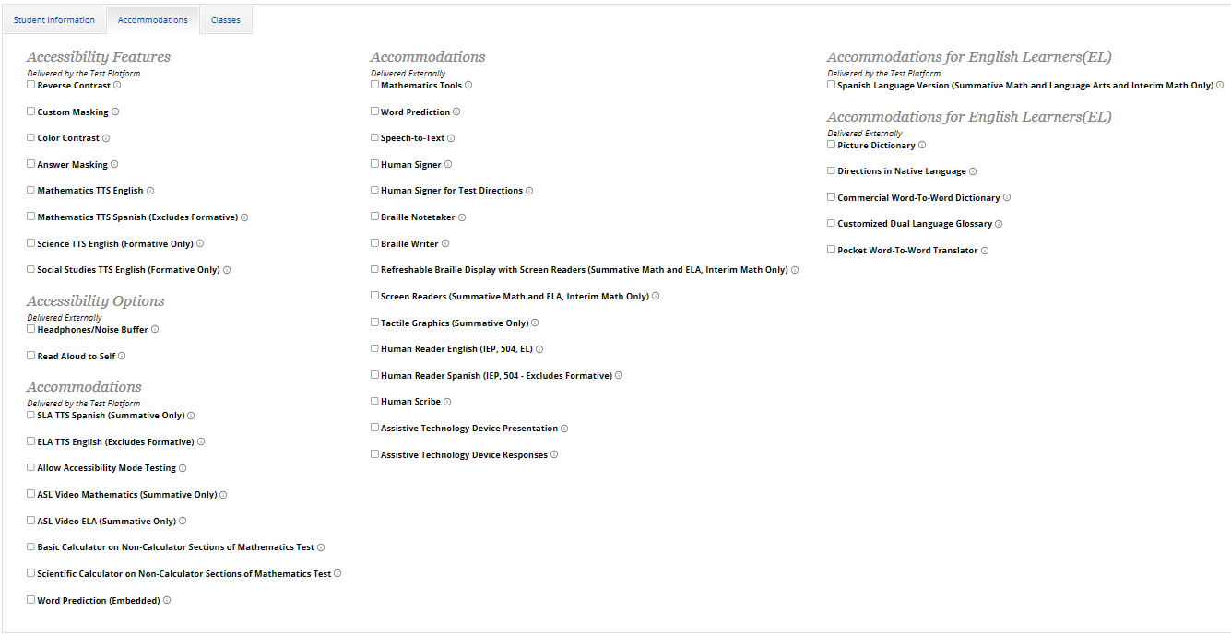
Assigning Platform Delivered Accessibility and Accommodations
Ensure the accommodation is available in the assessment!
See online video tutorials for demonstrations!

Slide 53
Assigning Accessibility and Accommodations: Spanish Testers
Place the student in a class with Spanish testers and assign class to Spanish Version of Test!
See online video tutorials for demonstrations!

Slide 54
Assigning Accessibility and Accommodations: Screen readers
Screen reader can be used with test platform for Math and ELA (screen reader/braille display on external device not needed)
See the “Testing with Third Party Assistive Technology” guide for more information on using the test interface with screen readers, speech-to-text, text-to-speech and other assistive technologies.
Try-out your assistive technology using a Formative test with a kiosk

Slide 55
Assigning Accessibility and Accommodations: Special Supports
Windows only! Proctor must enter proctor password when student logs in to test.
Student can use CoWriter© word-prediction; an additional file must download which may delay loading test by a minute.
Update: available in Windows, Mac and Chrome, available in English and Spanish!
See the “Testing with Third Party Assistive Technology” guide for more information on using the test interface with screen readers, speech-to-text, text-to-speech and other assistive technologies.
Try-out your assistive technology using a Formative test with a kiosk

Slide 56
Assigning Accessibility and Accommodations
Review the test ticket cover sheet!

Slide 57
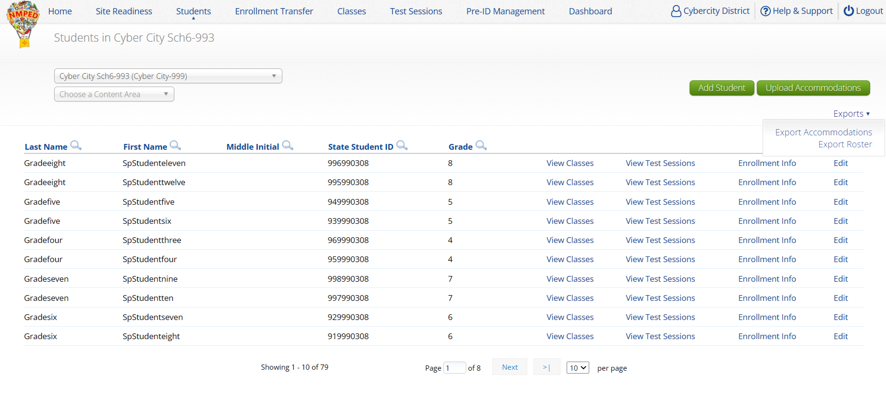
Assigning Accessibility and Accommodations

Slide 58
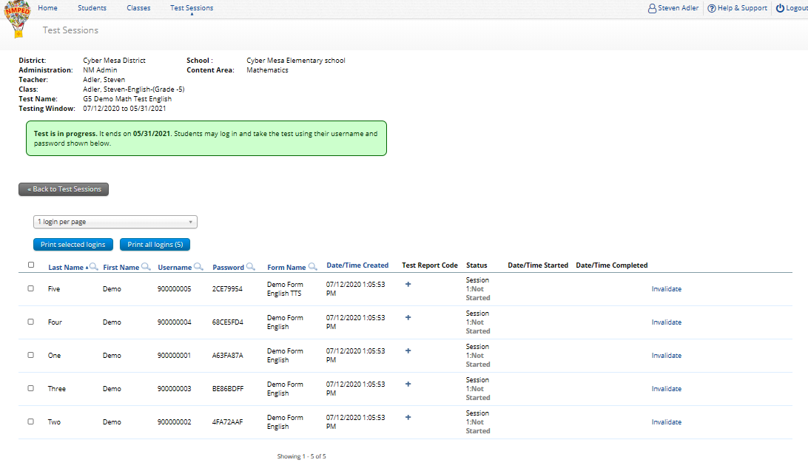
Text-To-Speech
Form Name
See online video tutorials for demonstrations!

Slide 59
Text-To-Speech
The student test interface uses the default voice set on the student’s workstation.
See Kiosk Installation Guide for specific steps on how to change the default voice.
Assign all student text-to-speech accommodations PRIOR to student logging into tests.
If you must add accommodation after student is scheduled but before they log in, click on Add or Update Students test Logins button after TTS has been added:
If student logs in and realizes they do not have TTS, you must assign accommodation and then place them in new/different class

Slide 60
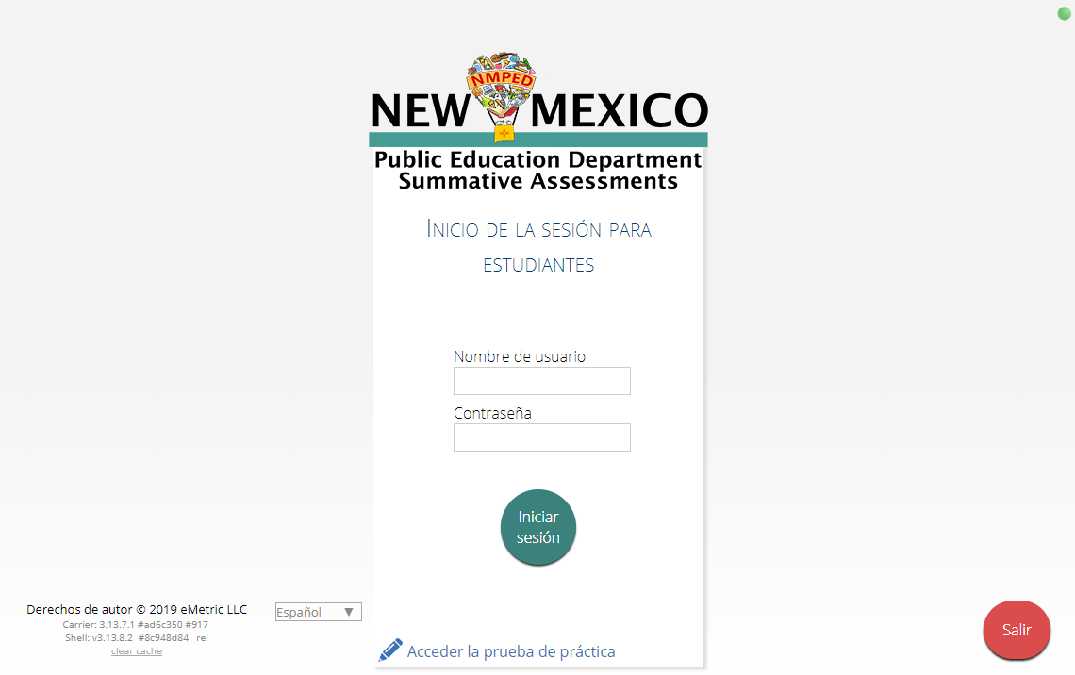
Spanish Language Testing
Create separate class for Spanish test
Schedule Spanish class for Spanish test
Ensure Student changes Kiosk to Spanish version before they log-in
Spanish TTS Accommodation
Ensure Spanish TTS is selected
Must use Cepstral Software when testing on Windows or Mac
Available via the Cognia Help desk
See NMPED Assessments Technical Guide for Spanish Language Support 2022-2023 for more information
Switch between English
and Spanish Kiosk

Slide 61
Remember!
DTCs/STCs:
Deactivate unused accounts
Once a student has been added in a Pre-ID upload or manually, they can be used in any assessment (MSSA, iMSSA, Cognia Formative)
TAs/Proctors:
Ensure Students have TTS form BEFORE they log into test (see TTS slide)
Spanish version of test must be scheduled separately – accommodation setting is for reporting only (see Spanish Test slide & Spanish Testing Guide)
Do not schedule students for the Spanish version if they do not need the Spanish version

Slide 62
Thank you for viewing!

