Slide 1
New Mexico PED Assessments
Test Administration Platform Orientation for
New Mexico MSSA (Summative), iMSSA (Interim) and Formative Assessments
Part 2: Student Test Interface

Slide 2
Agenda
Training plan and additional training resources
Overview of system and testing process
Student Test Interface orientation and new features
Logging-in and navigating a test
Tools and features
Turning in the test
Technical requirements and trouble shooting common issues
Practice testing

Slide 3
Training & Help
For end-to-end overview of MSSA and iMSSA testing with the iTester platform, view:
Test Administration Platform Orientation for New Mexico MSSA (Summative), iMSSA (Interim) and Formative Assessments Part 1: Test Administration
Test Administration Platform Orientation for New Mexico MSSA (Summative), iMSSA (Interim) and Formative Assessments Part 2: Student Test Interface
Test Administration Platform Orientation for New Mexico MSSA (Summative), iMSSA (Interim) and Formative Assessments Part 3: Kiosk Installation and Site Readiness Testing
View tutorial videos to see demonstration of specific tasks to include:
Certifying Your Site
Creating Classes
Assigning Accessibility Features and Accommodations
Scheduling Test Sessions
Adding Students & Downloading School Rosters
Creating and Editing Portal User Accounts
Deactivating User Accounts
Uploading and Exporting User Accounts
Uploading Pre-ID Files
Resolving Pre-ID Errors
Viewing Reports in Data Interaction
Available at https://newmexico.onlinehelp.cognia.org/cbt-tutorials/

Slide 4
Training & Help
Consult user guides for additional information:
NMPED Assessments Portal User Guide
NMPED Assessments Kiosk Installation Guide
NMPED Assessments Technology Guidelines
NMPED Assessments QuickStart Scheduling Test Sessions
NMPED Assessments QuickStart Printing Student Log-ins
NMPED Assessments QuickStart Student Interface
NMPED Assessments QuickStart Practice Site
NMPED Assessments Kiosk User Guide
NMPED Assessments Testing with Third Party Assistive Technology
NMPED Assessments Technical Guide for Spanish Language Support
NMPED Reporting Guide
CBT guides are available at https://newmexico.onlinehelp.cognia.org/cbt-guides/
Support Desk
Portal Practice Site:
url: https://intro.emetric.net/
DTC login: NMADTC/N3wM3xico!
STC login: NMASTC/N3wM3xico!
TA login: NMATA/N3wM3xico!
View various menus and tabs
Pre-loaded students and classes
Can schedule classes for a test
Nightly Clean-up
Not New Mexico-specific

Slide 5
Terms and Acronyms
iTester: eMetric test administration system used with Cognia assessments (NM-MSSA Math and ELA, iMSSA Math and ELA, Formative Math, ELA, Science, and Social Studies)
New Mexico PED Assessments Portal (aka “Portal”)
New Mexico PED Assessments Student Test Interface
Kiosk application (Web browser option for Interim/Formative)
Data Interaction: eMetric reporting system for LEAs, accessed via the Portal
Family Portal: eMetric reporting website for parents and legal guardians, includes ISRs for NM-MSSA, iMSSA, and College Board SAT
User Account Types:
DTC: District Test Coordinator
STC: School Test Coordinator
TA: Test Administrator (teacher or test proctor)
ITC: Information Technology Coordinator
RAO: Report Access Only
See online video tutorials for demonstrations!

Slide 6
Key differences between Summative (MSSA) and Interim (iMSSA)/Formative Item Sets
Summative | Formative/Interim
Students must use kiosk to access test | Students can access tests using a web browser or kiosk
Session Access Codes and Proctor Passwords are used | Session Access Codes and Proctor Passwords are NOT used
ASL, Spanish tests and TTS available | No ASL, limited Spanish tests and TTS
Machine or professionally scored tests with later reporting following score review and data cleanup | Interim: machine scoring with next-day reporting Formative: machine/teacher scoring and near real-time results
See the Formative User Guide for more information on specialized Formative-specific features such as creating custom item sets and teacher scoring of human scored items.

Slide 7
Test Administration Timeline
A specific schedule for each school year will be published by PED
A general sequence of events for each school year is:
Early summer: test administration portion of the Portal is closed for a three week maintenance window to remove previous school year’s data (students, classes, test sessions removed) from administration portal (All test scores will continue to be available in Data Interaction.)
Mid summer: Pre-ID upload window opens and Formative tests are available for upcoming school year
August: new student test kiosks are available to download and install for the upcoming school year, iMSSA Beginning of Year window opens (8 week window)
December: iMSSA Middle of Year window opens (8 week window)
January: State accountability office will upload Pre-ID for any schools who have not already uploaded students
March: Pre-ID upload window closes and MSSA (Summative) begins
April: iMSSA End of Year window opens
May: MSSA and iMSSA EOY test windows close
Late May: early summative reporting released
Late Jun: final summative reporting released

Slide 8
iTester Testing Platform
Online System
Administration and Reporting Portal
https://newmexico.cognia.org
Users
Administration
Test Delivery
Student Test Interface
Kiosk
Site Setup
Students
Browser
Reporting
Classes
Test Sessions
Scoring
Enrollment Transfer

Slide 9
New Mexico Assessments Student Test Interface
Two ways to access this:
New Mexico Public Education Department Assessments Kiosk
Required for summative
Optional for interim and formative
Must be downloaded and installed onto each student test device
Chrome and iPad Kiosks are available from app stores; automatically updated to newest version after initial install
Windows and Mac must be downloaded from portal and installed whenever a new version is available - usually once a year in August, exact date will be communicated by PED
For more information on how to install and test the kiosk see New Mexico Assessments Kiosk Installation and Site Readiness Testing Overview
Web browser:
https://newmexico.cognia.org/student
Can use with all Practice tests
Can use with Interim and Formative operational tests

Slide 10
Test Preparation Process
ITC
Download and install kiosks (if required)
Complete Site Readiness Test
DTC/STC
Add/edit/transfer students
Assign accessibility features and accommodations
Make classes
DTC/STC
Schedule classes for test
Print/distribute log-in tickets
Students
Launch kiosk
Log-in and test
When test window opens
During or after testing…
DTC/STC
If needed, add test report codes and invalidate tests
DTC/STC/RAO
View Reports
Formative: 10-15 min
Interim: next day
Summative: per schedule published by PED

Slide 11
New Mexico Assessments Portal:
Online Test Administration System
New Mexico Assessments Student Test Interface:
Student Test Delivery System
See the New Mexico Assessments Student Test Interface Overview tutorial for more information

Slide 12
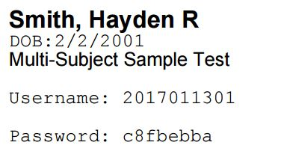
Logging into a Test

Slide 13
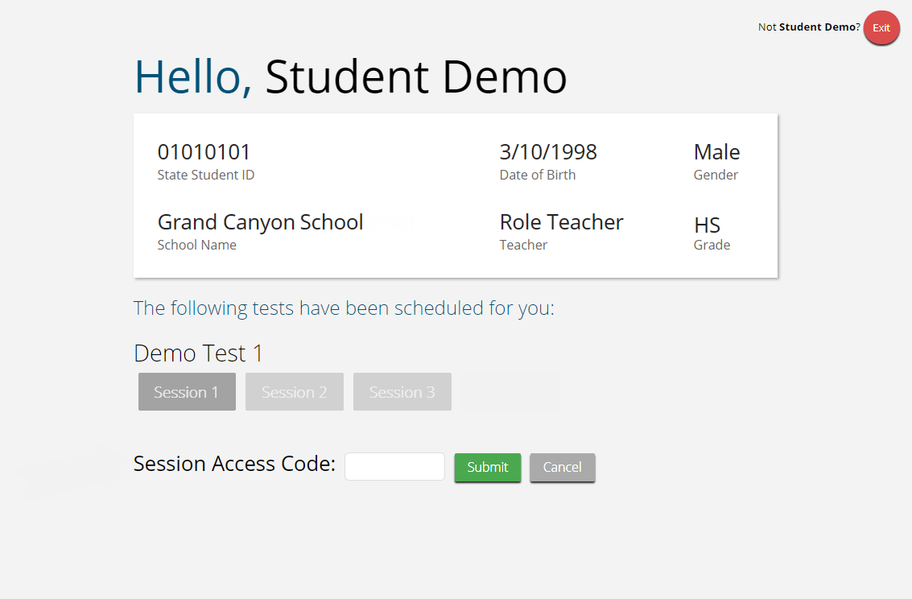
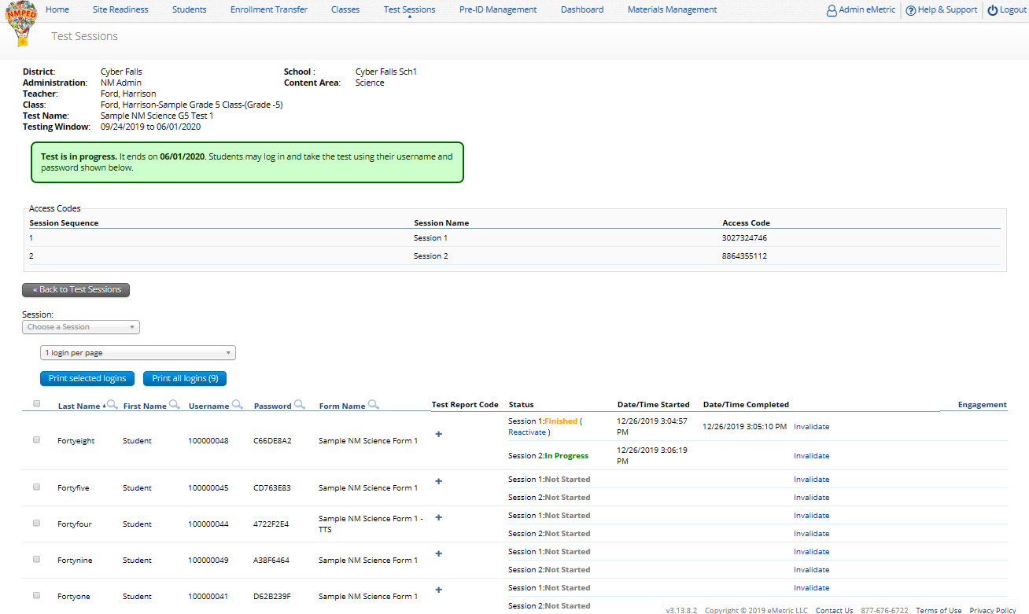
Logging into a Test

Slide 14
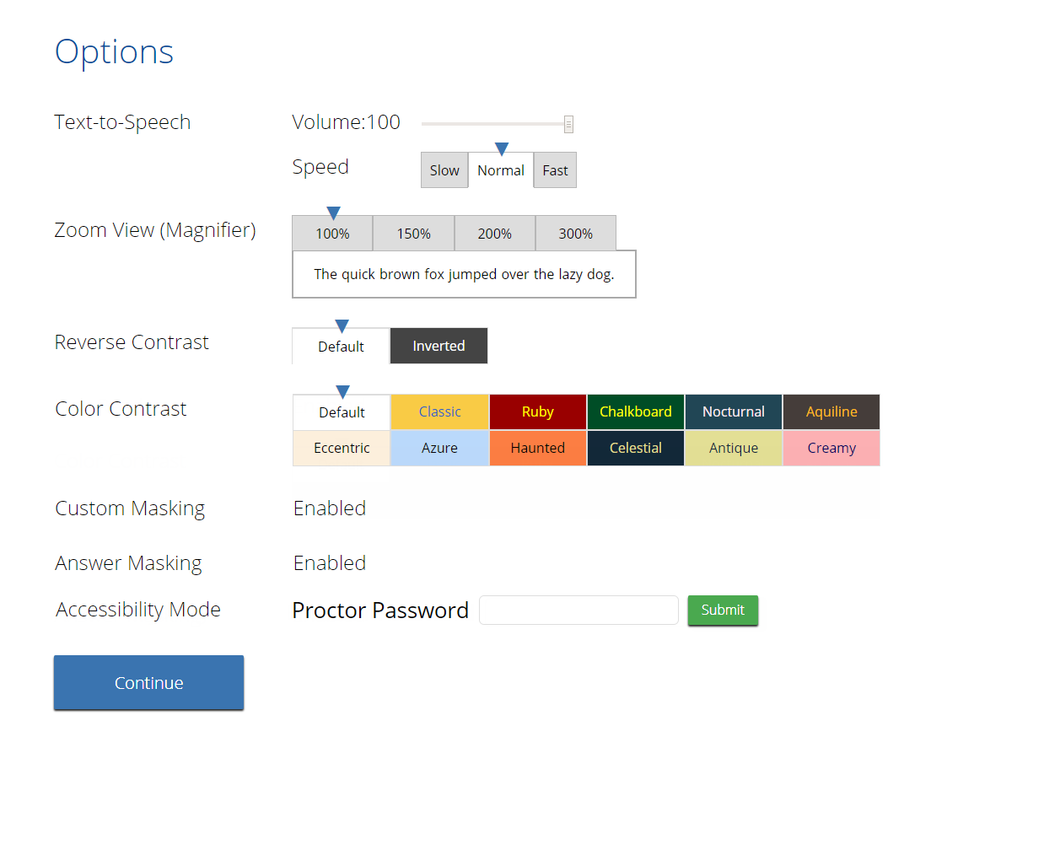
Logging into a Test

Slide 15
Logging into a Test

Slide 16
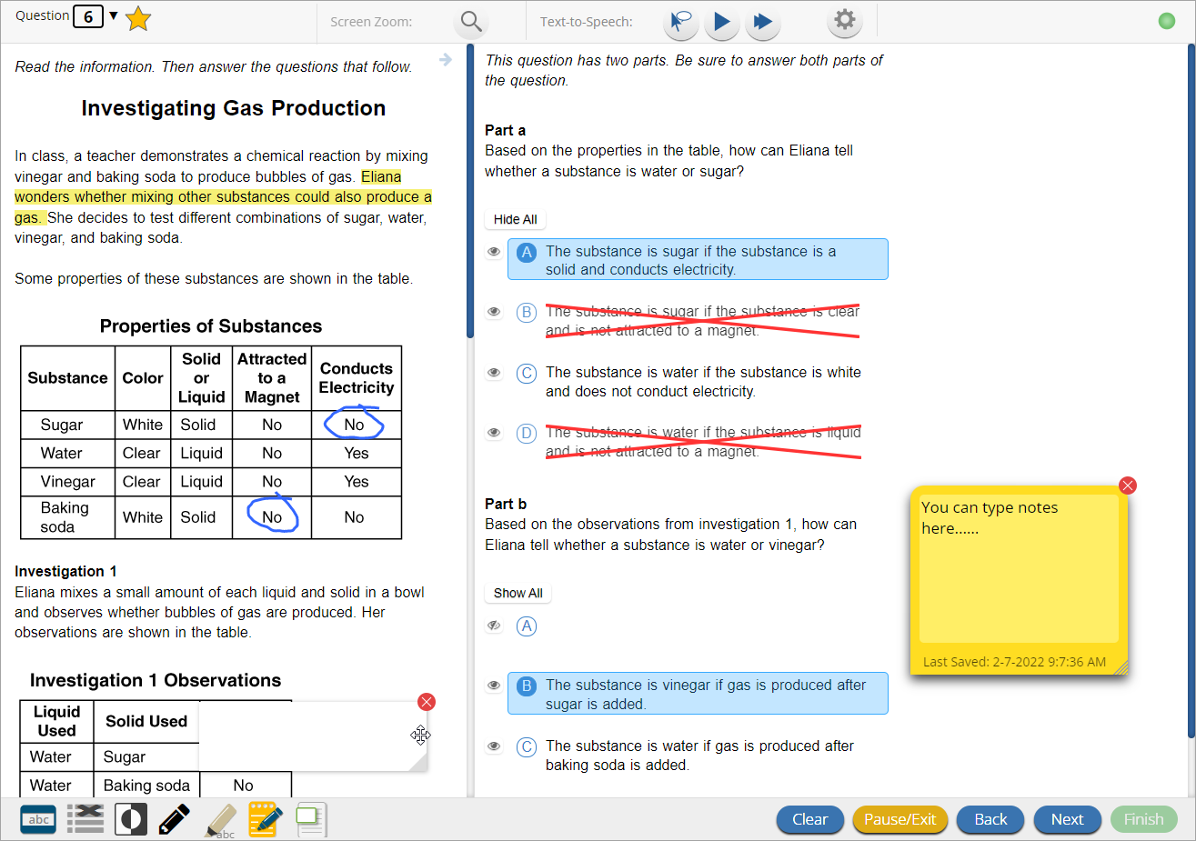
Test Navigation

Slide 17
Universal Tools
Name | Tool Icon
Sketch Tool (Not available on constructed response items)
Text Highlighter
Note Pad
Line Reader
Answer Eliminator
Reference Sheet
Pop-up Glossary
Notes:
If they pause test, these will not be saved!

Slide 18
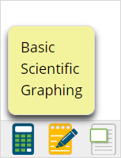
Universal Tools
Name | Tool Icon
Zoom View (magnifier)
Bookmark
Expand Passage
Basic Calculator* Scientific Calculator* Texas Instruments™ Calculators are used on Interim and Summative
Writing Tools
*Also available as accommodation on non-calculator portions of the Math test
Notes:
If they pause test, these will not be saved!

Slide 19
Accessibility Features Delivered by Test Platform
(Must be pre-identified before testing, but student does not need a legal plan to have accessibility features assigned to them for testing.)
Name | Tool Icon
Reverse Contrast
Custom Masking
Color Contrast
Answer Masking
Mathematics Text-to-Speech English Mathematics Text-to-Speech Spanish

Slide 20
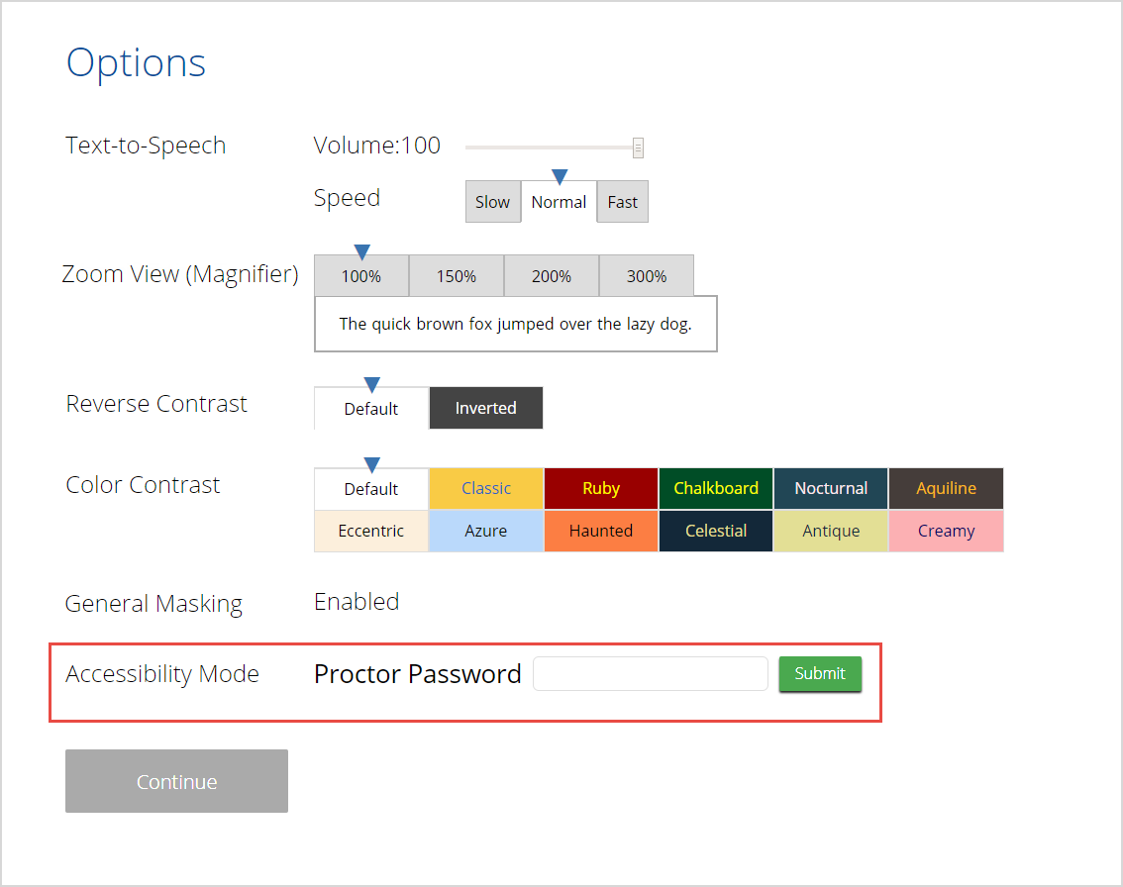
Accommodations Delivered by Test Platform
(Must be pre-identified before testing, student needs a legal plan to have accommodations assigned to them for testing.)
Name | Tool Icon
ELA Text-to-Speech English (SWD, 504, EL)
Allow Accessibility Mode Testing
Word Prediction (Embedded)
ASL Videos (Math and ELA)

Slide 21
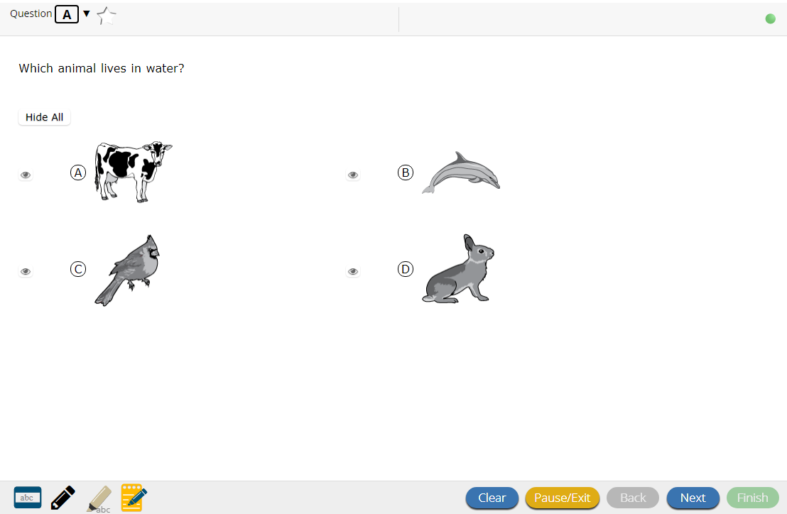
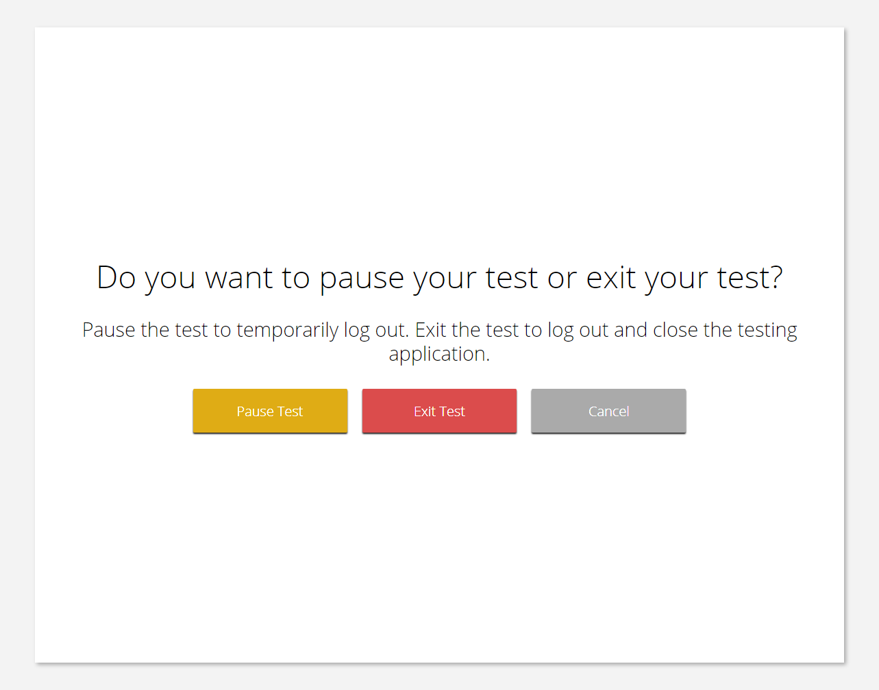
Test Navigation

Slide 22
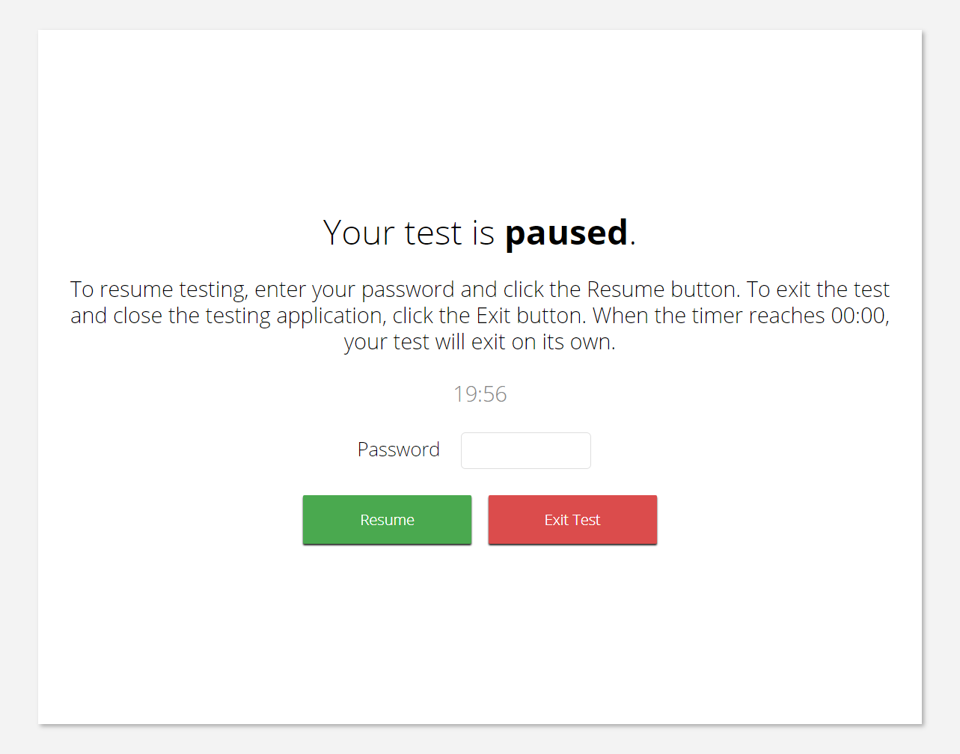
Test Navigation
Pause and inactivity timeout is 60 min

Slide 23
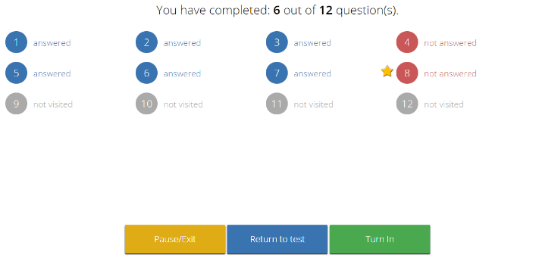
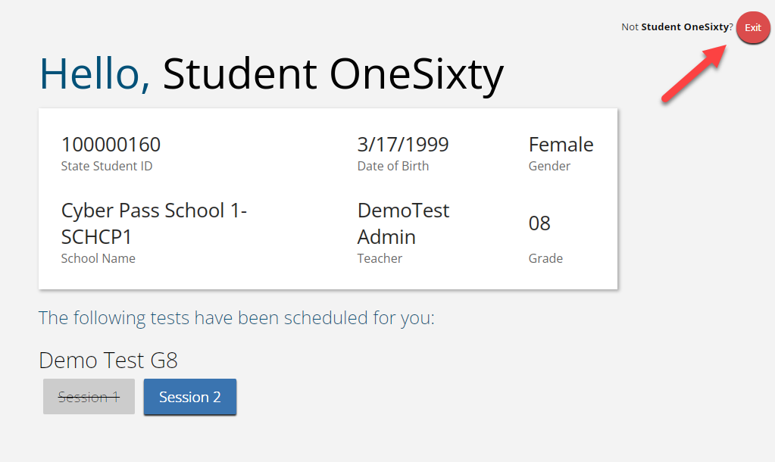
Test Turn-In
Steps | Button to Click
On the last item, students click Finish.
On the test review screen, students click Turn In.
Below the confirmation question, students click Turn In.
Student returns to test section selection page and may select the next section or click Exit to exit the kiosk.

Slide 24
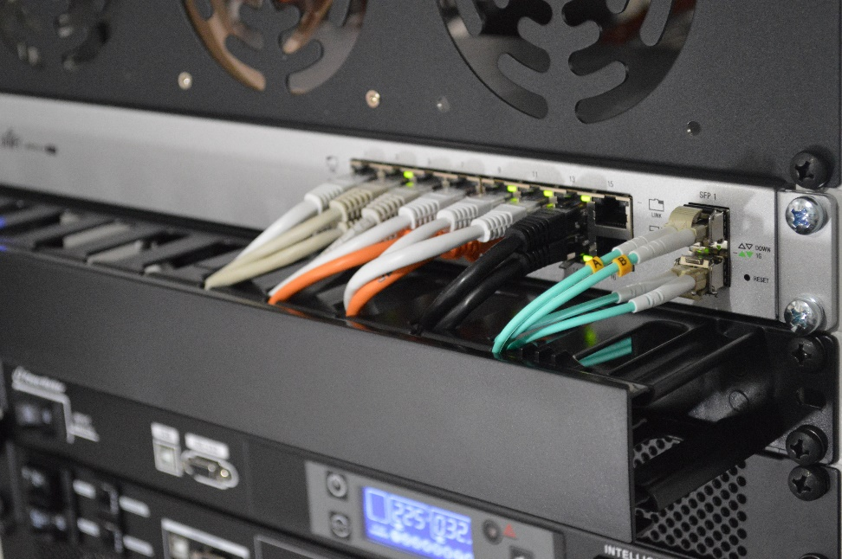
Site Technology Preparation

Slide 25
Kiosk Requirements
Windows and Mac Applications
Available to download in Portal
Newest Windows and Mac app version released at the beginning of the school year
PED will publish release date
iPad and Chromebook Applications
Download directly from App Stores
Download “iTester” iPad app and select state on 1st log-in
iPad and Chrome apps will auto-update to the newest iTester version
Browser (practice test, interim and formative only)
Available on Chrome, Safari, Firefox, and Microsoft Edge
If the last kiosk application you installed was prior to the release dates provided by PED for the current school year, you need to download and install the newest version and complete site readiness testing with that version.
We strongly recommend ITCs complete Site Readiness Testing prior to the MSSA testing!

Slide 26
System Requirements
System Requirements – All Hardware
Connectivity | Must be able to connect to the internet via wired or wireless networks
Screen Size | 9.7” screen size or larger/ “10-inch class” tablets or larger
Screen Resolution | 1024 X 768
Headphone/Earphone/Ear Buds | Headphones/earphones/ear buds are required for students who have a text-to-speech accommodation
Browser Requirements (Portal and Practice Tests)
Check the Cognia help site online testing for current supported browsers. | Chrome™ 88 or newer Firefox® 84 or newer Safari® 14 or newer Microsoft Edge™ 88 or newer

Slide 27
Desktop and Laptop Specific Requirements
CPU | 1.3 GHz
Memory | 2 GB (4GB strongly recommended)
Input Device | Keyboard – wired or wireless/Bluetooth® mouse or touchpad
Windows® | See the Cognia help site for current supported versions
Mac® | See the Cognia help site for current supported versions
Tablet and Chromebook Specific Requirements
iPad® | See the Cognia help site for current supported versions
Chromebook™ notebook computer | See the Cognia help site for current supported versions
Google releases new versions to the stable channel every four weeks and new versions to the Long-term Support (LTS) channel every six months. eMetric strongly recommends the use of the LTS channel. The LTS channel offers more stability with fewer releases but devices will continue to receive frequent security fixes.

Slide 28
Kiosk Requirements (network)
Beginning of Test:
Authenticate login
Download test content
End of Test:
1. Submit responses for scoring
What happens if a student loses network connection in the middle of a test?

Slide 29
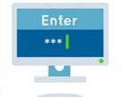
Kiosk Test Integrity
A
C
D
B
45-90sec
A
C
Stored response folder
D
B
A
C
D
B
Notes:
Pause, log out is OK,

Slide 30
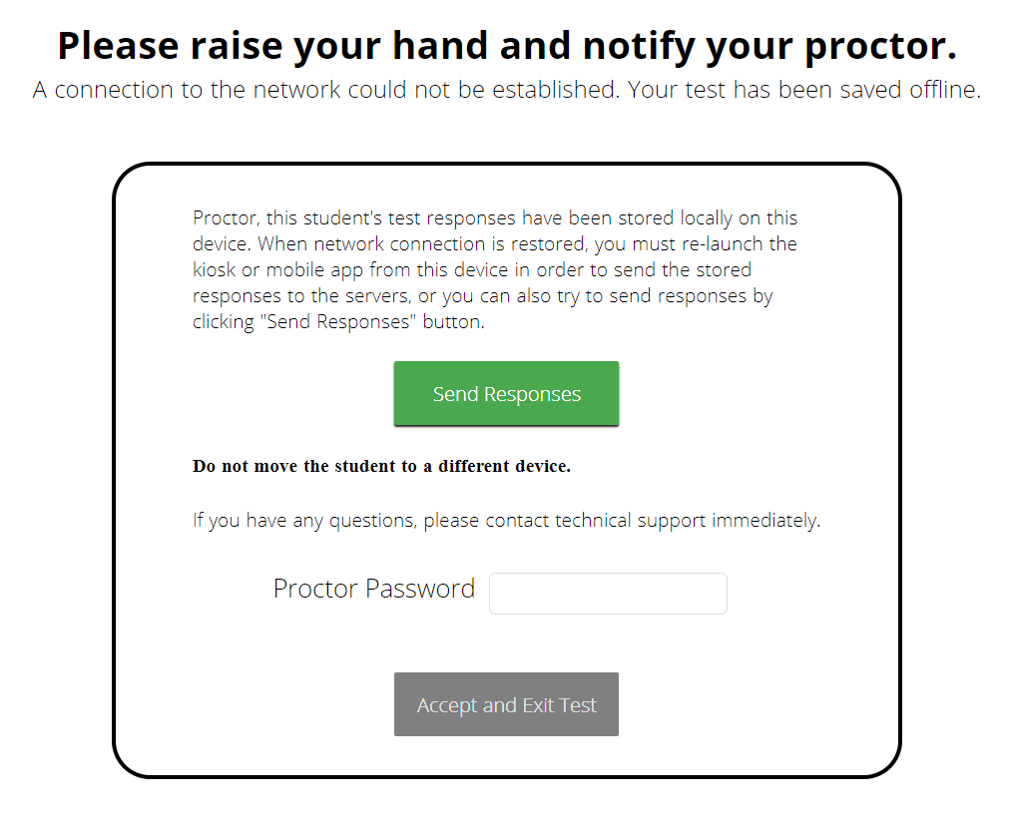
What if a student finishes a test but has no network connection?
A
C
C
A
B
D
D
B
C
A
B
C
D
A
B
C
D
A
B
D
Turn In
A
C
C
A
B
D
D
B
C
A
B
C
D
A
B
C
D
A
B
D
Notes:
Pause, log out is OK,

Slide 31
Kiosk Test Integrity
Loss of Network Connectivity Procedure Summary
If a student loses network connectivity in the middle of a test:
Keep testing on that device
Test content and responses are stored securely on the test device
Responses will be sent when network is restored
If student finishes and is ready to turn in test prior to network being restored:
Allow student to turn in test
Record the exact device the student is testing on
Ensure no network management tools or system maintenance will alter that devices files or configuration
When network connectivity is restored, return to that exact device and relaunch the kiosk
If you are unsure of the status of the student responses, call the help desk

Slide 32
Practice Test Options
1. Use internet-based practice test with web browser (recommended)
Best option for:
Practice testing with browser or on devices that do not have a testing kiosk installed
Note: all accommodations except allow accessibility mode and screen zoom are available
To access the practice test in web browser:
Launch Browser
go to https://nmpracticetest.cognia.org
Use the drop-down menu to select the practice test and click on “Go” button
2. Use internet-based practice test with student kiosk
Best option for:
Realistic practice testing in secure kiosk
Note: all accommodations are available except allow accessibility mode
To access the practice test in student testing kiosk:
Launch Kiosk
Click on the “Access the Practice Test” link
Use the drop-down menu to select the practice test and click on “Go” button

Slide 33
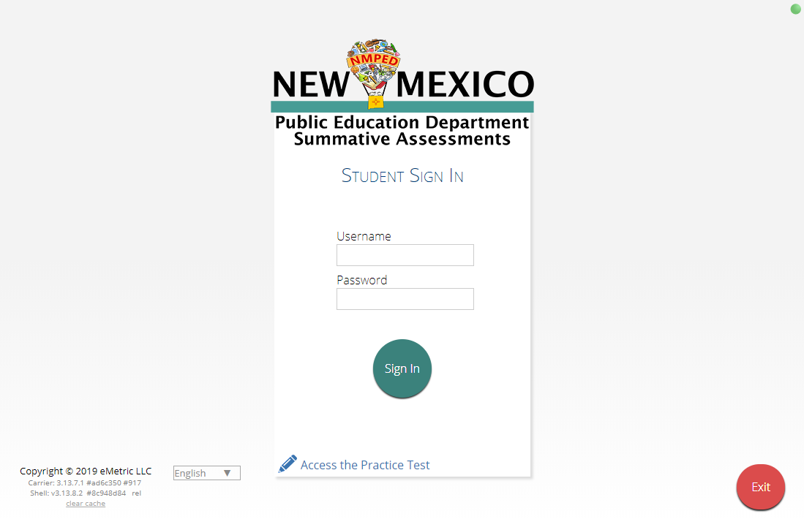
Practice Test

Slide 34
Remember!
DTCs/STCs:
Deactivate unused accounts
Once a student has been added in a Pre-ID upload or manually, they can be used in any assessment (MSSA, iMSSA, Cognia Formative)
TAs/Proctors:
Ensure Students have TTS form BEFORE they log into test (see TTS slide)
Spanish version of test must be scheduled separately – accommodation setting is for reporting only (see Spanish Test slide & Spanish Testing Guide)
Do not schedule students for the Spanish version if they do not need the Spanish version
Check for stored responses (see What happens if student finishes test and network connection has not been restored? Slide)
ITCs:
Ensure you have the current kiosk version and complete site readiness testing
Chrome LTS channel is strongly recommended!
Make sure network management tools don’t delete stored response folder

Slide 35
Thank you for viewing!

