Slide 1
New Mexico MSSA and iMSSA Online Reporting Training
2024-2025 Assessments

Slide 2
Agenda
Introducing Data Interaction
Dynamic Reports Available for NM MSSA Assessments
Dynamic Reports Available for NM iMSSA Assessments
Static ISR PDF Reports Available for MSSA Assessments
Static PDF Reports Available for SBA
Accessing Online Reporting
Getting Started
Demonstration
Key Dates for 2024-2025
Training Resources & Help Desk Info
Q&A

Slide 3
Introducing Data Interaction
Summary Views
Roster Views
Individual Student Reports
Data Tools
Summary Statistics Tables
Frequency Distributions
Cross-Tabular Reports
Scatter Plots
Notes:
The Data interaction platform essentially provides 3 different types of data views – summary views, roster views, and Individual student reports. Along with these views, the platform also provides a set of more advanced data analytics tools which allow users to create summary statistics tables, frequency distributions, cross-tabular reports, and scatter plots.

Slide 4
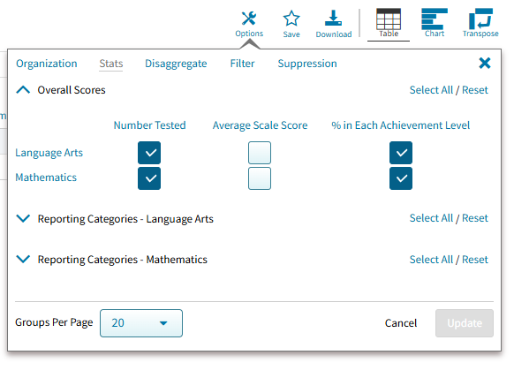
Reporting Components
Summary View
Displays group performance data in a table or graphical format
Customize the display by selecting different subject areas, statistics, administrations, and demographic variables; disaggregate by subgroup or directly access individual student results for a selected subgroup

Slide 5
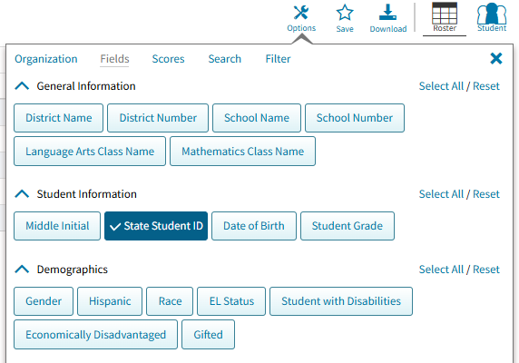
Reporting Components
Roster View (Student List)
Provides dynamic access to a list of students and their individual student results
Interactive data analysis features allow users to dig deeper into the data

Slide 6
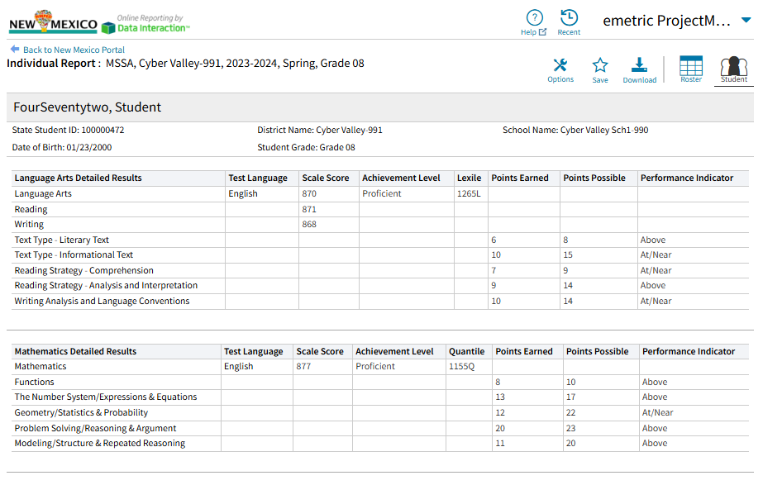
Reporting Components
Individual Student Reports
Provides a student’s results from a single administration for all subjects
Can be accessed by drilling down from a summary or roster view, or by using the Student Search function on the landing page

Slide 7
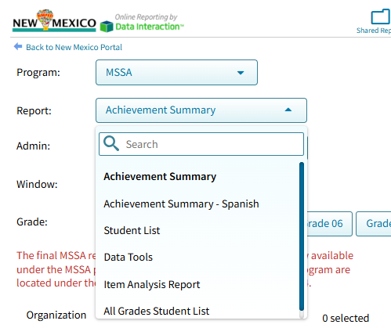
Dynamic Reports Available for MSSA
Achievement Summary
Achievement Summary – Spanish
Student List
Data Tool
Item Analysis Report
All Grades Student List

Slide 8
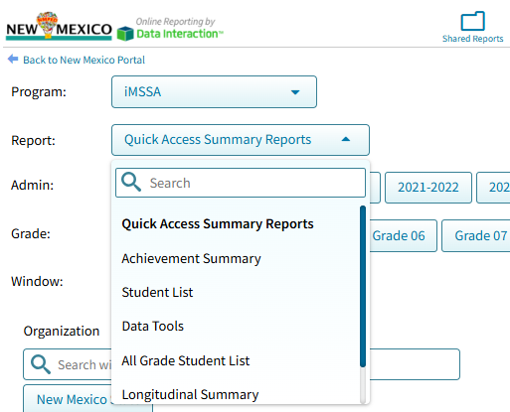
Dynamic Reports Available for iMSSA
Quick Access Summary Reports
Achievement Summary
Student List
Data Tools
All Grades Student List
Longitudinal Summary
Item Analysis Report

Slide 9
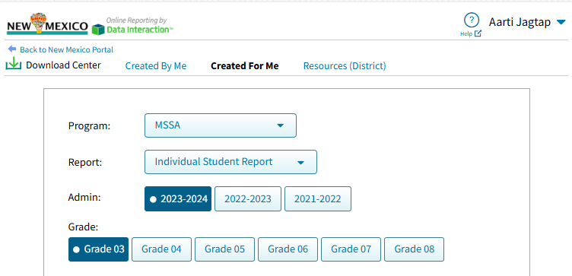
Static ISR PDF Reports Available for MSSA (DTC view)
Available under Download Center

Slide 10
Static PDF Reports Available for SBA
Available under Download Center
Based on your role, reports will be available to download
Static PDF Reports
Student Results Data File - District
Benchmark Data File
Student Report to Teachers – Reading
Student Report to Parents – School Copy
Student Roster Report
Student Roster Data File
Student Results Data File – School
DTCs
STCs

Slide 11
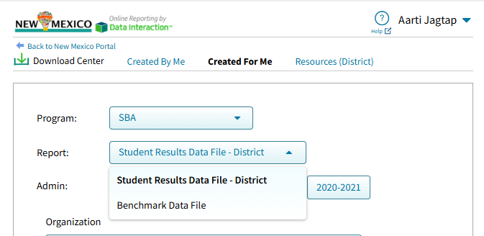
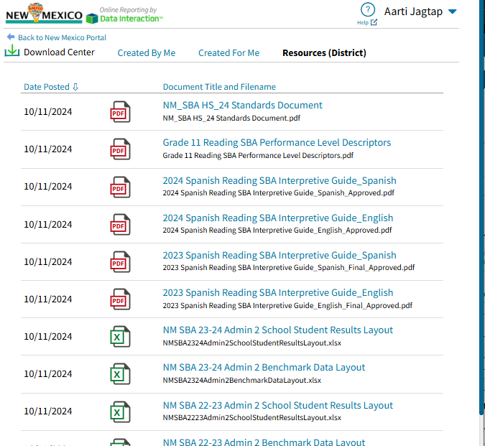
Static PDF Reports Available for SBA (DTC view)

Slide 12
User Roles & Dynamic Reports
User Role | MSSA | iMSSA
District Test Coordinator (DTC) | Yes, for all schools in district | Yes, for all schools in district
School Test Coordinator (STC) | Yes, for schools assigned to account | Yes, for schools assigned to account
Test Administrator (TA) | Yes, but for students assigned using Roster Upload by DTC and STC | Yes, but for students in classes assigned to TA
Reports Access Only (RAO) | Yes, for schools assigned to account | Yes, for schools assigned to account
Note: Users with IT Coordinator accounts cannot view reports.

Slide 13
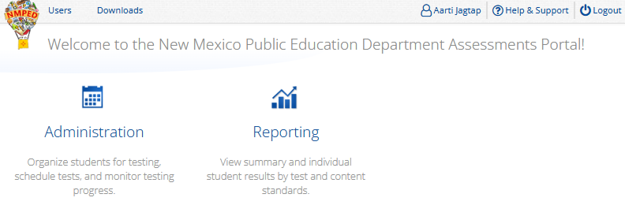
Accessing Online Reporting
Authorized users can log in at https://newmexico.cognia.org/ with their portal username and password

Slide 14
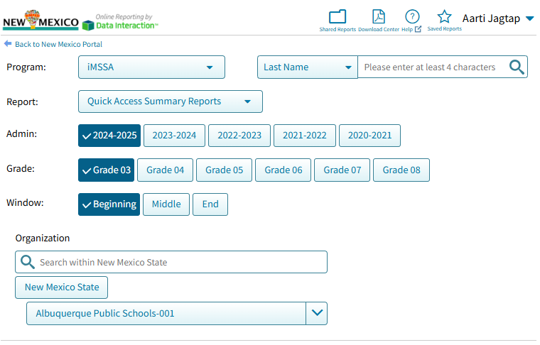
Getting Started (DTC view)
What data do you want to explore?
Select the desired….
assessment program.
report type.
administration year(s).
grade and window.
Only your district will be displayed under Organization
organization(s).

Slide 15
Getting Started (DTC view)
Other Tools:
Share a report
Download Center to access Static ISRs or large file downloads
Help guide
View a recent report
Save report or view a saved report
Search for student by name or SSID
Control panel

Slide 16
Demonstration

Slide 17
Demo Outline
Use production environment with a demo DTC user account
iMSSA
Show Achievement Summary report
Use Admin: 2021-2022; Grade 8; and Cyber Valley-991 district
Show Options tab; Chart view
Drill to Student List > Roster Report
Show Options tab
Show Save, Download, and basic functionality
Click on student name to show Individual Student Report (ISR)
MSSA
Show Achievement Summary report
Uses Admin: 2023-2024; Spring; Grade 8; and Cyber Valley-991 district
Show Options tab; Chart view
Drill to Student List > Roster Report
Show Options tab
Click on Achievement Level > Cross-Tab > Scores > Mathematics > Mathematics Achievement Level
Go back, click on student name to show ISR
Download Center
Created By Me (any large file downloads)
Created For Me: MSSA and SBA data
Resources (District)
Other Tools
Shared Reports
Help
Recent
Saved Reports
Student Search

Slide 18
Key Reporting Dates for 2024-2025
Date | Task
May 23, 2025 | NM-MSSA Preliminary reports available in Data Interaction
May 27, 2025 | NM EOY iMSSA Final reports available in Data Interaction and Family Portal
June 20, 2025 | NM-MSSA Final reports available in Data Interaction
July 11, 2025 | NM-MSSA PDFs of Individual Student Reports (ISRs) available in Data Interaction under Download Center NM-MSSA Final data release in Family Portal
July 25, 2025 | SBA PDFs available in Data Interaction under Download Center

Slide 19
Training Resources & Help Desk Info
New Mexico Help & Support site
Tutorials for Accessing Online Reporting Information
Cognia Help Desk
(877) 676-6722
nmtechsupport@cognia.org
Mon-Fri: 7 AM – 3 PM MT
https://newmexico.onlinehelp.cognia.org/cbt-tutorials/

Slide 20
Questions?

Slide 21
Thank You!

